Slide 1
Professional Registration & the IST’s CPD Award
Ben Palmer MIScT RSci

Slide 2
My position
A need for recognition
The benefits of Professional Registration
Application process
The IST’s CPD Award
Further information

Slide 3
My Position
BSc (Hons) Ecology 2002
Pennine Foods
Laboratory Technician 2002 – 04
University of Sheffield
Dept. of Animal & Plant Sciences
Research Technician 2004 – 10
Dept. of Materials Science & Engineering
Stores Technician 2010 – 12
Research Technician 2012 –

Slide 4
A need for recognition
No current benchmark for demonstrating ability
Lack of developmental activity
Uncertainty of future job market
A need to develop a transferable skill set

Slide 5
Benefits of Professional Registration
Organisation
Demonstrate the excellence of HE Technical Staff both nationally and internationally
Promote professional development and therefore improve quality of service

Slide 6
Benefits of Professional Registration
Individual
Recognition of your experience and skills
Benchmark allows easier movement within and between organisations
Emphasis on continuing development
Future-proof your career!

Slide 7
Professional Registration
3 levels of Registration depending upon experience

Slide 8
Application Process
Membership of a licensed body (such as the IST)
Application form
CV
A PPD Report
A Competencies Report
Cost
£25 for Registration
£42 membership of IST

Slide 9
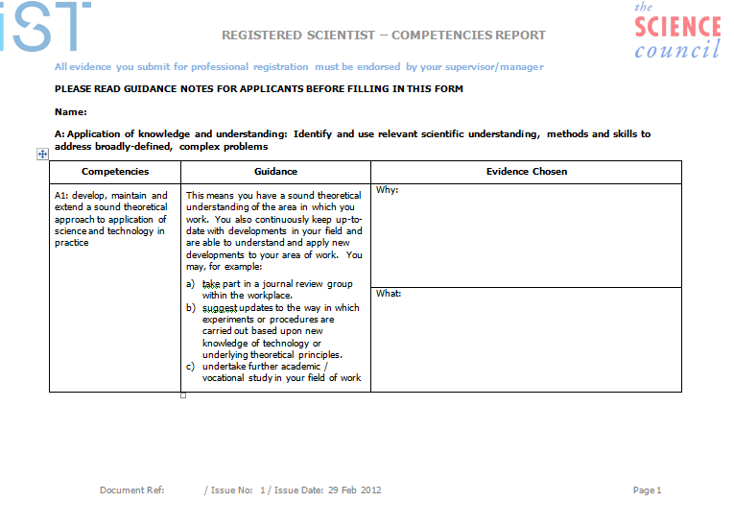
Competencies Report
Evidence of work against key competencies

Slide 10
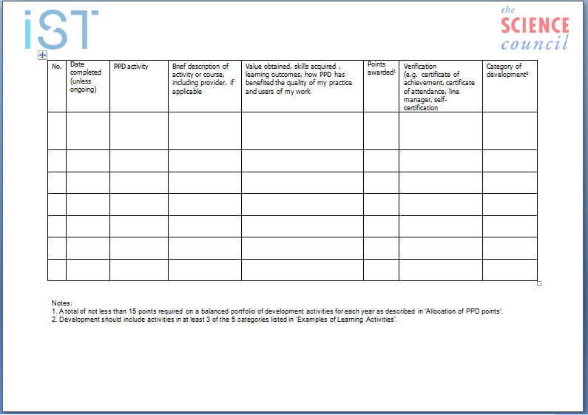
PPD Report
Details of recent developmental activity

Slide 11
IST’s CPD Award
Can be used as evidence of PPD towards Registration
Two-year programme:
Induction
Personal Development Plan
CPD Learning Logs
Learning Resources (VLE)
Work-based project
Assessment/Certification

Slide 12
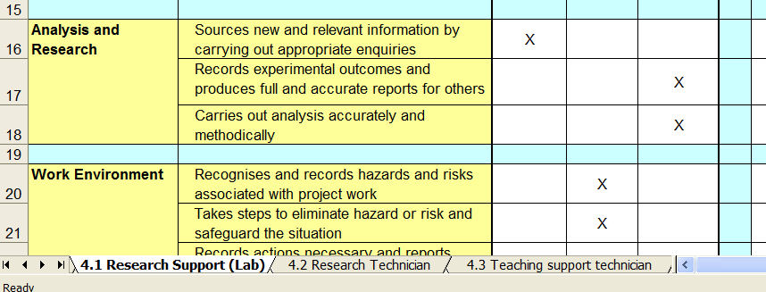
IST’s CPD Award - PDP
Role specific development plans (tailored)
Agreed with mentor/assessor
Each role is mapped by key competencies
in the Programme Development Plan

Slide 13
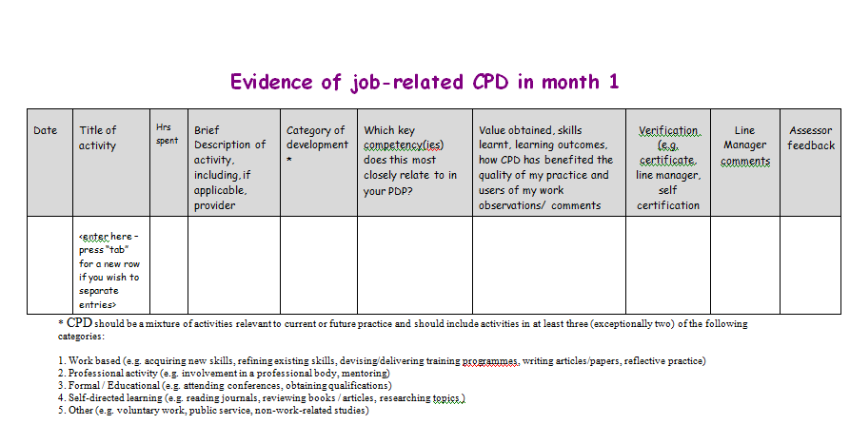
IST’s CPD Award – Learning Logs
Demonstrate evidence against Key Competencies on a monthly basis

Slide 14
IST’s CPD Award - Structure
Registration
Induction
Programme Development
Plan
Development activities
to meet Plan
Learning Log
Periodic review
VLE resources
Networking
Courses, conferences etc
Online Forums
Dissertation/Project
Assessment
Certification

Slide 15
IST’s CPD Award - Assessment
Assessment
44 hours per year CPD (88 total)
Work based Project or Dissertation
Completed Induction module
What learners get
2 years IST membership
Agreed development plan
Periodic reviews
Use of IST PPD VLE
Assessment / Certification
Cost
£498 – IST/Heated
£600 – non-members

Slide 16
Further Information
http://www.professionalregisters.org/whatisit
http://istonline.org.uk/professional-registration/
http://istonline.org.uk/cpd/

