Slide 1
Reporting – using the Planning Tool and monitoring progress against KPIs using Achiever
Wayne Jarvis, Regional Lead

Slide 2
The Session
The aim of the session is to:
Brief SLPs with regard to the SLP Planning Tool and how this can be used to track SLP KPIs
Be able to monitor KPI targets using Achiever’s reporting system

Slide 3
Reporting
Monitoring using Achiever reports:
The KPIs that you will need to monitor is:
CPD Days / Units
Reach
Engagement

Slide 4
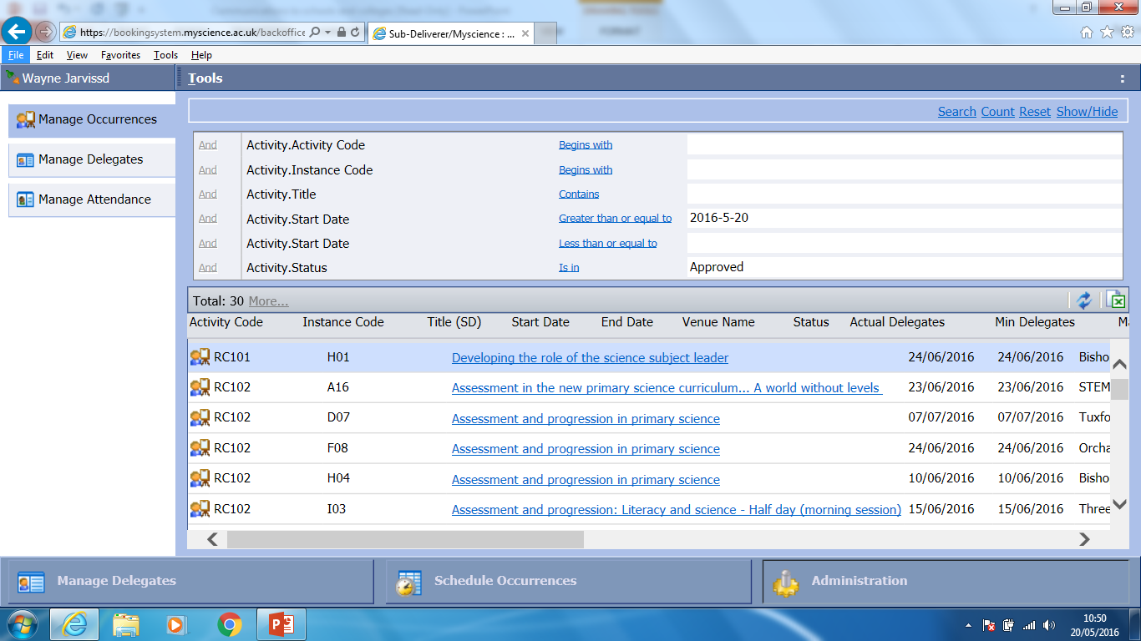
CPD Units / Days KPI
Log into Achiever and select the Administration tab

Slide 5
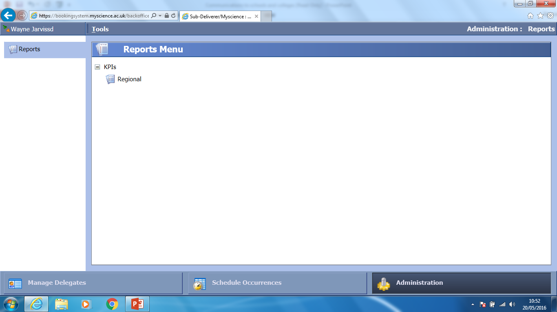
CPD Units KPI
Click the Regional Link

Slide 6
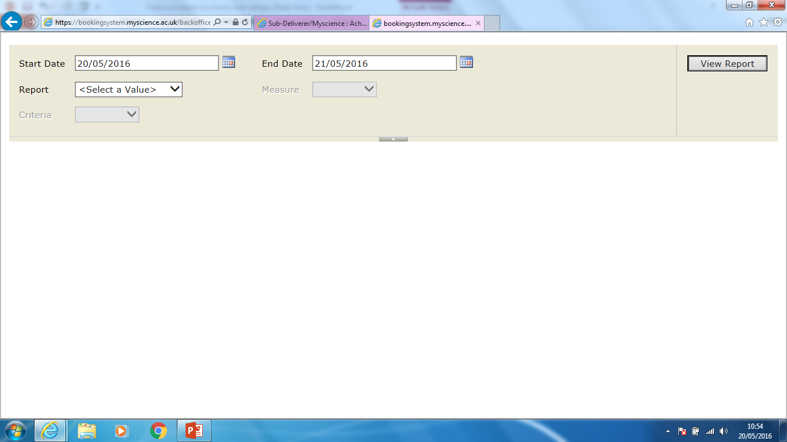
CPD Units KPI

Slide 7
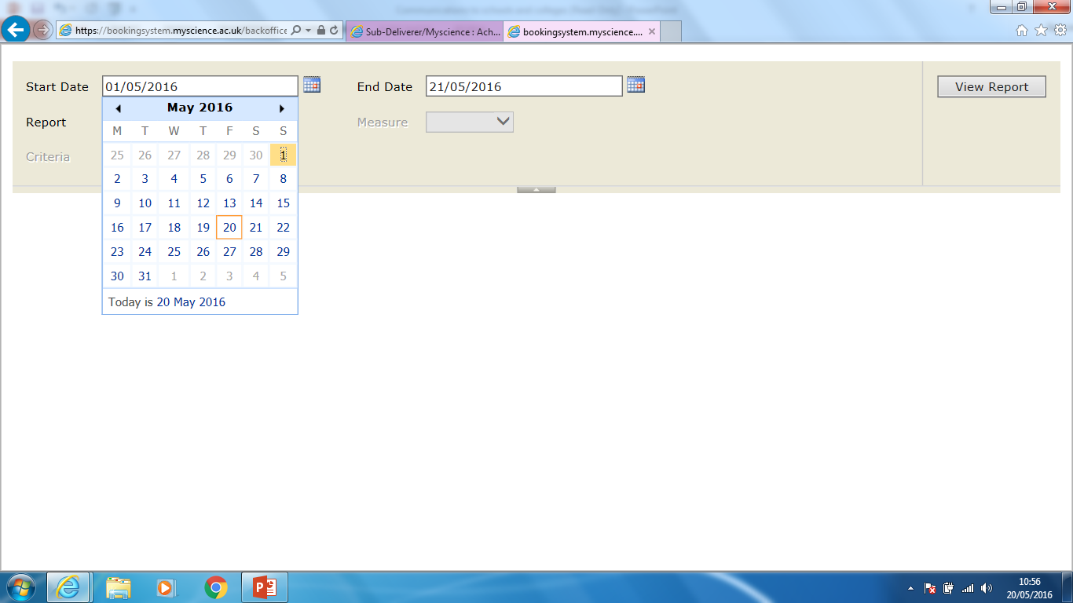
CPD Units KPI
Set the reporting start and end date.
For the monthly data – set the Start Date as 01/05/2016 and the End Date as 31/05/2016

Slide 8
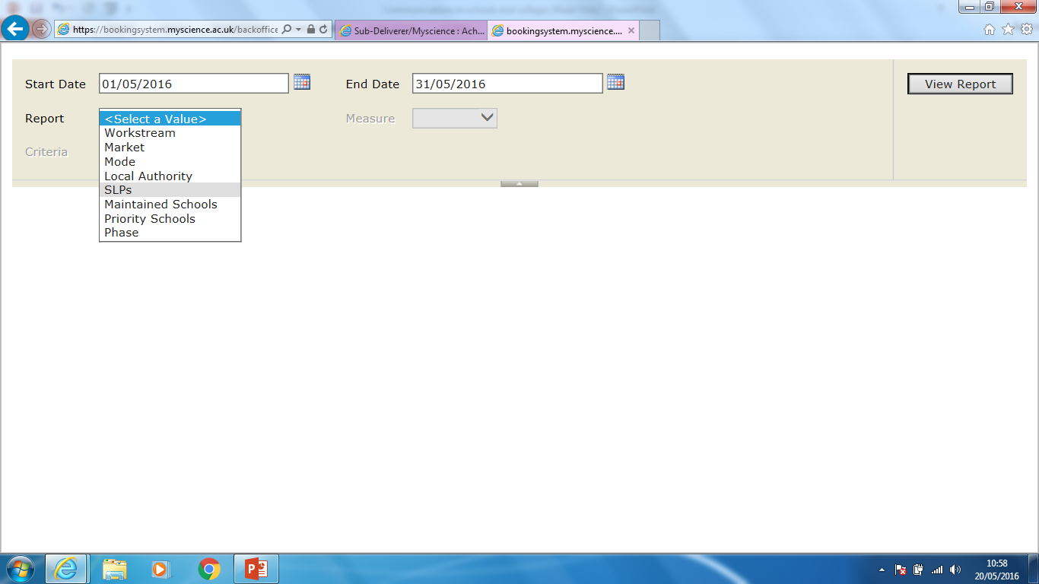
CPD Units KPI
Select SLP from the Report Menu

Slide 9
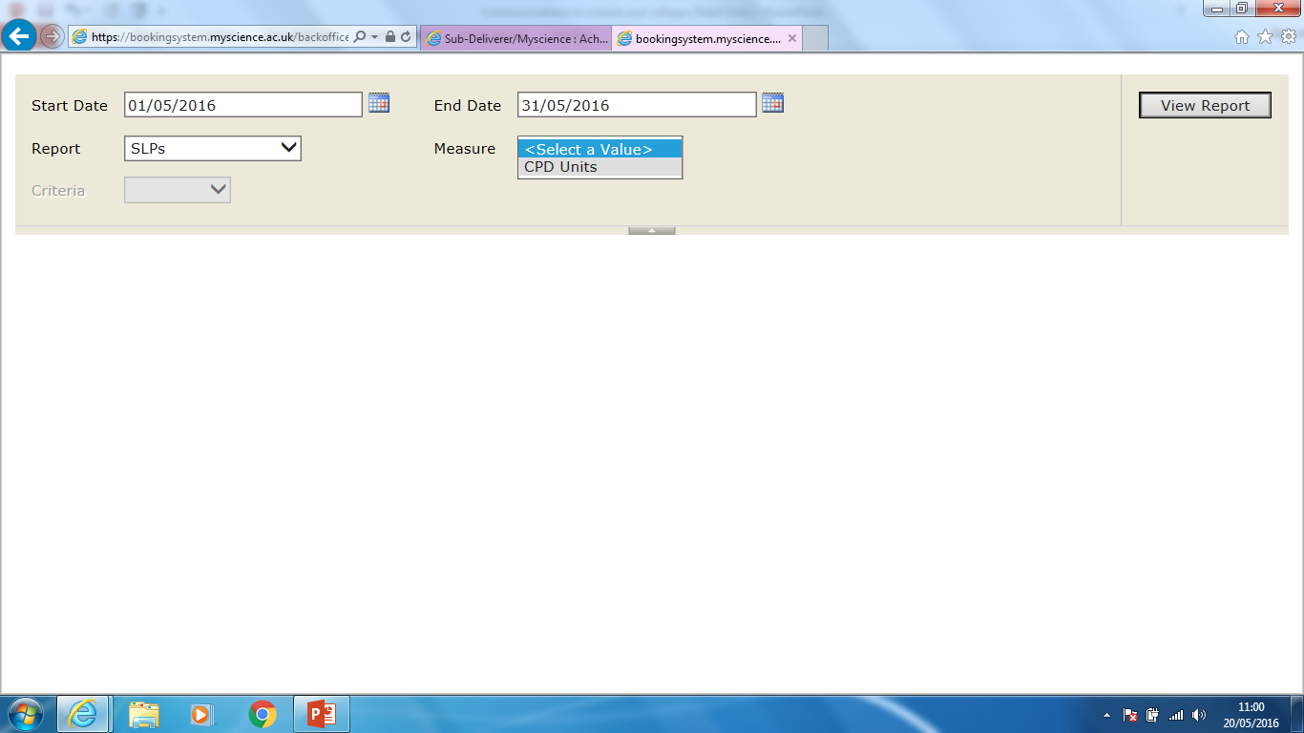
CPD Units KPI
Select CPD units from the Measure drop down box

Slide 10
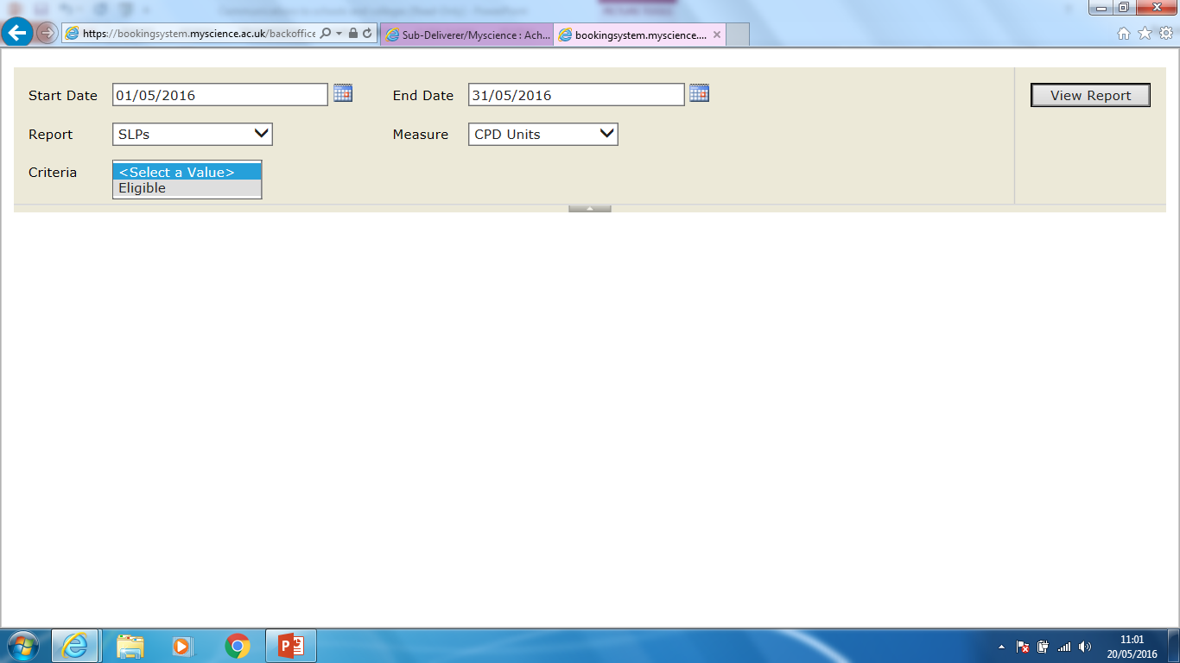
CPD Units KPI
Select Eligible from the Criteria drop down box

Slide 11
CPD Units KPI
Select Eligible from the Criteria drop down box
Then click View Report

Slide 12
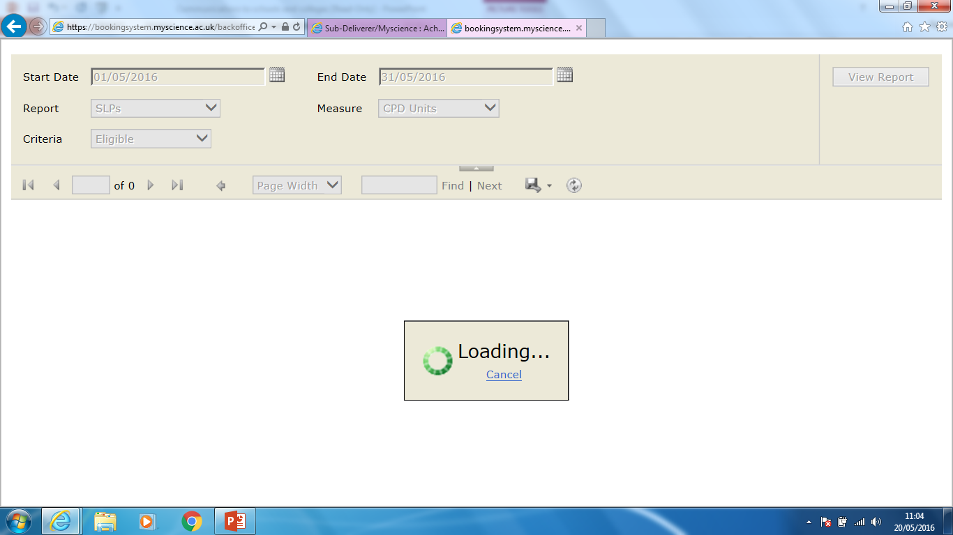
CPD Units KPI
A report will then be generated

Slide 13
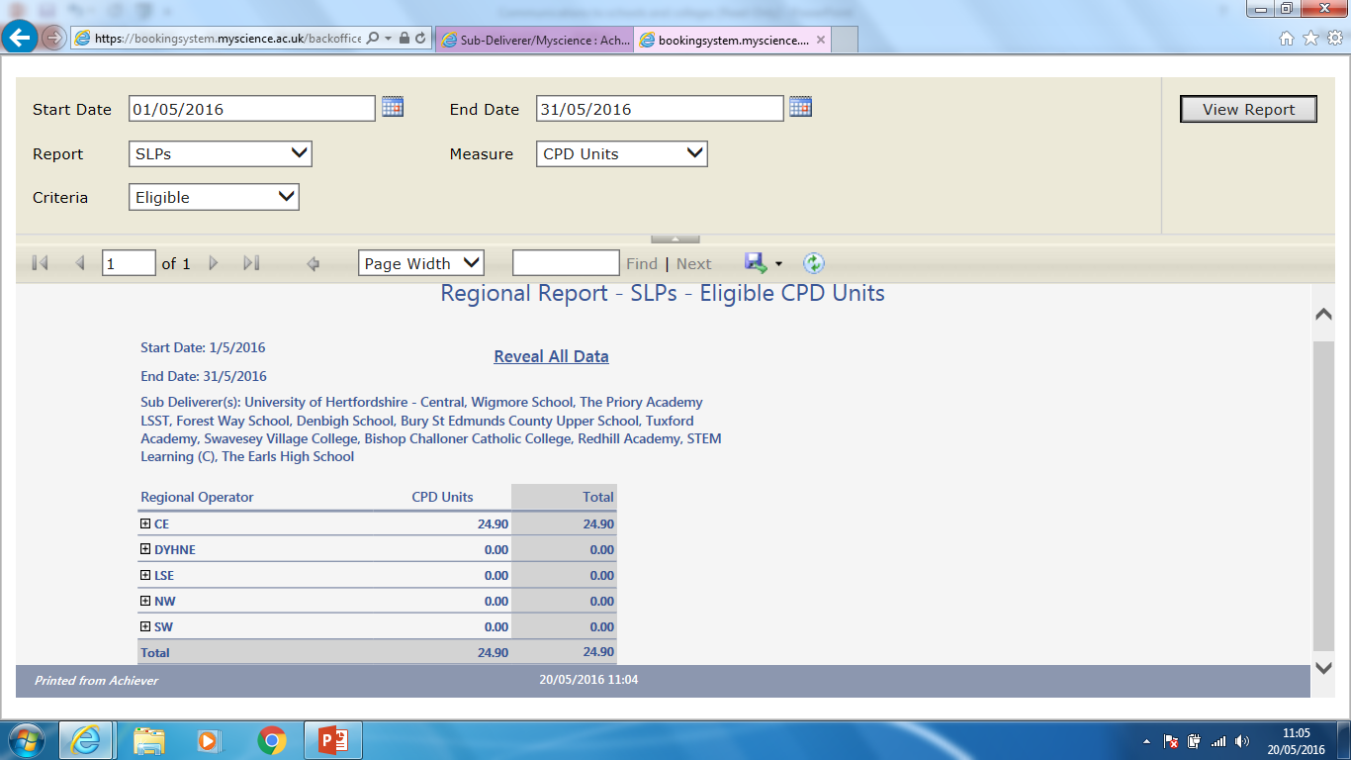
CPD Units KPI
A report will be generated and your SLP regional data will be shown
Click the + next to the region you are in

Slide 14
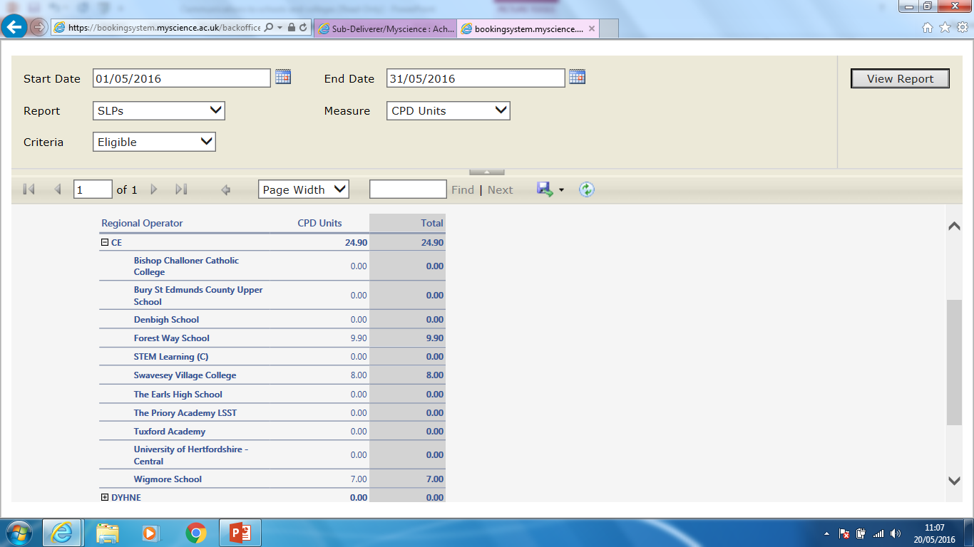
CPD Units KPI
Your SLP data will be shown.
This is the number that should be put into the monthly report.
Repeat this process to get your “Year to date” data by changing the date parameters in the report.

Slide 15
CPD Units KPI
By clicking on the number in the report next to your SLP you will be able to drill down into your data that has been recorded.
This is useful to cross check your throughput

Slide 16
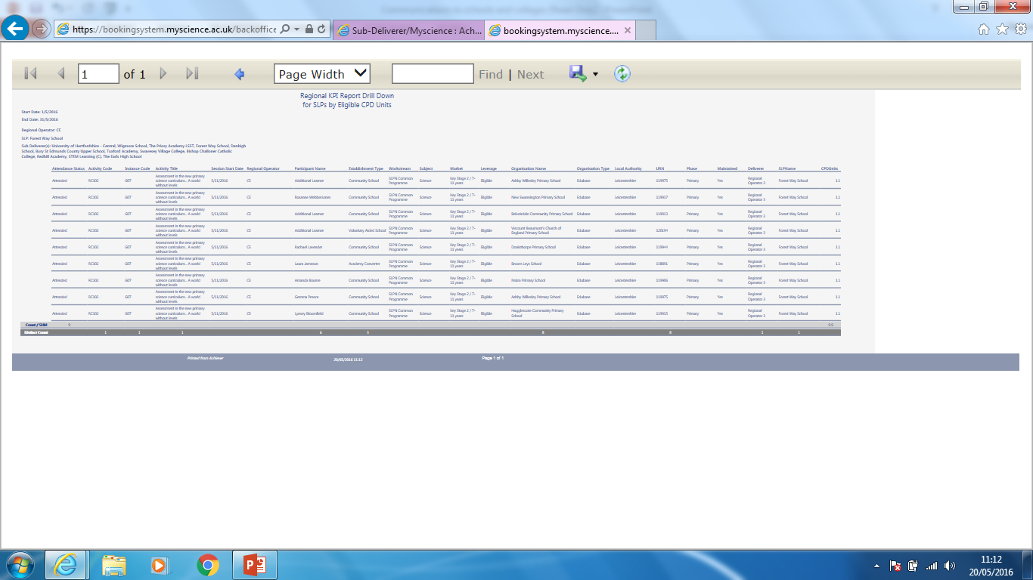
CPD Units KPI
A report of your data will then load (in very small print!)
This can be exported by clicking the disc icon to the format that you want

Slide 17
Reach KPI
Monitoring SLP reach:

Slide 18
Reach KPI
Back to the Administration tab in Achiever…
Select your date parameters as before but this time

Slide 19
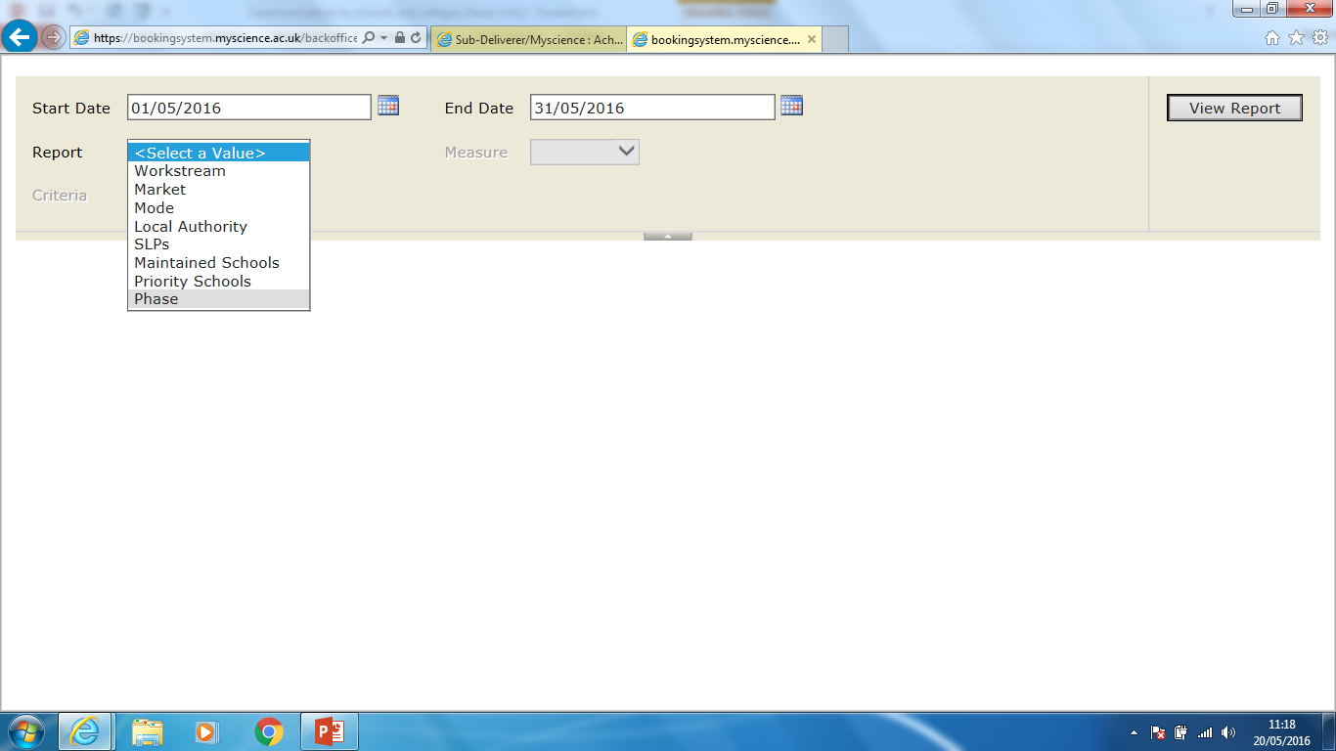
CPD Units KPI
Select Phase from the Report menu

Slide 20
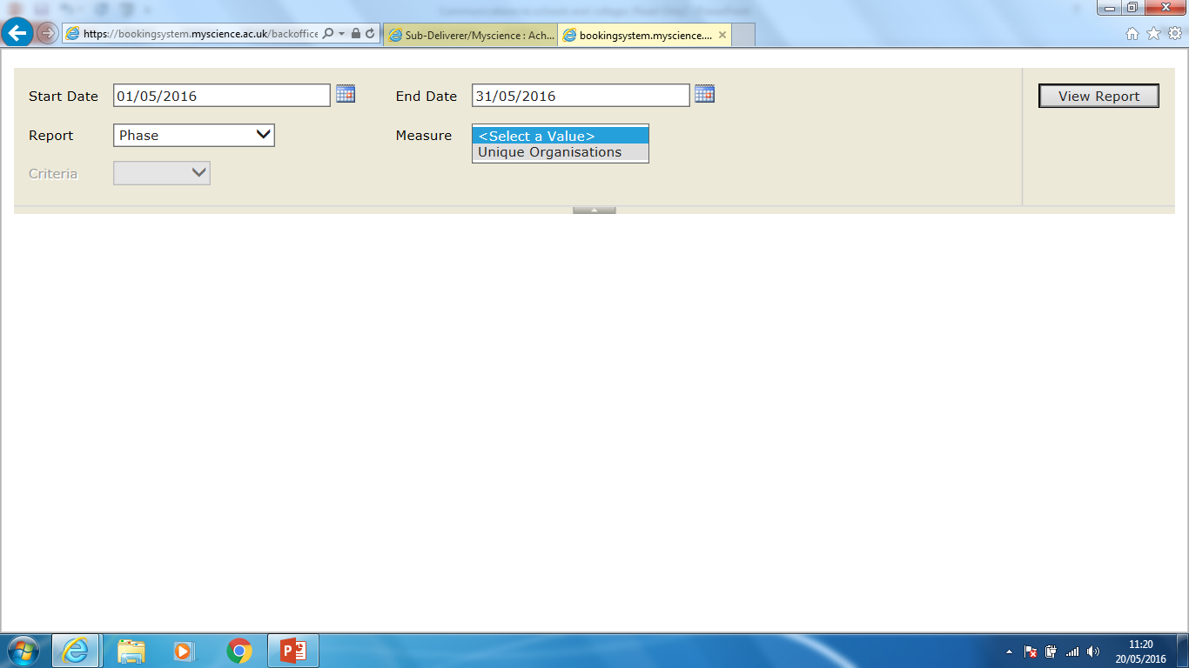
Select Unique Organisations from the Measure menu

Slide 21
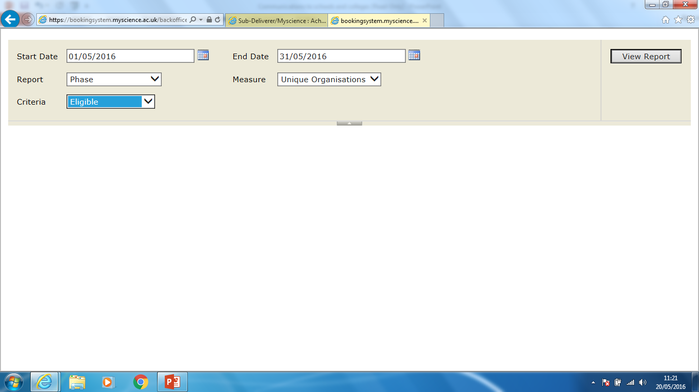
Select Eligible from the Criteria menu
Then click View Report

Slide 22
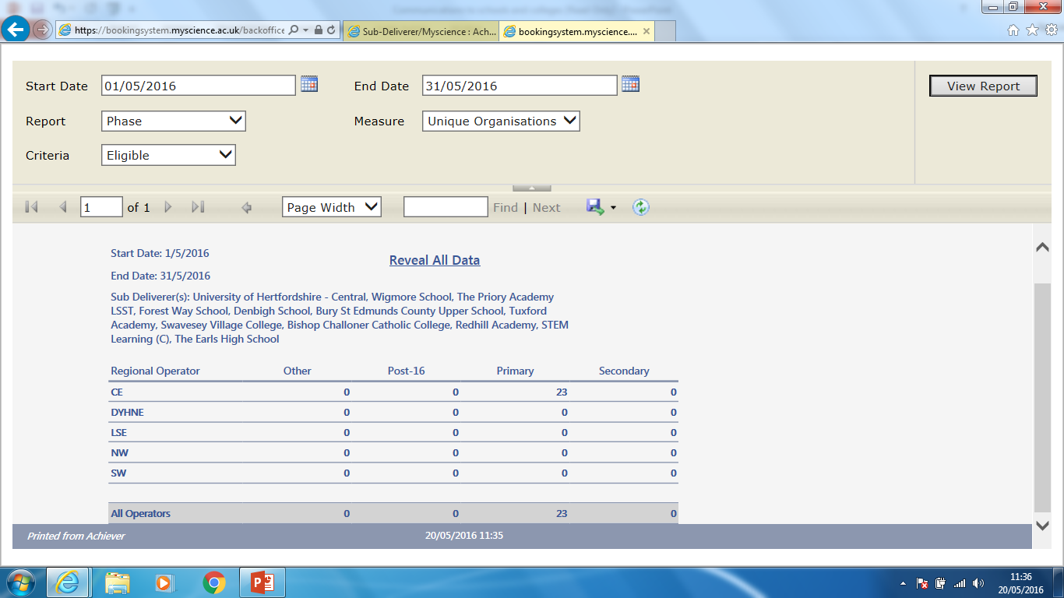
The number of schools engaged for the reporting period is displayed in your regional totals.
Change the date parameters for the Year to date figure

Slide 23
Clicking on the number will again drill down into the phase data which can then be exported as before
In this case primary participants will be downloaded

Slide 24
Engagement KPI
Monitoring Engagement:

Slide 25
Engagement KPI
Back to the Administration tab in Achiever…
Select your date parameters as before but this time

Slide 26
Engagement KPI
Select Market from the Report menu

Slide 27
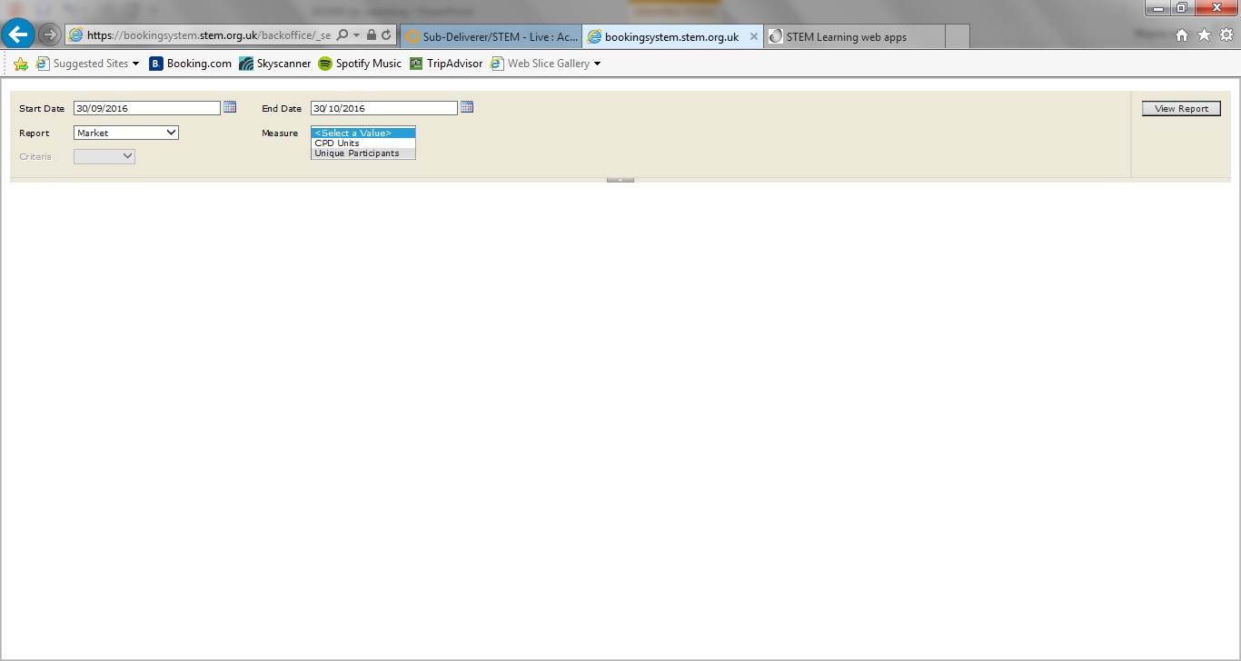
Select Unique Participants from the Measure menu

Slide 28
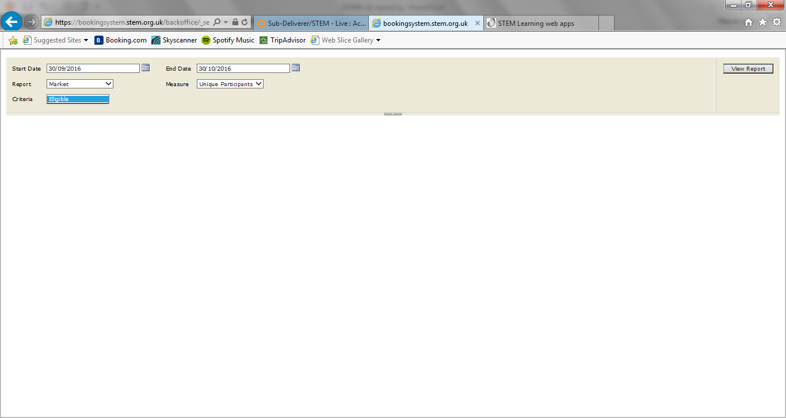
Select Eligible from the Criteria menu

Slide 29
Click View report

Slide 30
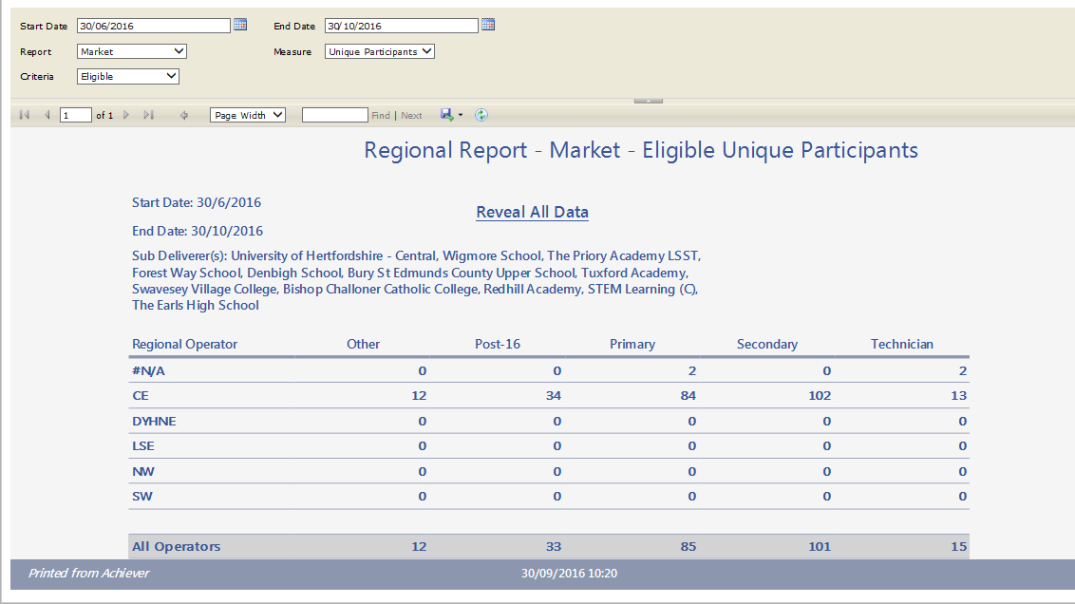

Slide 31
