Slide 1
SLP Training Day 3
30th September 2016
National STEM Learning Centre and Network

Slide 2
Learning intentions
Explain how the impact evaluation process can benefit its’ users and the SLP
Recognise the principles of using the SLP planning tool to track your KPIs
Devise improved communications
Clarify any queries with the systems
Discuss and share practice

Slide 3
Our Unique Selling Point
The Why, What, Where and What next? Of the impact process
National STEM Learning Centre and Network

Slide 4
Learning intentions
Describe the impact process and your role within it
Recognise the potential of the impact process to
    Improve learning for participants (and thus students)
    Provide the SLP with useful marketing data

Slide 5
Bringing about change
Describe some professional development you have attended where:
    You enjoyed the CPD, but nothing changed as a result
    You went back to work and shared an idea from the CPD
    You put into practice something you had learned
  On post-its identify what happened in the CPD, or after that helped bring about change?

Slide 6
Why?

Slide 7
What makes CPD effective?
Key principles
maintains a focus on benefit for pupils and learning
matches teachers’ training needs
targets school/departmental development priorities
is collaborative (i.e. teachers are active learners)
is continuous
  (i.e. implemented over a long time scale, and include opportunities for trialling new things and reflection on actions)
includes evaluation and use of research evidence

Slide 8
What makes evaluation effective?
Evaluation needs to
measure achievement of intended outcomes and any additional impacts
be embedded in the learning process and post-CPD actions
be easy to implement
be useful for both participants and providers

Slide 9
STEM Learning’s approach to evaluation
    Evaluation is embedded in professional learning and post CPD actions of teachers to support both effective CPD and effective evaluation
      Evaluation starts with participants’ application to attend CPD
      Course leaders make good use of evaluation data before, during and after the actual CPD session
      Planning of post-CPD actions, impacts and evidence collection is integral to the CPD session
      Participants are not only supported with the content of the CPD they are also helped to plan for and measure a range of impacts resulting from their professional learning and can more easily evaluate the effectiveness of the CPD

Slide 10
What?
Impact
    did it bring about a change?
Evaluation
    what is the judgement about how good the CPD was to facilitate that change?

Slide 11
Please complete the next step of your CPD
6 weeks before the course, participants are invited to engage with the impact evaluation process
At other times they are reminded about the next step, all by email

Slide 12
Impact evaluation process
Before
During CPD event
Post event impact
Intended learning Outcomes
– thinking about intended outcomes of the professional development for you, the pupils/students, and wider impact in school/college.
Learning and evaluation
- record any key learning/ ideas/actions throughout the session
Your action plan. Planning how the professional development will have impact in your school/college. This may be completed in the next week with a colleague/line manager.
Evaluation form
– completed at the end of the professional development event; helping us to measure impact and make improvements.
Impact evaluation
– what is the impact to date?
This should be completed in 8-14 weeks’ time, using your action plan to help you. A longer term impact report is also requested.

Slide 13
Thinking about the whole process
Which parts do your participants complete?
How do you support them?
What do you do with the information?
What would you like to be able to do with the information?

Slide 14
Extract from intended learning outcomes: completed by participants before the course
“Gain confidence in using ITK”
“To understand the ITK and Achiever systems better, and to maximise opportunities for marketing courses”

Slide 15
Impact evaluation process
https://impacttoolkit.stem.org.uk/
Before
During CPD event
Post event impact
Intended learning Outcomes
– thinking about intended outcomes of the professional development for you, the pupils/students, and wider impact in school/college.

Slide 16
Impact evaluation process
Before
During CPD event
Post event impact
Intended learning Outcomes
– thinking about intended outcomes of the professional development for you, the pupils/students, and wider impact in school/college.
Learning and evaluation
- record any key learning/ ideas/actions throughout the session

Slide 17
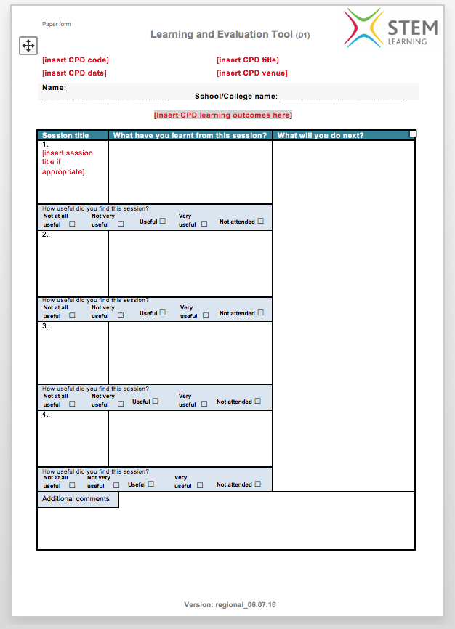
During the CPD
Use the Learning and Evaluation sheet (D1) to record learning, ideas/actions throughout the sessions

Slide 18
Impact evaluation process
Before
During CPD event
Post event impact
Intended learning Outcomes
– thinking about intended outcomes of the professional development for you, the pupils/students, and wider impact in school/college.
Learning and evaluation
- record any key learning/ ideas/actions throughout the session
Your action plan. Planning how the professional development will have impact in your school/college. This may be completed in the next week with a colleague/line manager.

Slide 19
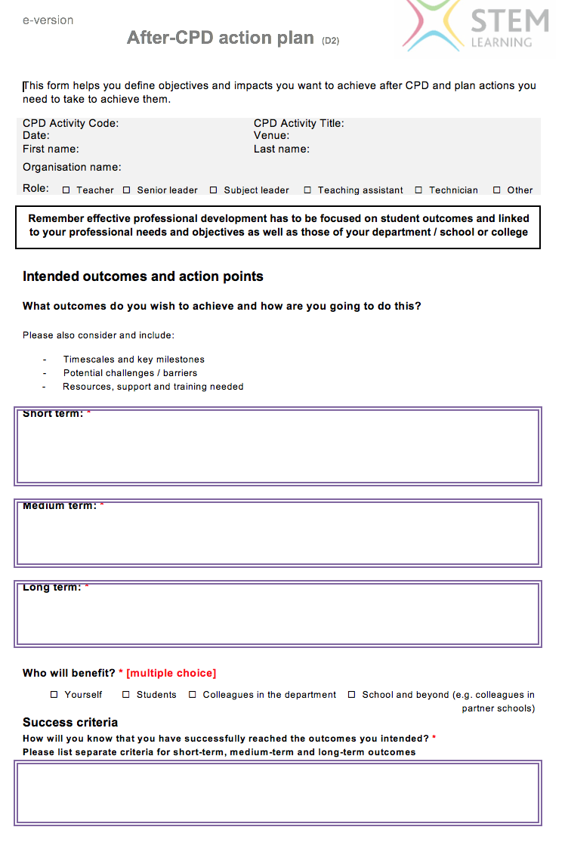
Action plan (D2)
Reverse has lists of suggestions of potential impact

Slide 20
Examples of evidence of Impact
Student progress/ attainment data
Student feedback (e.g. Student Voice, interviews)
Samples of student work
Uptake of STEM subject(s) pre and post-16
Feedback from external observation of lessons (e.g. by a colleague, subject leader, Ofsted)
Feedback from colleagues
Changes to schemes of work/ lesson plans/ assessment methods/ resources
Videos/ posters/ photos
School/ department developmental plans/ documents
Your perceptions/ reflections/ reflective journal

Slide 21
Impact evaluation process
Before
During CPD event
Post event impact
Intended learning Outcomes
– thinking about intended outcomes of the professional development for you, the pupils/students, and wider impact in school/college.
Learning and evaluation
- record any key learning/ ideas/actions throughout the session
Your action plan. Planning how the professional development will have impact in your school/college. This may be completed in the next week with a colleague/line manager.
Impact evaluation
– what is the impact to date?
This should be completed in 8-14 weeks’ time, using your action plan to help you. . A longer term impact report is also requested.

Slide 22
Impact evaluation process
Before
During CPD event
Post event impact
Intended learning Outcomes
– thinking about intended outcomes of the professional development for you, the pupils/students, and wider impact in school/college.
Learning and evaluation
- record any key learning/ ideas/actions throughout the session
Your action plan. Planning how the professional development will have impact in your school/college. This may be completed in the next week with a colleague/line manager.
Evaluation form
– completed at the end of the professional development event; helping us to measure impact and make improvements.
Impact evaluation
– what is the impact to date?
This should be completed in 8-14 weeks’ time, using your action plan to help you. . A longer term impact report is also requested.

Slide 23
Can you provide on-line access?
At your home SLP?
At your partner venues?
What actions are needed to make this happen? Share solutions

Slide 24
What next?
Updated on-line tools
Short CPD pathway
Aggregating data from evaluation forms
“Single Sign On”
Extracting useful data for the SLP (& tutors)

Slide 25
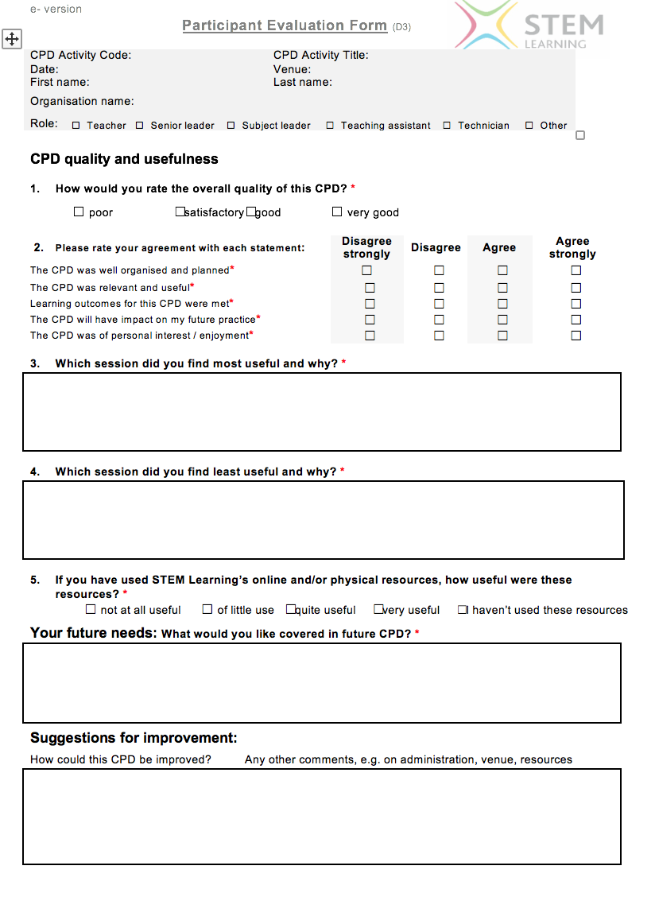
Evaluation form (D3)
Now one side of A4

Slide 26
Reduced process for CPD that lasts up to 3 hours
Before
During CPD event
Post event impact
Intended learning Outcomes
– thinking about intended outcomes of the professional development for you, the pupils/students, and wider impact in school/college.
Learning and evaluation
- record any key learning/ ideas/actions throughout the session
Combined action plan and evaluation form.
Completed on line.
(If on paper a copy should be taken for the participant to keep)
Impact evaluation
– what is the impact to date?
This should be completed in 8-14 weeks’ time, using your action plan to help you. . A longer term impact report is also requested

Slide 27
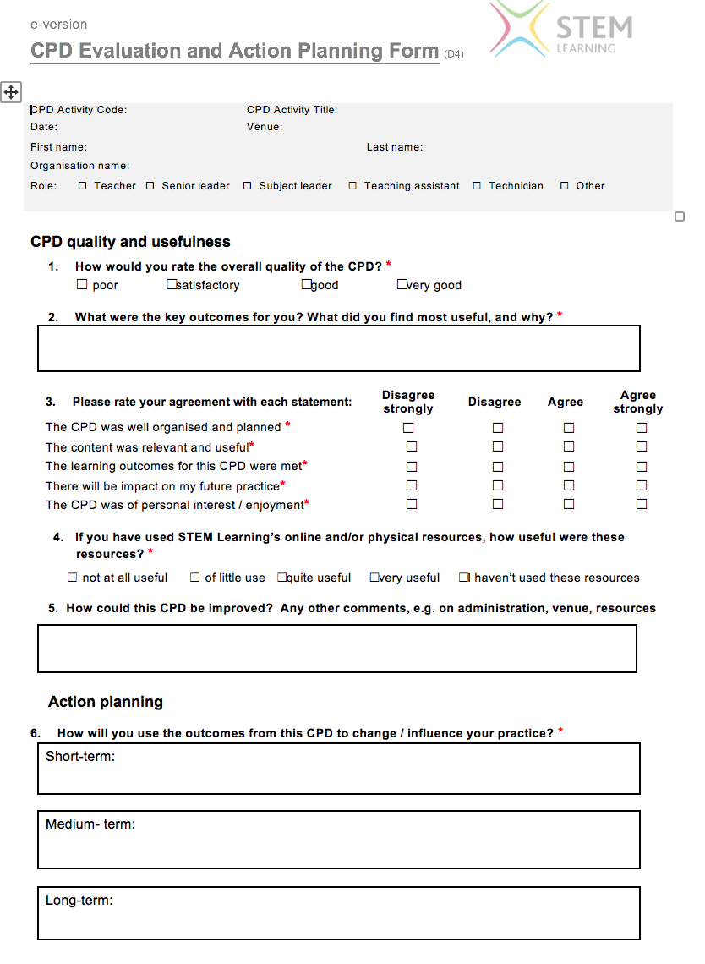
Combined evaluation and action planning (D4)

Slide 28
Aggregating the data from paper forms
All paper forms should be downloaded from Confluence
This link explains about aggregating data

Slide 29
Aggregate data form for evaluation forms only

Slide 30
Extracting data to support the SLP
All from the admin access screen
Choose all reports
Choose “combined impact (Short and long term impact)
Enter your date range and other filters

Slide 31
Detailed impact on Self

Slide 32
Detailed impact on students

Slide 33
Impact 8-14 weeks after the CPD

Slide 34
Impact 8-9 months after the CPD

Slide 35
Learning intentions
Describe the impact process and your role within it
Recognise the potential of the impact process to
    Improve learning for participants (and thus students)
    Provide the SLP with useful marketing data

Slide 36
Learning intentions
Explain how the impact evaluation process can benefit its’ users and the SLP
Recognise the principles of using the SLP planning tool to track your KPIs
Devise improved communications
Clarify any queries with the systems
Discuss and share practice

