Slide 1
CPD ITK and Single Sign On (SSO)

Slide 2
Outcomes
What is SSO
The user journey
Reporting issues about ITK
Possible ITK developments
Notes:
I’ll cover the basics of the newly implemented Single Sign on process and what to do if a participant has an issue accessing the ITK.
I’ll also mention a few of the likely upcoming ITK developments.

Slide 3
What is SSO
Single Sign On:
Removes the need for the token system previously used
Will streamline the process for participants
Works seamlessly when their website registered email address, matches the email address passed through to ITK from Achiever
Notes:
The previously used token system has been removed and now participants will be able to use the same account details they use on the STEM learning website to access the Impact Toolkit. They will only need to login once in any session (period of time they are logged in) to access both sites.
Emails sent from the Toolkit previously, should still work allowing participants to access ITK.
However new tokens cannot be sent from the Toolkit.
Once logged in the participant will be able to move between the website and the ITK with out the need to login again.

Slide 4
The 4 ITK rules – plus one
A course start date must be within 28 days
Participants must have an “enrolled” progress
Invited participants must have a “complete” registration status
“Manually assigned pathway” should not have been ticked
Participants must have an active account on the STEM Learning website
Notes:
In order for the participant to be successfully passed through to ITK the following rules (1-4) still stand.
There is now an additional rule that participants must be registered on the STEM Learning Website for the Single Sign On process to work, to allow them to access ITK.

Slide 5
User journey
Participant (already registered on the website) books themselves on an activity
Participant applies for an activity on the website
They receive a number of emails from bookingsystem@stem.org.uk:
New application – info only
Enrolled (when minimum numbers have been met) - info only
services@impacttoolkit.stem.org.uk:
Please complete the next step of your CPD – includes ITK link to next form due
Notes:
This is the most straightforward user journey.
A user books themselves onto an activity, they will receive a small number of emails from Achiever.
If the basic ITK rules apply (activity starting within 28 days etc..), they will receive an email from ITK inviting them to complete the next form due.

Slide 6
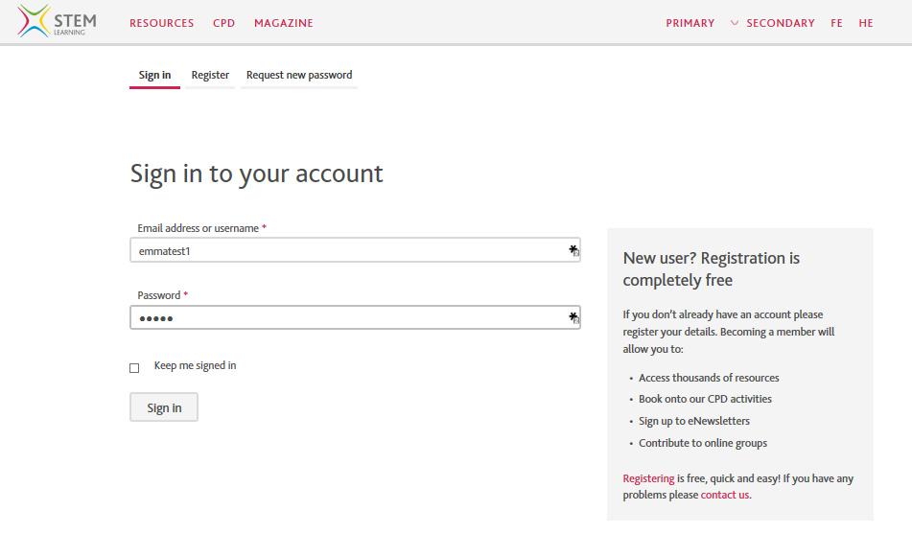
User journey
Notes:
They will be taken to the STEM Learning website where they will be able to login

Slide 7
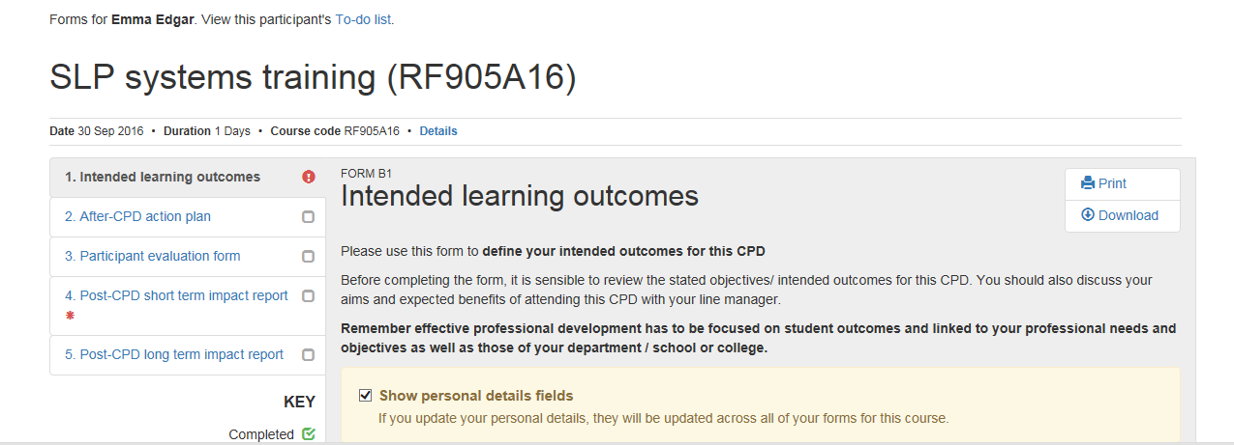
User journey Next due ITK form
Notes:
When they click on the link in the email they received from the ITK, they are taken to the next form due.

Slide 8
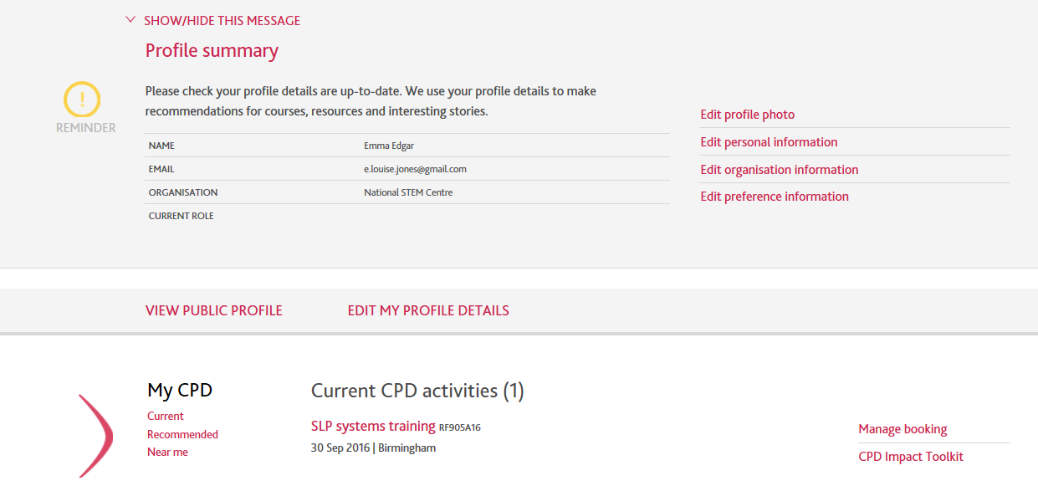
User journey ITK link on participants website dashboard – current CPD
Notes:
Alternatively they can also access ITK by going to their website dashboard, when logged in and in the My CPD section they will see the link to the ITK.
Following the link will take them to the next form due.

Slide 9
User journey Next due ITK form

Slide 10
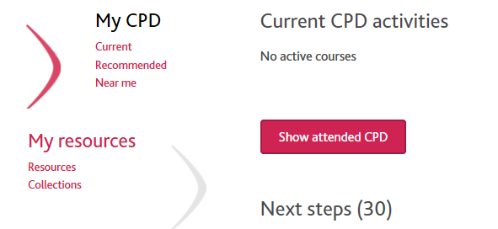
User journey ITK link on participants website dashboard – past CPD
Notes:
If their CPD has happened in the past they will need to click on the Show attended CPD button to view their CPD and the link to the Impact Toolkit

Slide 11
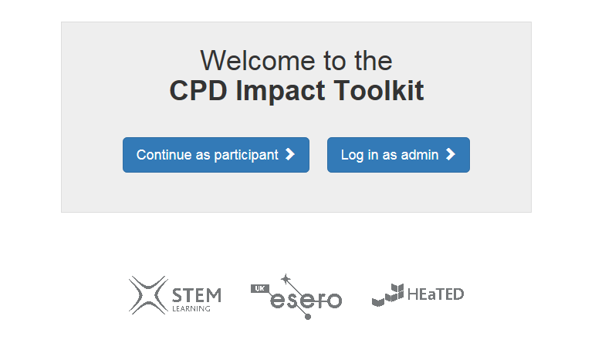
User journey ITK login page
Notes:
If they go straight to the ITK login page, they will login as a participant and will be taken to their To Do List.

Slide 12
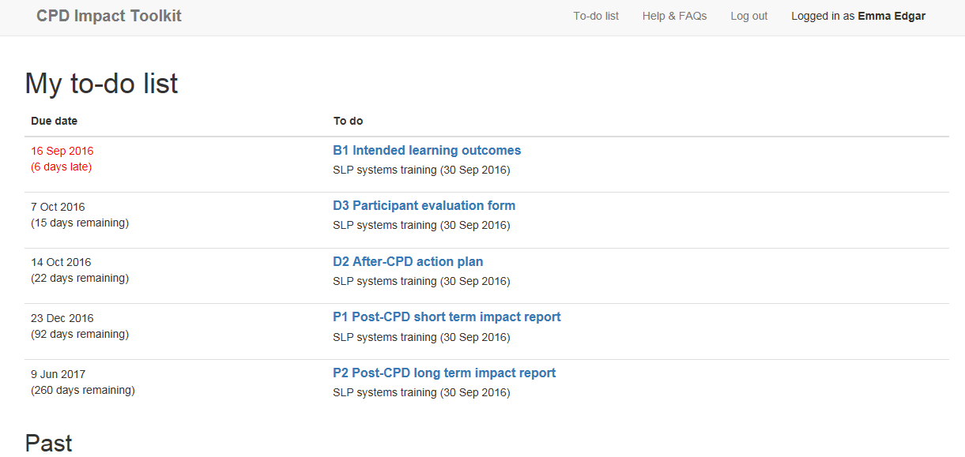
User journey ITK To do list
Notes:
They will be able to view all of the forms that they are due to complete for their activities.
We do plan to make some improvements to this page – allowing participants to:
filter by due date and title
and removing forms that have been completed by aggregate data entry

Slide 13
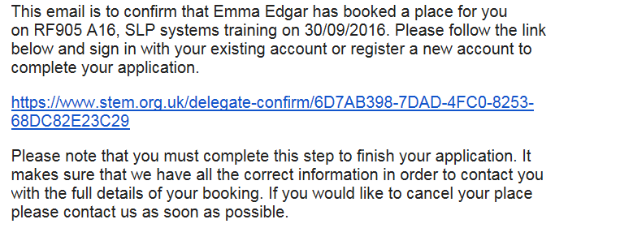
Other user journeys
A participant has been booked on by someone else and has not confirmed their application
They will have received an Application Confirmation email from bookingsystem@stem.org.uk
Notes:
Application confirmation email: If someone else has booked on their behalf, a participant must complete their application by clicking on the link in their application confirmation email, which will allow them to confirm their details and create an account on the website if required.
It is essential that participants know to book and complete their applications – their application status will remain as outstanding if they don’t follow the steps in the application confirmation email, but needs to be complete in order for them to be picked up by ITK.

Slide 14
Other user journeys
Participant sees the following messages on the Help and FAQ page:
“Your account is not currently linked to any activities using the CPD Impact Toolkit. If you think you should be able to access the system then please get in touch”.
Two possible scenarios:
The user has more than one account on the website and they have logged in with the wrong one (not linked to that activity).
Someone else has already logged onto the website on the same PC – a shared PC.
Solution: Go to STEM Learning website and logout, then login to website or ITK with the correct account details. They could also clear browser cookies for good measure.
Notes:
If a participant sees the following message when they attempt to access the ITK from any of the possible routes, it probably means that either they either have:
More than one account on the website – possibly with activities attached to each and they have used the wrong one.
They are using a shared PC and someone has previously logged onto the website with a different account.

Slide 15
Possible ITK Development
Possible new developments:
Improvements to report downloads to make it easier to locate qualitative data/comments from participants
Performance improvements – more responsive
Printable Certificate and 1 page summary of relevant forms available for participants.
Continuing to make the experience more user friendly
Notes:
We are considering a number of improvements to the ITK, user facing also improvements to the admin interface. We will be reviewing and prioritising these development wishes in the next few weeks.

Slide 16
Reporting issues about ITK
Email: support@stem.org.uk
Notes:
Email support@stem.org.uk if you need to report any issues with the Impact Toolkit.

