Slide 1
STEM Insight
Immerse yourself in the world of industry and university
Notes:
What was called TIPS/TAPS

Slide 2
STEM Insight
What is it?
  a unique chance for staff in schools and colleges to experience STEM-related work in industrial or university settings
  a placement with either an employer or university
  supported by a tailored package of face-to-face and online CPD

Slide 3
Insight into industry
What is it?
  work with world-leading employers across a range of STEM industries
    manufacturing
    medical science
    computing
    engineering
  develop knowledge of STEM careers and routes for students to progress into

Slide 4
Insight into university
What is it?
  spend time in a leading UK university and learn about the latest cutting edge research in your field
    University of Cambridge
    University of Glasgow
    University of Birmingham
  support students as they make the transition to university

Slide 5
STEM Insight
The benefits
  gain first-hand experience of the range of STEM-related careers
  receive generous financial support to cover the cost of participating in the programme from Project ENTHUSE
  help students to make better informed choices about their futures
  make long-term links with employers and universities
  be part of the nationwide drive to improve careers education

Slide 6

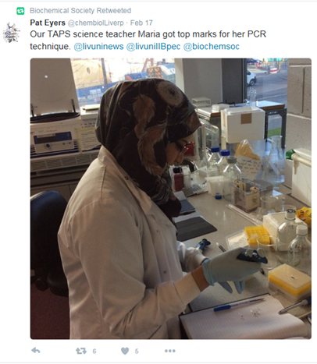
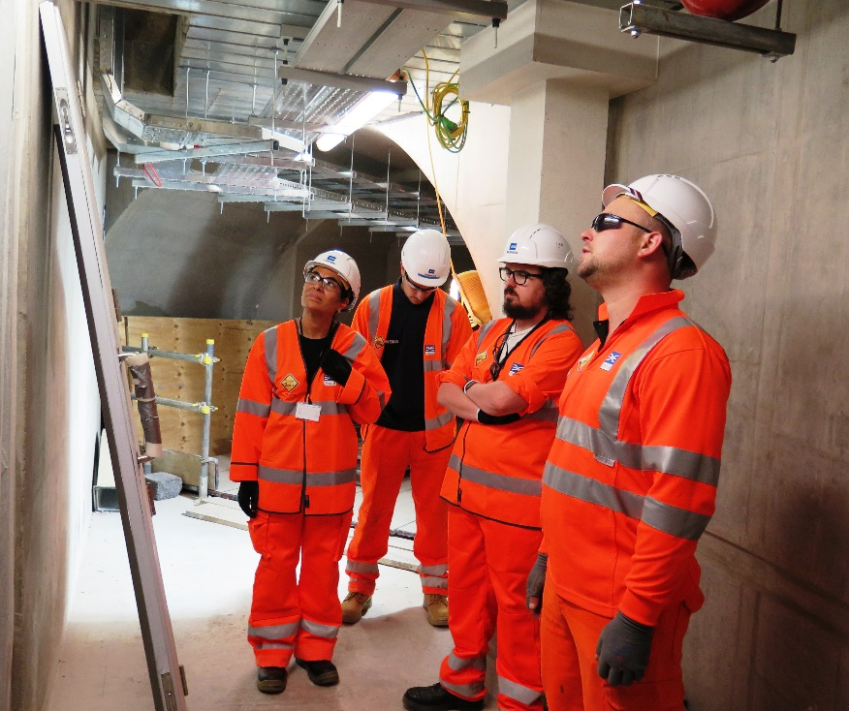

Get involved
www.stem.org.uk/stem-insight
#STEMInsight

