Slide 1
Using the STEM learning impact evaluation process
Also known as
The Impact Toolkit (ITK)

Slide 2
Learning intentions
Describe the impact process
Explain why the impact process is important
To the pupils learning science
To the participants attending your CPD
To the SLP and the STEM Learning network
Notes:
LOs for the SLP session
Explain that there is a PDE to support tutors (and SLPs) with the impact process, some of todays slides have been taken from that PDE.
Availability?

Slide 3
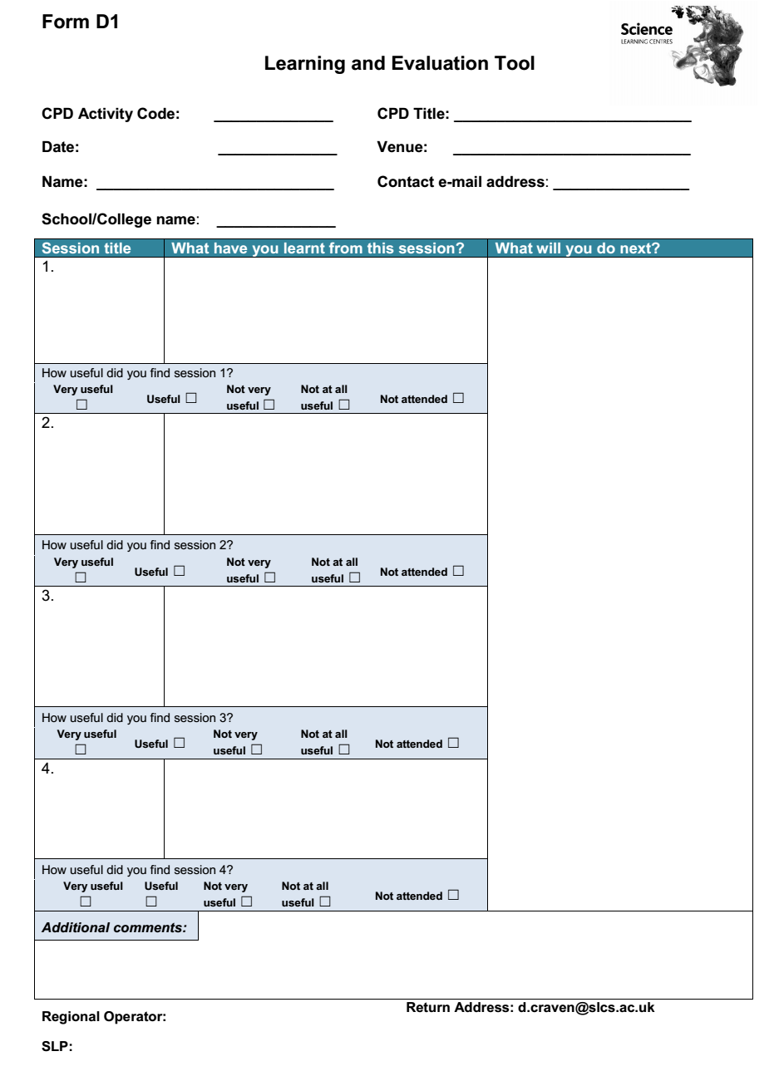
During the CPD
Use the Learning and Evaluation sheet (D1) to record learning, ideas/actions throughout the sessions
https://myscience.atlassian.net/wiki/display/NN/The+Impact+forms
Notes:
Refer back to use of learning and evaluation sheet introduced at the start of the day.. (and used at the end of session 1)
Confluence link explaining the process and form downloads)

Slide 4
Impact evaluation process
https://impacttoolkit.stem.org.uk/
Before
During CPD event
Post event impact
Intended learning Outcomes
– thinking about intended outcomes of the professional development for you, the pupils/students, and wider impact in school/college.
Learning and evaluation
- record any key learning/ ideas/actions throughout the session
Notes:
Provide A3 paper and pens
Ask them to sketch out the impact process, (Before revealing the Before , green, shape)
Then question tables/groups,
What happens before the CPD even starts?
Now reveal the Before/green shape and talk through if needed. Stress importance of tuning in, and discussing with leaders at school. (see next slide notes for more info
The only access to the intended learning outcomes information is on-line
Next slide

Slide 5
Accessing the on-line impact process
See an Email with the subject
“Welcome to the CPD Impact Toolkit”
The participant’s code is at the end of the url in the email
https://impacttoolkit.stem.org.uk/participant-landing/ooooo
Administrator access
https://impacttoolkit.stem.org.uk/
Notes:
… Show admin access here, search and demo the list for today’s session, if you dont have access, use the screen shots of what a participant might see slides 10 & 11, explain they should have had an invitation so can check out what a participant will see.
Info below from ITK PDE with a focus on using the intended learning outcomes exercise
Contextualisation
Thinking about, reflecting, and discussing with line managers what the participant wants to get out of a CPD experience, has been shown to increase the likelihood of the participant been alert to this learning throughout the session, and that it will be taken back to school, and acted on.
Check with the venue about use of wifi and access to this site for participants. In the pre course information ask them to bring either
their access code/email and a device to access it during the course. Or
A downloaded copy of their Intended Learning Outcomes completed before the start of the course. If there is no online access you will also need to request paper copies of the other ITK paperwork
The ITK is accessible on mobile devices, so a wifi connection may not be necessary
As a tutor you can request sight of these intended learning outcomes from your SLP, prior to the session
You could edit this link replacing the “oooooo” with your own invite code (if you have one) so you can show on screen what the online toolkit looks like.
Task 1
If participants are accessing the ITK on line, they could log in now. If not ask them to retrieve copies of their Intended Learning Outcomes, they may have downloaded them or have them on paper.
Those that have not accessed the on-line toolkit will not have their reflections. Insert a new side and display the outcomes for the day, and ask them to think about what they are hoping to learn, and take back to school. You could provide a few paper copies of the intended learning outcomes sheet (B1), this is not essential if some of them have accessed the on-line version.
Ask the participants to share their intended learning outcomes in pairs or across tables, either listen in so you can respond to their thoughts or ask for feedback from the group, and record outcomes on flipchart. You could then return to these at times in the session to be explicit when an outcome has been achieved.

Slide 6
Impact evaluation process
https://impacttoolkit.stem.org.uk/
Before
During CPD event
Post event impact
Intended learning Outcomes
– thinking about intended outcomes of the professional development for you, the pupils/students, and wider impact in school/college.
Learning and evaluation
- record any key learning/ ideas/actions throughout the session
Your action plan. Planning how the professional development will have impact in your school/college. This may be completed in the next week with a colleague/line manager.
Notes:
Reveal Action planning box, and explain what is expected to happen.. (on line or paper).
Info from ITK PDE
Contextualisation
At the end of the CPD, participants use their reflections (D1) from all the sessions to prioritise their actions, these feed in to their action plan. This is started now and completed back at school in consultation with their line manager who will receive a link once the plan is completed and saved in the system. If this CPD is being run as a two day course, the action planning can be completed after day 2. However it is useful to have some actions to add to the plan at the end of day 1. Some actions may relate to a gap task. Providing some time at the end of the session to get this process started will increase the chance of impact back at school. It is not necessary to be restricted by the layout, there may be one key action or several actions that emerge from this CPD
Task 4 Action planning
Show the first part of the slide
Ask participants to retrieve their completed learning and evaluation sheet (D1)
Provide Highlighters so they can identify any key actions.
Now
Ask them to access their online ITK or provide a printed copy of the action plan (D2) If you choose to use a paper version you will need to request this from the organisation leading the CPD.
Encourage participants to consider the likely impact on various stakeholders, and also what evidence they will collect to demonstrate that impact.
The following 2 slides are hidden but you could use them to help participants to identify the sort of impact and what they might look for to help them identify any evidence. You may have some ideas from the context of the CPD that could be suggested.
Provide a little time then ask them to share one action with their table or the wider group. Here you are getting feedback on the effectiveness of the session against the outcomes. Hearing participants ideas also influences others, who may start to adapt their actions.

Slide 7
Types of Impact
Beneficiary | Examples of impacts
CPD participants | Improved enthusiasm and confidence Improved subject knowledge and understanding Increased pedagogical knowledge, skills and understanding (e.g. of science curriculum/assessment/practical work/literacy/numeracy) Improved leadership knowledge, skills and understanding (includes effective lesson organisation and planning, time management, collaboration and sharing of good practice) Use of new subject knowledge and skills and/or pedagogies Use of new leadership knowledge, skills and understanding
Pupils | Improved pupils’ progress in science knowledge, skills and understanding Improved pupils’ attainment in science knowledge, skills and understanding Increased pupils’ confidence, motivation and engagement in lessons Improved pupils’ behaviour and working safely
Colleagues/ School + Wider impacts | Improved leadership of science department/science curriculum Improved progress and attainment of pupils Increased profile/priority of science in school Improved sharing of effective practice and resources Increased uptake of pupils studying science (pre/post-16) Improved quality of teaching school/ TSA/network Improved collaboration with local community/business/industry
Notes:
From ITK PDE
Slide is hidden.
Unhide if you wish to use this to support participants choose what type of impact they might notice.
These items are similar to those that are found printed on the action plan, or on the on-line version

Slide 8
Evidence of Impact
Impact on | Evidence
Self | Feedback from colleagues Feedback from lesson observations (for example by a colleague/ PM/ external) Your perceptions/reflections e.g. recorded in a reflective journal or evaluation of lessons or schemes of work Feedback from pupils (see below) Changes to schemes of learning/ lesson plans/ assessment/ resources
Pupils | Attainment data Progression data (e.g. teacher assessment within/between years/Key Stages, progression from Key Stage 2 to GCSE or progression to post-16 study) Attitude surveys (before and after changes and with a comparison group if possible) Interviews/ discussions/ focus groups for pupil voice Videos/ photos/ posters Feedback on pupil engagement from the observation of lessons by colleagues Documenting your personal reflections/ observation of pupils Parent feedback
Colleagues and school | Informal or formal discussions with colleagues Evidence of improved student progress and attainment Feedback from lesson observations (for example (for example by a colleague/ PM/ external) Other evidence e.g. from staff /pupil surveys/ interviews/ videos Evidence of increased uptake of subject pre-/post-16 School/ department documents e.g. Improvement plans /vision statements/schemes of learning/ assessment policy/ lesson observation processes/ resources
Notes:
From ITK PDE
Slide is hidden.
Unhide if you wish to use this to support participants choose some method of collecting evidence of impact
These items are similar to those that are found printed on the action plan, or on the on-line version

Slide 9
Impact evaluation process
https://impacttoolkit.stem.org.uk/
Before
During CPD event
Post event impact
Intended learning Outcomes
– thinking about intended outcomes of the professional development for you, the pupils/students, and wider impact in school/college.
Learning and evaluation
- record any key learning/ ideas/actions throughout the session
Your action plan. Planning how the professional development will have impact in your school/college. This may be completed in the next week with a colleague/line manager.
Impact evaluation
– what is the impact to date?
This should be completed in 6-8 weeks’ time, using your action plan to help you. You will get a reminder about completing this.
Notes:
Reveal Post CPD box, and explain (see below)
From ITK PDE
Contextualisation
Asking for reflections of impact some time after the CPD has occurred, can help to increase the potential for impact.
The purple shape explains about the ‘Post’ impact evaluation activity. Some courses will require reflections over a longer period as well, so they may be asked to reflect 8-12 months later.
Advise that completing the ITK and including line managers will provide evidence of professional development for professional recognition like Chartered Science teacher run by the ASE or the Recognition scheme run by STEM Learning or for performance management purposes, or other in-school systems. Having this all on line, makes it easier to retrieve at any time in the future.
Participants will be sent links to the ITK at every part of the process, so they don’t have to remember when to do it.

Slide 10
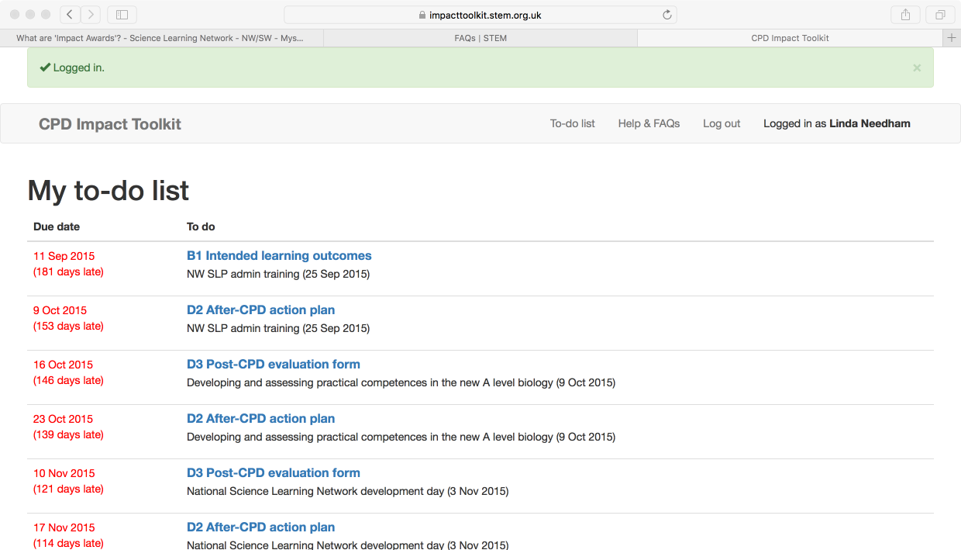
Notes:
Optional slide
If you cannot access the online version due to IT issues, this slide shows a screen shot of one of the ITK pages.
Choosing the title of the CPD in blue will take the user to the page for that CPD event, see next slide

Slide 11
Notes:
Optional slide
If you cannot access the online version due to IT issues, this slide shows a screen shot of a specific ITK page related to the Leadership conference.
Point out the list of the links in blue on the LHS, and that the first is completed (green)
Point out the colour coding below the list, to show partially complete (amber) and take action now (red)

Slide 12
Impact evaluation process
https://impacttoolkit.stem.org.uk/
Before
During CPD event
Post event impact
Intended learning Outcomes
– thinking about intended outcomes of the professional development for you, the pupils/students, and wider impact in school/college.
Learning and evaluation
- record any key learning/ ideas/actions throughout the session
Your action plan. Planning how the professional development will have impact in your school/college. This may be completed in the next week with a colleague/line manager.
Evaluation form
– completed at the end of the professional development event; helping us to measure impact and make improvements.
Hand in
Impact evaluation
– what is the impact to date?
This should be completed in 6-8 weeks’ time, using your action plan to help you. You will get a reminder about completing this.
Notes:
Evaluation box appears to complete the process, explain why if needed,
From ITK PDE
Contextualisation
The final evaluation completed during the CPD is the usual evaluation form (D3). Again this can be completed on-line, IT allowing. Or you can request a paper copy from the organisation leading the CPD. In this case participants fill in and hand the form back to you before they leave
Task 5
Complete the evaluation form
Insert an additional slide showing the outcomes for the day so they can reflect on these while they complete the evaluation document

Slide 13
Looking for evidence of learning to evaluate the impact of the CPD (After Guskey (2000)
Participants’ reaction | Participants’ learning | Organisational support & change | Use of new knowledge and skills | Student learning outcomes
LEVEL 1 | LEVEL 2 | LEVEL 3 | LEVEL 4 | LEVEL 5
Notes:
The process has emerged from research evidence into how to make CPD more effective, started with Thomas Guskey’s work.
Secondary Education Magazine ran an article recently about using Guskey’s ideas to evaluate in school CPD. TDT also using these ideas.
With evaluation of impact at 5 different levels.
Reflection on impact at these levels is supported by our impact evaluation process, can they explain how
Ask what might happen if there was no during reflection time, or no action planning time, or no asking the question some time later? You might reinforce that thinking about the course outcomes, and discussing with line managers helps to support all the levels.

Slide 14
5.0 Impact (SLP- SEF extract)
Stage 1 | Stage 2 | Stage 3 | Stage 4
The SLP provides limited evidence of impact of CPD on teacher practice and pupil outcomes from the monitoring and analysis of the CPD Impact Toolkit Data | The SLP provides some evidence of impact of CPD on teacher practice and pupil outcomes from the monitoring and analysis of the CPD Impact Toolkit Data and which is shared with course leaders and teacher presenters | The SLP provides evidence of impact on teacher development and pupil outcomes from case studies and regular monitoring and analysis of the CPD Impact Toolkit Data and which is used by course leaders and teacher presenters to adapt and improve CPD | The SLP provides extensive evidence of impact on teacher development /practice and on pupil outcomes though analysis of pupil data, case studies and the strategic analysis of CPD Impact toolkit data. The SLP develops an effective plan to improve the quality and impact of the CPD and in-school/college support
Notes:
Focus now on developing as an SLP
Provide the steps table for impact (From SLP SEF) The other 4 areas are
Partnerships
networks and communications
sustainability
programme
Ask to highlight their current stage
And decide what they will do to make steps towards the next stage.
If time ask to share with a colleague

Slide 15
Measurable impact https://www.stem.org.uk/impact
A key feature of what we do
Notes:
Use to emphasise ability to interrogate the data at all levels, to support SLP development, but also attraction of further funding to support subject specific CPD
From ITK PDE
Contextualisation
The Network has focused on increasing impact on participants over at least the last 10 years. It is a unique selling point for the CPD provided through the network
This slide shows an example of the data collected. (There may be other more up to date data available that is more appropriate to your context, do edit the slide)
More information can be found here https://www.stem.org.uk/impact
AS well as the importance of ensuring impact this sort of data supports our case for future funding. It is very difficult to justify otherwise

Slide 16
Impact evaluation process
https://impacttoolkit.stem.org.uk/
Before
During CPD event
Post event impact
Learning and evaluation
- record any key learning/ ideas/actions throughout the session
Notes:
Allow reflection time on learning in this session, and show next slide (the outcomes for the session) to reflect against

Slide 17
Learning intentions
Describe the impact process
Explain why the impact process is important
To the pupils learning science
To the participants attending your CPD
To the SLP and the STEM Learning network

