Slide 1
Surviving Change Individual motivation for Technicians
HEaTED North West 2015

Slide 2
Objectives
Identify the impact of Change on us as individuals
Identify how we deal with difficult situations – TEA
Importance of cascading change positivity & consistently
Supporting individuals and teams through change
Keeping motivation high throughout Change

Slide 3
What is CHANGE?
Think of the last major change that happened in your life
How did you react to the change?
How did you deal with the change?
What was the impact on you?

Slide 4
Is Change a Positive or Negative experience?
Depends on:
The circumstances
The individual

Slide 5
Why do we resist change?
Unknown
Uncertainty
Fear

Slide 6
FEAR
False
Evidence
Appearing
Real

Slide 7
Resistance to Change
Lack of :
Involvement and support
Understanding where you/the organisation is now
Understanding where you need to be,
when, why, and what the measures will be for having got there.
Communication, involvement, empowerment

Slide 8
Leading Transition
Change:
is the stuff, the events, the structures, systems, the business decisions, and can happen quite (possibly very) fast
Transition:
is to do with people, identity, shared purpose, culture and is slow – if it is not attended to then the quick fix will likely fail

Slide 9
The 3 Perceptual Positions
1st Position – seeing and feeling the situation through our own eyes
2nd Position – stepping into the other persons shoes
3rd Position – ability to stand back and view the situation as a third party

Slide 10
THINKING
FEELING
HEAD - Security
HEART - Attention
Thoughts
Internal Processes
Beliefs
Emotions
Feelings
Values
ACTION
GUT - Autonomy
Actions
Behaviours
Words

Slide 11
Response to Change
Acceptance
Shock
Denial
Testing
Anger
Bargaining
Time
Depression
Time

Slide 12
Three Phases of Transition
Time
The New Beginning
The
Neutral
Zone
Ending, Losing, Letting Go

Slide 13
Three Phases of Transition
1. Ending, Losing, Letting Go
dealing with tangible and intangible losses and mentally preparing to move on
2. The Neutral Zone
critical psychological realignments and re-patterning takes place - getting through it, and capitalising on all the confusion by being innovative, to find new ways of doing things
3. The New Beginning
develop the new identity, experience the new energy, and discover the new sense of purpose that make the change begin to work

Slide 14
Eight Steps to Successful Change'
Increase urgency
Be prepared to move, make objectives real and relevant.
Build the guiding team
Be prepared to show emotional commitment, and enhance your mix of skills and levels.
Get the vision right
Establish a simple vision and strategy, focus on emotional and creative aspects necessary to drive service and efficiency.
Communicate for buy-in
De-clutter communications - make technology work for you rather than against

Slide 15
Eight Steps to Successful Change‘
Empower action
Remove obstacles, enable constructive feedback and ask for support from leaders where needed
Create short-term wins
Set aims that are easy to achieve - in bite-size chunks. Manageable numbers of initiatives. Finish current stages before starting new ones.
Don't let up
Foster and encourage determination and persistence - ongoing change - highlight achieved and future milestones.
Make change stick
Reinforce the value of successful change.

Slide 16
Positive Response to Change
Hopeful Realism
Informed Optimism
Pessimism
Informed Pessimism
Completion
Uninformed Optimism
Time
Notes:
It’s based on the idea that people can succumb to pessimism as they move through change (which is why pessimism is on the Y axis). At Uninformed Optimism, people are feeling self-confident and positive towards the change. They arrive at Informed Pessimism – probably get more information and start to wonder if things are going to go as well as they’d originally anticipated – and start exhibiting signs of finding the change a more negative experience, and thus lose confidence in it. As they then start to see that the change is achievable, their confidence grows and they move to Hopeful Realism. Informed Optimism is when they have the information they need, and their original optimism and confidence return – basically people then start to throw themselves into whatever the change is. Finally on completion, such people can be useful to the organisation (or whatever) as they support the change and give out confidence for this and any future changes.

Slide 17
Motivation through Change
How do we keep ourselves motivated throughout the change process?
How do we help to keep our team motivated throughout the change process?

Slide 18
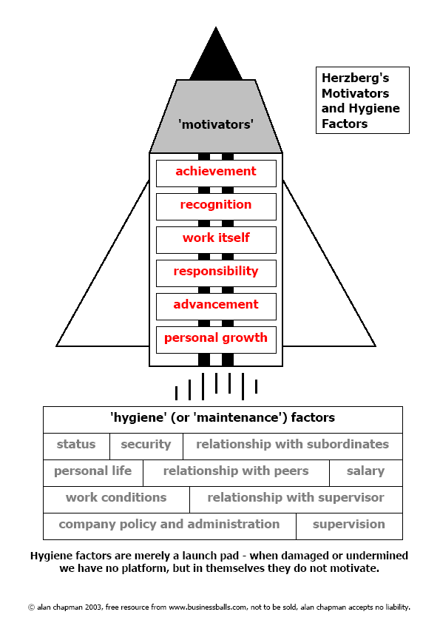

Slide 19
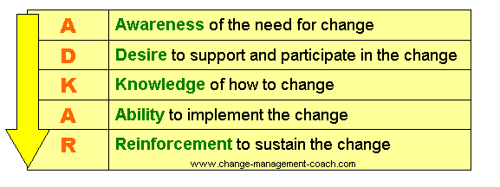
ADKAR: Simple, Powerful, Action Oriented Model for Change - Individual Focus

Slide 20
Seven ADKAR Principles
Be Proactive
Begin With The End In Mind
Put First Things First
Think Win/Win
Seek First to Understand, Then to Be Understood
Synergize, and
Sharpen the Saw.

Slide 21
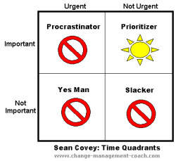

Slide 22
Change Quotes:
Human beings, by changing the inner attitudes of their minds, can change the outer aspects of their lives. William James (1842 - 1910)
Change your thoughts and you change your world. Norman Vincent Peale (1898 - 1993)
Genuine beginnings begin within us, even when they are brought to our attention by external opportunities. William Bridges
Change has a considerable psychological impact on the human mind. To the fearful it is threatening because it means that things may get worse. To the hopeful it is encouraging because things may get better. To the confident it is inspiring because the challenge exists to make things better. King Whitney Jr.
It is not the strongest of the species that survives, nor the most intelligent, but the one most responsive to change. Charles Darwin (1809 - 1882)

