Slide 1
Sue Churm
Membership & Networks Manager
@HEaTEDtechs
#HEaTEDtechs

Slide 2
Welcome
What is HEaTED?
What can HEaTED do for you?
What does HEaTED need from you?
@HEaTEDtechs
#HEaTEDtechs

Slide 3
What is HEaTED?
Membership organisation
Specifically for technical staff
72 active Member Institutions - Join Us
Providing support for over 3800 individual members
Sign up FREE here
@HEaTEDtechs
#HEaTEDtechs
@HEaTEDtechs
#HEaTEDtechs

Slide 4
Training & Development
Working to be the lead organisation supporting professional development of the technical workforce
Professional Registration
Regional Networks
CATTS
@HEaTEDtechs
#HEaTEDtechs
Notes:
What can HEaTED do for you?

Slide 5
Training and Development
Standard course listings
On demand / in house courses in your Institution
Bespoke sessions tailored to suit your needs
New courses added on a needs basis
If you need it we can source it, ask HEaTED first
By our members for our members
Almost 500 training days delivered last academic year
600 individuals attended
Save £’s by booking through HEaTED
What are your training needs this year?
@HEaTEDtechs
#HEaTEDtechs

Slide 6
Training and Development
Special Offer!
Book a HEaTED course before 31 January 2016 and receive a 10% discount on course fees.
This applies to all HEaTED delivered courses scheduled until the end of July 2016. For a list of the courses included see our news page.
Don’t see a date or venue that suits you? Offer to host a course at your own venue.
@HEaTEDtechs
#HEaTEDtechs

Slide 7
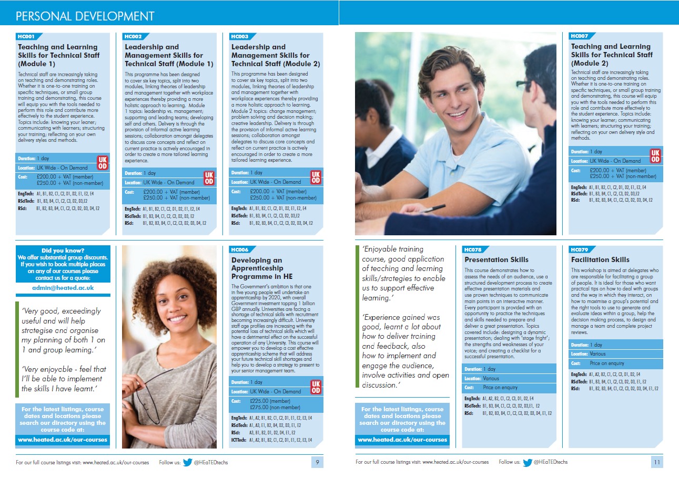
Training and Development
HEaTED Course Directory
Sent to all member organisations
Download full directory here
@HEaTEDtechs
#HEaTEDtechs

Slide 8
Training and Development
New for 2016!
Coaching and Mentoring skills for technicians
Facilitation Skills for technicians
Developed by HEaTED to meet member demand
Be the first in Yorkshire to host these courses
@HEaTEDtechs
#HEaTEDtechs
Notes:
http://www.heated.ac.uk/our-courses/

Slide 9
Training and Development
On- demand courses, in your institution, on a date to suit you, some examples...
Teaching & Learning Skills for Technical Staff
Leadership & Management Skills for Technical Staff
Abrasive Wheels
Carriage of Dangerous Goods by Air Certification
Safe Lifting and Slinging Procedures
Safe use of Laboratory Gases
Laboratory & Cryogenic Gases Safety Training
Use and Maintenance of Pipettors
PAT Training
Browse our full Course Directory
@HEaTEDtechs
#HEaTEDtechs
Notes:
http://www.heated.ac.uk/our-courses/
Handout to give out showing on-demand courses

Slide 10
Training and Development
Useful Guide Library - Available though our Online Groups
Example training guides:
Mentoring Essentials
Managing Projects
Assertiveness
Dealing with Difficult Behaviour
Delegating
Effective Change
Goal Setting
Managing Conduct
Managing Teams
Managing People
Managing Email
@HEaTEDtechs
#HEaTEDtechs

Slide 11
Training and Development
Confidence Building - Profile Raising - Career Progressing
Revenue Generating
We are seeking new course providers
What can you, your department, your institution offer?
Teaching & Learning Skills for Technical Staff Module 2 gain the skills necessary to develop into a training role
@HEaTEDtechs
#HEaTEDtechs
Notes:
http://www.heated.ac.uk/our-courses/

Slide 12
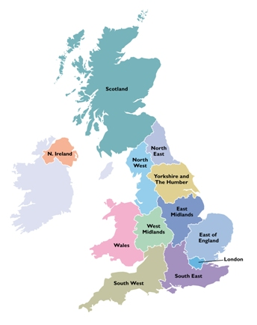
Regional Networks
Our network covers all UK regions
Our free regional events take place in all regions at least twice a year
Core opportunity to network with peers and colleagues across the region
You set the agenda
Workshops, tours, presentations, discussions and more.
Over 850 technicians attended our events last year
You can attends events in ANY region
Details of all events on our website
@HEaTEDtechs
#HEaTEDtechs
@HEaTEDtechs
#HEaTEDtechs

Slide 13
Regional Networks
Your region
Manchester University
Lancaster University College St Martin
Preston University
Edgehill
John Moores University
Who’s missing?
Full UK membership list here
@HEaTEDtechs
#HEaTEDtechs
@HEaTEDtechs
#HEaTEDtechs

Slide 14
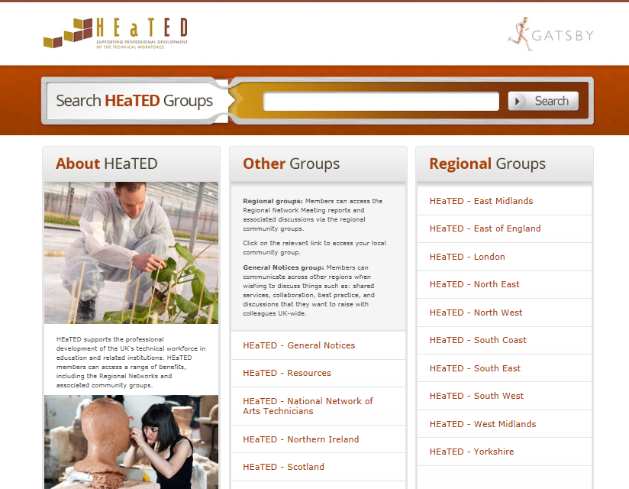
Regional Networks
HEaTED Online Groups
Your virtual Regional Network
Join for free
Connect with colleagues from all HEaTED member institutions
Share resources
You get out what you put in!
User guide here
@HEaTEDtechs
#HEaTEDtechs
@HEaTEDtechs
#HEaTEDtechs
Notes:
http://www.nationalstemcentre.org.uk/heated
Your Online Groups
The HEaTED Online Groups support the HEaTED Regional Networks. Please get involved, start a topic and contribute to a discussion before and after the Regional Network Event. Technical Staff from HEaTED member Institutions can access this facility for free, just register on the main HEaTED Website and then the Online Groups if you have not done so already.

Slide 15
News
New Website & Communications
New website launched January 2016
Single sign on for website and online groups
New course bookings system
Your own personal CPD record
New email format
Communications tailored to your location and specialism
Magazines, Blogs, Twitter
Write for us - Showcase your work - Raise your profile
@HEaTEDtechs
#HEaTEDtechs
@HEaTEDtechs
#HEaTEDtechs
Notes:
http://www.nationalstemcentre.org.uk/heated
Your Online Groups
The HEaTED Online Groups support the HEaTED Regional Networks. Please get involved, start a topic and contribute to a discussion before and after the Regional Network Event. Technical Staff from HEaTED member Institutions can access this facility for free, just register on the main HEaTED Website and then the Online Groups if you have not done so already.

Slide 16
CATTS
Competency Assessment Toolkit for Technical Staff
We received many requests for help with organisational and individual performance assessment. In response and to meet a wider UK need, we have developed a new resource:
• CATTS has been developed specifically for technical staff, designed by Technical Managers in conjunction with HR professionals
• CATTS has been designed to change the way that the professional technicians explore performance. It requires a shift in thinking towards continuous review and improvement
• Resource pack/Toolkit to help you and your Manager assess current competency and plan for future demands and needs
@HEaTEDtechs
#HEaTEDtechs

Slide 17
CATTS
CATTS addresses 5 key competency areas as Modules:
@HEaTEDtechs
#HEaTEDtechs

Slide 18
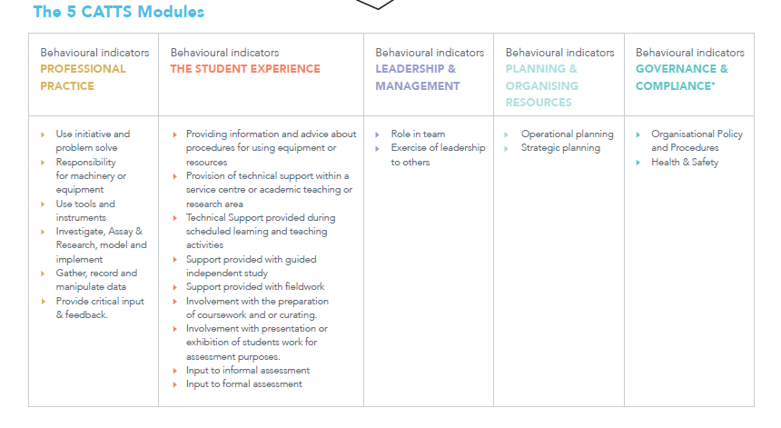
CATTS
Each Module has a set of Behavioural Indicators
@HEaTEDtechs
#HEaTEDtechs

Slide 19
CATTS
Within each behavioural indicator there are 5 levels of competency to be matched against:
Learner
Experimentalist
Practitioner
Specialist
Expert
The aim is to progress through these levels
@HEaTEDtechs
#HEaTEDtechs

Slide 20
CATTS
Successful implementation of CATTS will mean…
Technical staff ensuring regular assessment of their own competency and professionalism and owning their own development.
Line managers / reviewers engaging regularly with their reviewees to ensure a competent, proactive, professional workforce ready to respond to changing needs.
CATTS is available NOW, £250 member organisations and £450 non members. Payment is per institution, not per individual.
@HEaTEDtechs
#HEaTEDtechs

Slide 21
Professional Registration
What is it all about?
Important milestone for all vocational and technical staff
Response to many calls that technicians do not feel valued or recognised as professionals
Establishing proven knowledge, expertise and commitment to professional standards
Evidence-based
Overseen by Science / Engineering Councils
Categories: RSciTech, RSci, CSci; EngTech, ICTTech, IEng, CEng

Slide 22
Professional Registration
Why should I get involved?
Recognition as a professional in your field
Improved self-motivation, career opportunities and salary prospects
Greater influence within your organisation and industry
Confirmation that you are highly competent in your field
Connecting you with innovative, influential and inspirational people
International recognition of qualifications

Slide 23
Professional Registration
The role of HEaTED
Think of HEaTED as a vehicle!
All HEaTED courses are linked to the competencies for Professional Registration – make every CPD instance count!
Regional Network Events and contribution to the Online Groups demonstrate your commitment to professional development and contribution to the Technical Community
Sign posting routes to Registration
Hundreds of you using HEaTED activities as evidence for application or renewal
Notes:
HEaTED is a vehicle, we can sign post you to professional bodies, give you the tools to meet the competencies and have matched our courses to the Science and Engineering Council’s competencies.
This year to date, 10% of attendees who completed evaluation forms at our Course and Regional Network Meetings have stated that their attendance at one of our events / courses contributed to their application for/renewal of Professional Registration. A further 13% of our attendees requested more information on Professional Registration which we followed up with our ‘Quick Guide’ and have passed their details on to the IST to follow up.
We are in discussions with the IST and Science Council about how to increase the number of our members gaining Professional Registration in a more joined up manner.
http://www.heated.ac.uk/professional-registration/

Slide 24
Professional Registration
HEaTED supports technical and vocational staff on their journey to Professional Registration
Regional Networks and Events
Specialist training and development
Personal Development Resources
Technical & vocational staff
Professional Registration
Directly through councils or licensed awarding bodies
HEaTED ‘the vehicle’
Online Groups
CATTS
Representative
Voice

Slide 25
Professional Registration
Who to register with?
Wide range of Awarding Bodies
Fast track route directly through Science Council
Choose route specific to your requirements / specialism
More information via Science and Engineering Councils
No Arts Professional Register yet, NNATs lobbying for an equivalent register. Registered Practitioner scheme available through the IST

Slide 26
What does HEaTED need from you?
What do you think about Professional Registration?
To ensure continued support from the Gatsby Charitable Foundation we need to gather information from all members to identify the following:
current attitudes to professional registration
how you have used / will use HEaTED to support your application for professional registration
the barriers to achieving professional registration
what more can HEaTED do to support your professional development
Complete our short survey
Notes:
HEaTED is a vehicle, we can sign post you to professional bodies, give you the tools to meet the competencies and have matched our courses to the Science and Engineering Council’s competencies.
This year to date, 10% of attendees who completed evaluation forms at our Course and Regional Network Meetings have stated that their attendance at one of our events / courses contributed to their application for/renewal of Professional Registration. A further 13% of our attendees requested more information on Professional Registration which we followed up with our ‘Quick Guide’ and have passed their details on to the IST to follow up.
We are in discussions with the IST and Science Council about how to increase the number of our members gaining Professional Registration in a more joined up manner.
http://www.heated.ac.uk/professional-registration/

Slide 27
What does HEaTED need from you?
Sign up with HEaTED today
Access to all the benefits of HEaTED membership is free for technicians at a member institution
Visit the HEaTED website to register - it is quick and easy.
Use your “ac.uk” email address
Encourage your colleagues to join!
@HEaTEDtechs
#HEaTEDtechs
@HEaTEDtechs
#HEaTEDtechs

Slide 28
What does HEaTED need from you?
Get involved
Host and come to free Regional Network Events
Register and post in your Regional Online Group
Help to spread the word in your organisation – posters, cascade emails, event report follow up
Run your own course through HEaTED
Tell us what training you need
Tweet!!
Complete the Professional Registration Survey
Bring a friend
@HEaTEDtechs
#HEaTEDtechs
@HEaTEDtechs
#HEaTEDtechs

Slide 29
Contact Us
HEaTED Membership & Networks Managers
Sue Churm Katherine Forsey
s.churm@slcs.ac.uk k.forsey@slcs.ac.uk
@HEaTEDsue @DrBiol
HEaTED Central Team
admin@heated.ac.uk
01904 328173
@HEaTEDtechs
#HEaTEDtechs

