Slide 1
Teaching and Learning Skills for Technical Staff
Module 1
@HEaTEDtechs
#HEaTEDcourse

Slide 2
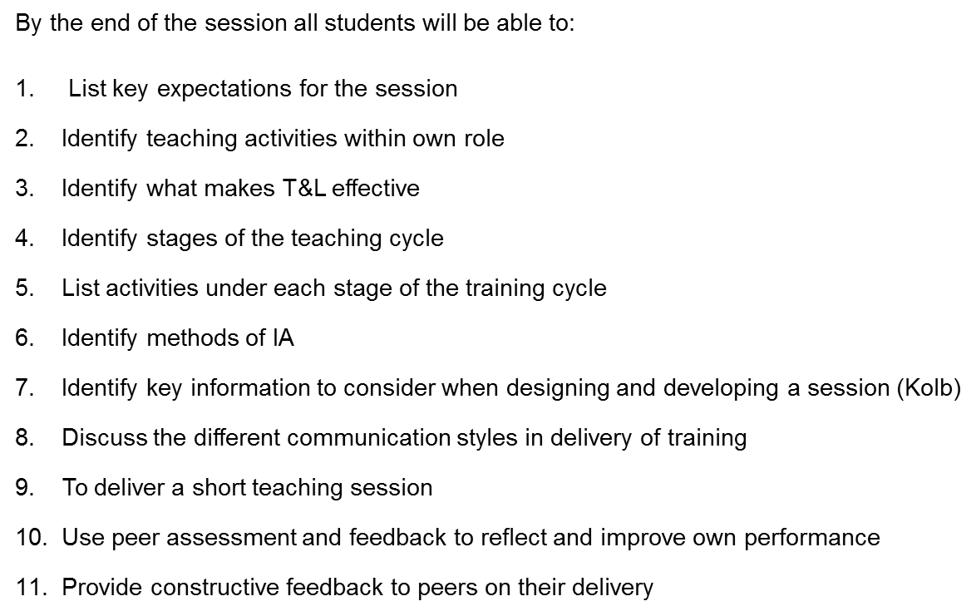
Learning Outcomes

Slide 3
Getting to know you
What are your expectations of the day?
When have you experienced effective training?
What made it effective?

Slide 4
The Teaching Cycle

Slide 5
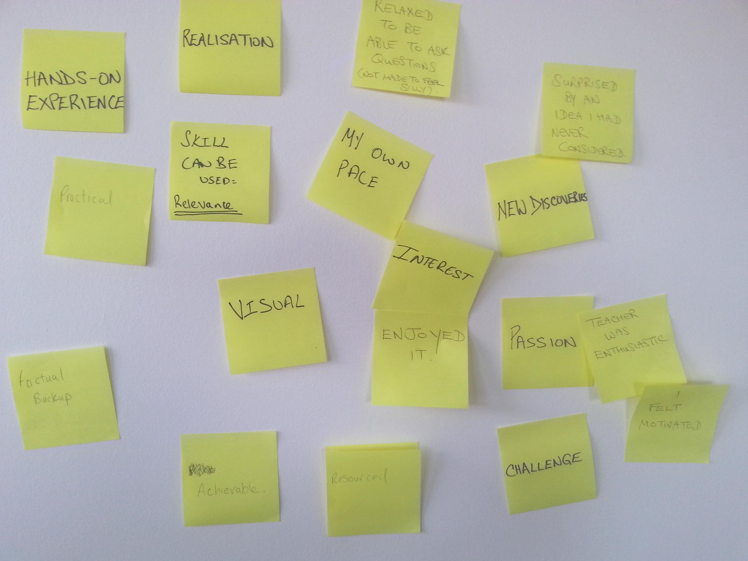
Effective Learning
@HEaTEDtechs
#HEaTEDcourse

Slide 6
Training Needs Analysis
Before running any training you need to know what experience and knowledge your students already have and what training they need
How do you find out?
Ask them
Ask lecturer
Questionnaires
Prior performance
Check lists
@HEaTEDtechs
#HEaTEDcourse

Slide 7
What?
Learning styles
Age
Gender
Disability
Learning difficulty
Cultural, ethnic and religious background
Interests and preferences
Socio-economic background
@HEaTEDtechs
#HEaTEDcourse

Slide 8
How do you know they are learning?
What can you do?
Methods of assessment:
Observation
Questioning
Learning from each other
@HEaTEDtechs
#HEaTEDcourse

Slide 9
Feedback
make it specific and about what happened
positive language (no buts‘)
try not to be judgemental
try not to use I feel
keep it factual an analysis of what happened
link feedback to the future (idea’s and options)
What about you? How do you gather evaluation feedback on your training?
@HEaTEDtechs
#HEaTEDcourse

Slide 10
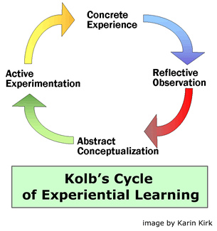
@HEaTEDtechs
#HEaTEDcourse

Slide 11
Learning - a cyclical model
CONCRETE EXPERIENCE
(Doing/having the experience)
REFLECTIVE OBSERVATION
(Reviewing/reflecting on the experience)
ABSTRACT CONCEPTUALISATION
(Concluding/learning from the experience)
ACTIVE EXPERIMENTATION
(Planning/trying out what you have learnt)
Kolbs cycle of Experiential Learning (1984)
@HEaTEDtechs
#HEaTEDcourse

Slide 12
CONCRETE EXPERIENCE
(Doing/having the experience)
ACTIVIST
REFLECTIVE OBSERVATION
(Reviewing/reflecting on the experience)
REFLECTOR
ABSTRACT CONCEPTUALISATION
(Concluding/learning from the experience)
THEORIST
ACTIVE EXPERIMENTATION
(Planning/trying out what you have learnt)
PRAGMATIST
@HEaTEDtechs
#HEaTEDcourse
Kolb (1984) v Honey & Mumford (1982)

Slide 13
What do you do?
How did you prepare the session you have brought with you today?
What did you consider as you prepared?
@HEaTEDtechs
#HEaTEDcourse

Slide 14
Aim(s) and
Learning Outcomes
Think about….
What you want to achieve and why is it important for the learner? (aim)
‘the aim of this session is to … so that’
What you specifically want the learners to achieve? (learning outcomes)
‘by the end of this session you will…’
@HEaTEDtechs
#HEaTEDcourse

Slide 15
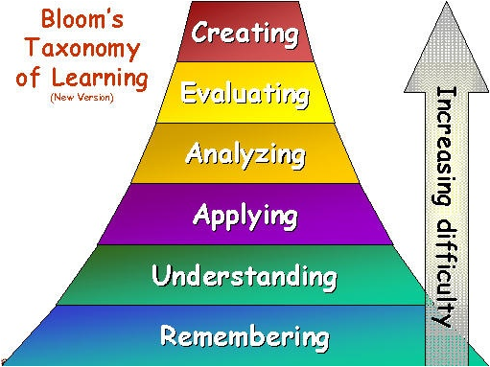
Learning outcomes
@HEaTEDtechs
#HEaTEDcourse

Slide 16
Learning Outcomes
build, design, plan, produce,devise, invent
test, detect, experiment, judge, monitor
compare, organise, integrate
Operate, share, upload, use, implement
compare, explain, summarise
list, name, identify, locate, describe
@HEaTEDtechs
#HEaTEDcourse

Slide 17
Inclusion
“recognises that each learner is different from other learners in many ways, and should not be excluded from any activities within a session for any reason”. (p21)
Gravells, A. & Simpson, S. (2008) Planning and Enabling Learning in the Lifelong Learning Sector. Exeter: Learning Matters.
@HEaTEDtechs
#HEaTEDcourse

Slide 18
How to respond to individual needs?
Differentiation: “...identifying and addressing the different needs, interests and abilities of all learners to give them the best possible chance of achieving their learning goals”
(DfES. (2004). Standards Unit, Improving differentiation in business education. London: Crown Copyright.)
How?
@HEaTEDtechs
#HEaTEDcourse

Slide 19
How can you achieve it?
Prepare questions and activities at different levels
Resources/ activities/ classroom management adapted for specific learners
Think of the strategies to provide individual support (1-2-1; pairing; grouping)
@HEaTEDtechs
#HEaTEDcourse

Slide 20
Effective Communication
@HEaTEDtechs
#HEaTEDcourse

Slide 21
The Learning Pyramid How well information is retained
Demonstration
5%
Audio-visual
10%
Lecture
20%
Teaching others / immediate use of learning
30%
Reading
50%
75%
Discussion groups
90%
Practice by doing
@HEaTEDtechs
#HEaTEDcourse

Slide 22
Structuring Your Learning
Task
Using the information from today create a plan for the micro-teach session you will be doing later this afternoon.
Use the plan you did first thing this morning as a point of reference to help you.
@HEaTEDtechs
#HEaTEDcourse

Slide 23
Delivering your
training
In small groups you will be delivering your 10 minute training
For each training slot there will be a presenter and 2 ‘students’ - These roles will be rotated so everyone has a go
Each turn will have 15mins, 10 min for delivery (tops) and 5 minutes changeover time.
@HEaTEDtechs
#HEaTEDcourse

Slide 24
Feedback/Reflection
What did you learn from observing others?
What did you learn from feedback from others?
What will you do differently as a result?
@HEaTEDtechs
#HEaTEDcourse

Slide 25
Learning Outcomes

Slide 26
Follow up
More information about Higher Education Academy awards here
More information about professional registration for Technicians here
@HEaTEDtechs
#HEaTEDcourse

Slide 27
HEaTED Member Benefits
Institutional and Individual Membership – sign up online
Biweekly eNewsletter and biannual Updates
Training Directory with over 250 specialist courses
Access to over 60 ‘Useful Guides’ soft skills resources
Free Regional Network Events in every region
Competency Assessment Toolkit for Technical Staff
Support to deliver your own courses
Sign posting routes to Professional Registration
Online Community Groups
Annual Conference
@HEaTEDtechs
#HEaTEDcourse
Notes:
Please include this slide and ask all attendees to ensure that they are individually registered on the HEaTED website, if they are from member institutions (a full list of member institutions is available on the website) then it is FREE for them to sign up and signing up will ensure they are able to hear about and access the full range of HEaTED member benefits.

Slide 28
Contact HEaTED
HEaTED Central Team
admin@heated.ac.uk
01904 328173
@HEaTEDtechs

