Slide 1


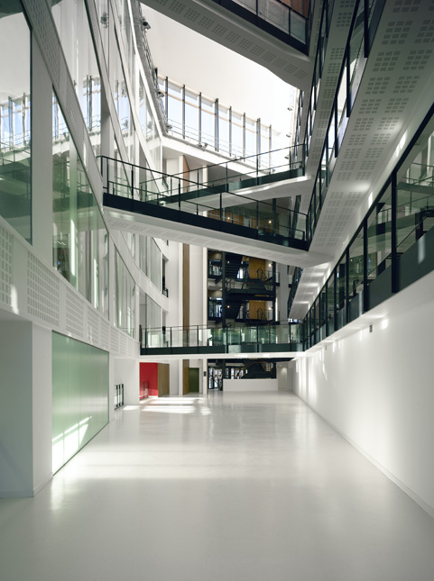
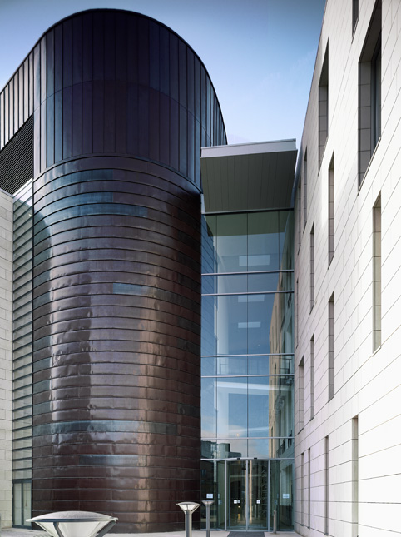
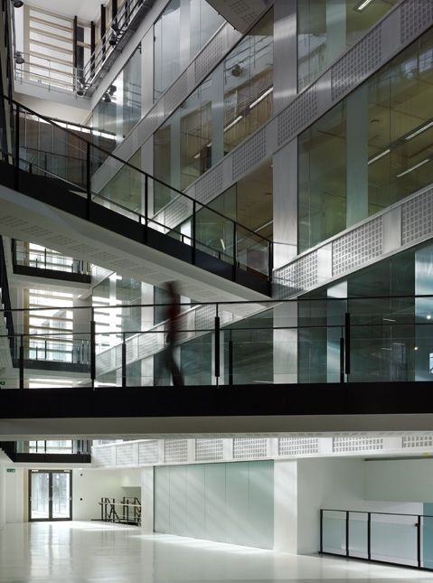
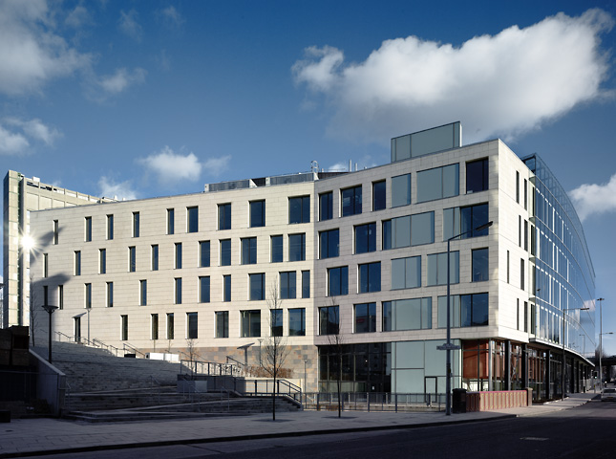
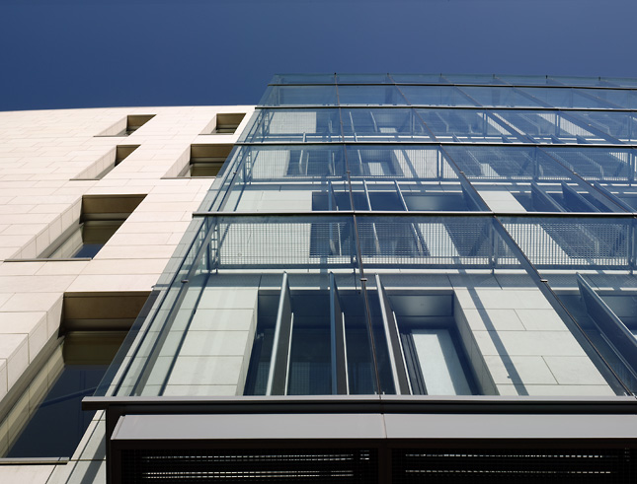
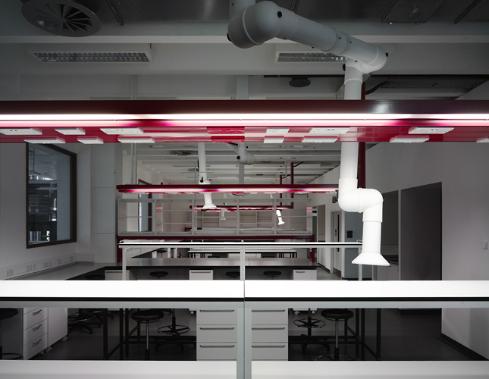
Past, Present and Future – how I came to support SYNBIOCHEM
Sandra Taylor, Senior Research Technician, BSc (Hons), MPhil, RSci, MIScT
sandra.taylor@manchester.ac.uk

Slide 2
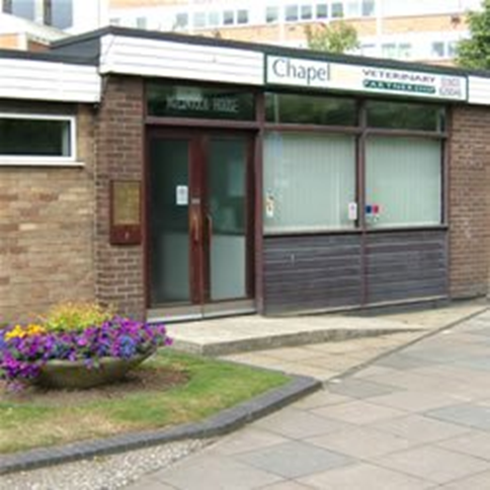
Small beginnings in Norwich, after my first degree
1987 - First lab job veterinary tests Bacteriology post mortems) blood, urine, faeces tests etc.

Slide 3
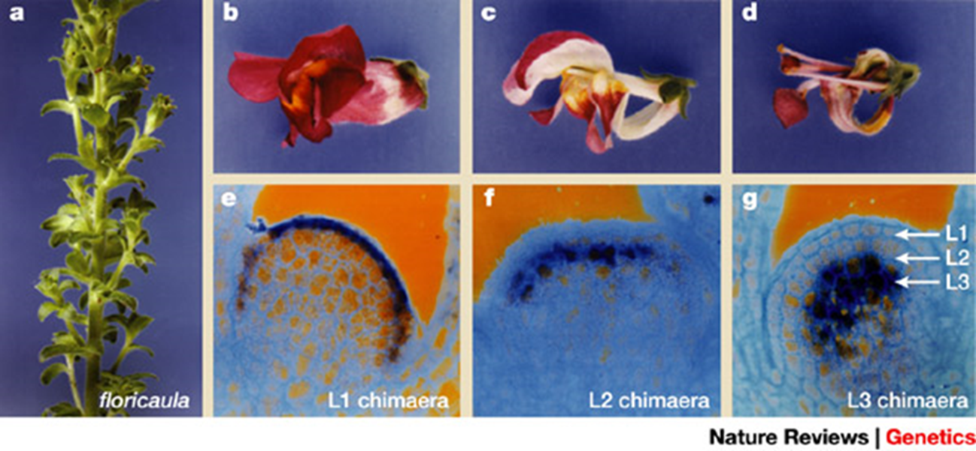
Plant Molecular Genetics
1988 to 1998 – the lab grew from 6 to 16 people and several papers were published on the way that flowering is controlled.

Slide 4
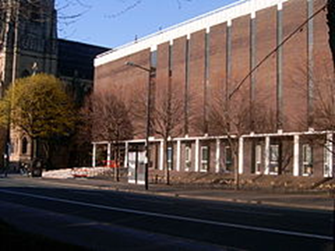
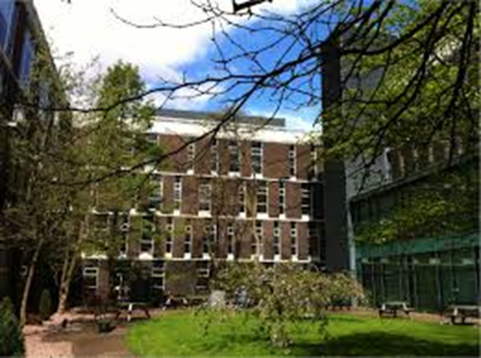
1998 to 2001: Biochemistry Division, School of Biological Sciences, Manchester University – I supported 6 research groups, sharing expertise.
Topics from cell division (in toads) to asthma (in horses and people), and cultured human cells.

Slide 5
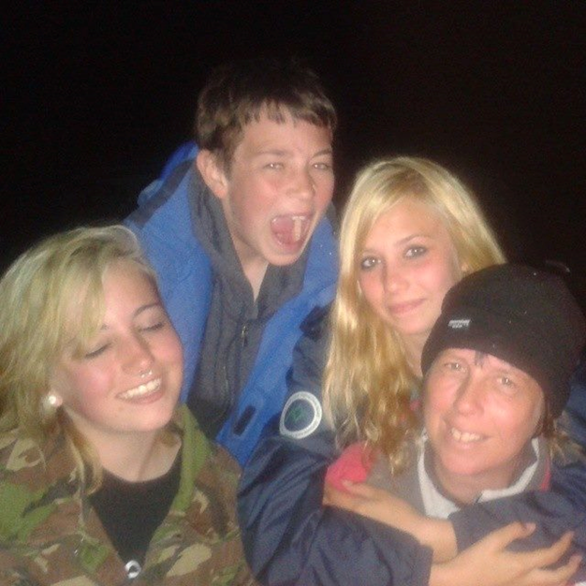
Career Break from 2001 to 2007
Starting again after 6 years was a challenge but I soon got back up to speed. Technical roles are very varied, never boring, a bit like being a Mum!

Slide 6
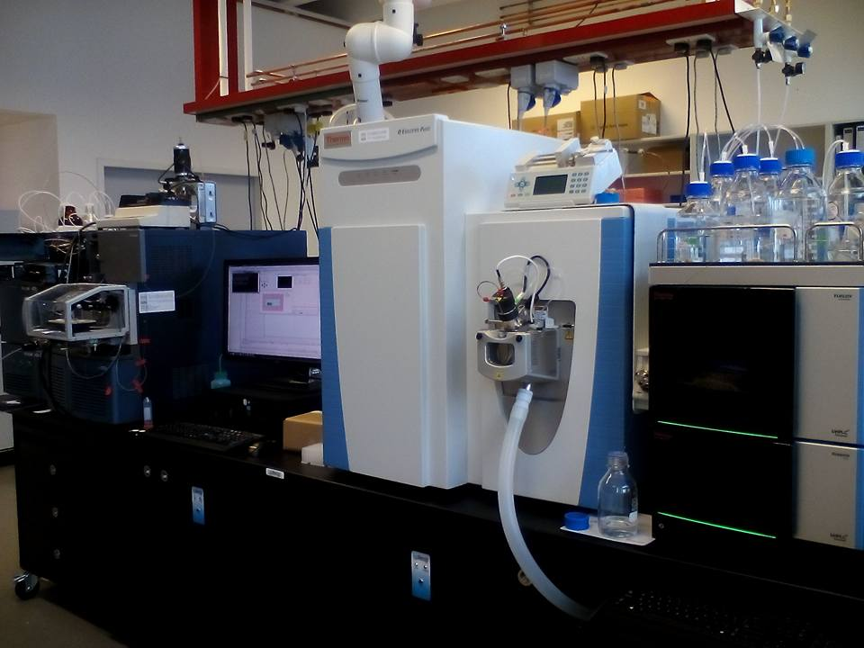
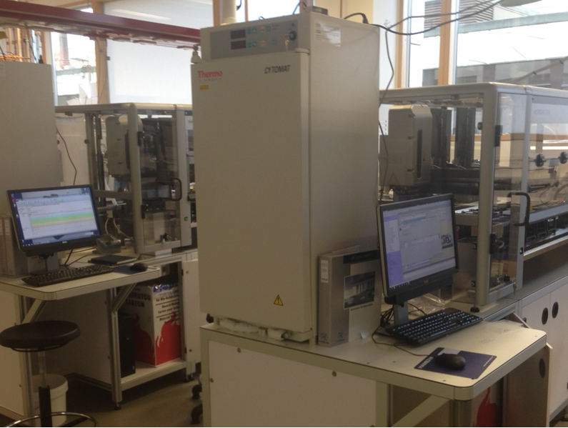
2007 to present
I spent 7 years in the Michael Smith Building (Life Sciences) – various roles (cell culture, cloning, yeast two-hybrid)
In 2014 I moved to the MIB – more Chemistry/Biochemistry focussed

Slide 7
Present Challenges Supporting SYNBIOCHEM
New subject(s) and equipment to learn about
The new SYMBIOCHEM team is 10 people and 4 robots!
IT technology means writing electronic lab notebooks instead of paper ones!
The new team is multidisciplinary so lots to learn but good fun!
And this is the age of writing DNA as opposed to just reading it!

Slide 8
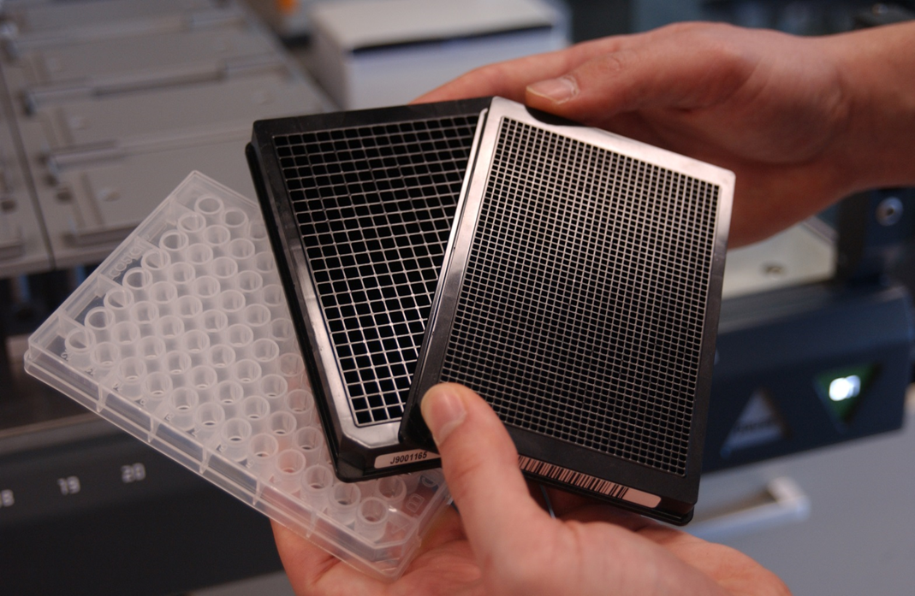
Nano-scale 3D printing?!
Micro-titre plates with 96, 384 or even 1536 sample wells – technology is being developed to “write” strings of DNA into these tiny wells using 3D nano-printing technology.

Slide 9
Sometimes a job is what you make it…
Lab organisation/ordering/health and safety etc
Research/analysis/own training/training others
Writing/presenting/conferences
Collaborations
New projects, new supervisors, new challenges
Notes:
By means of an example Paddon et al. (Kiesling lab) assembled the genes identified in green into a pathway and expressed them in yeast, allowing them to produce high yields of the compound artemisinic acid, a precursor to artemisinin which is used to treat malaria.
ARE WE OK USING FIGURES PULLED FROM NON-OPEN ACCESS PAPERS?
It’s important to understand that there are several levels of complexity that occur when expressing pathways in a chassis. The pathway itself may not be optimal, and when expressed in the context of the chassis and it’s own metabolic pathways there are added complications of pathway fluxes, toxicity, etc. This section focusses on experimental ways to optimise these pathways, aside from the modeling that can be done at the outset.
KEY POINT:
In synthetic biology optimisation can be done through a variety of methods:
1) Engineering the pathway expression levels (constitutive expression)
2) Controlling when (temporal) the parts of the pathway are expressed
3) Controlling where (spatial) they are synthesised/localised in the cell.

Slide 10
And to keep a fresh outlook
Life long learning
Higher education (part time MPhil)
Continuing Professional Development
Organising speakers for seminars/network meetings
Professional Registration/trained assessor
Always take any opportunities offered
Always ask!

Slide 11


Slide 13

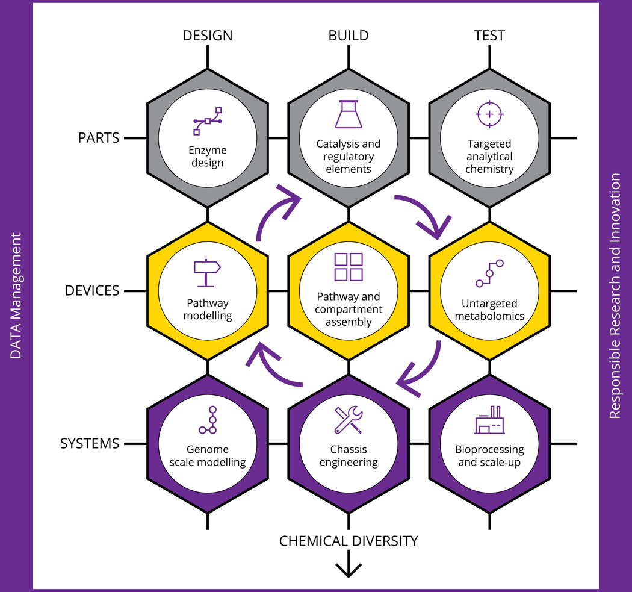
DESIGN-BUILD-TEST (What is SYNBIOCHEM?)

