Slide 1
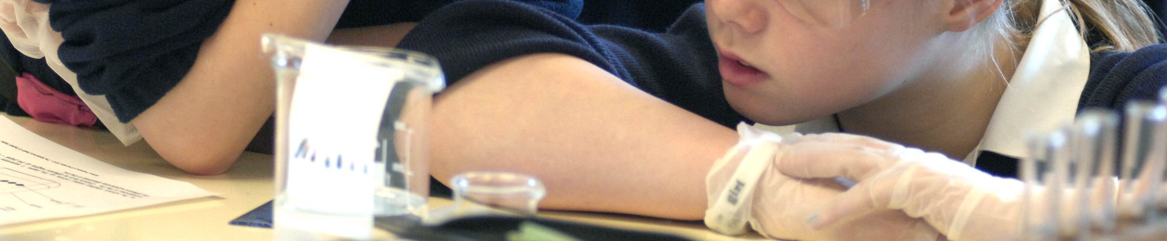

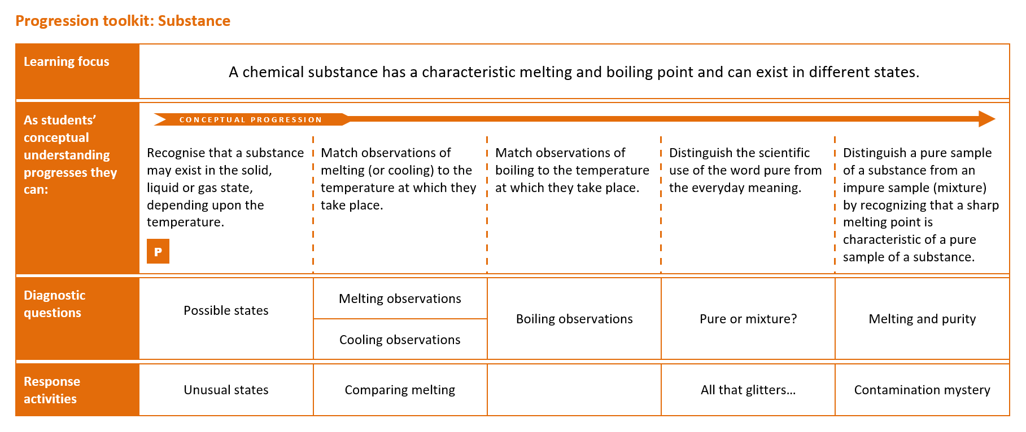
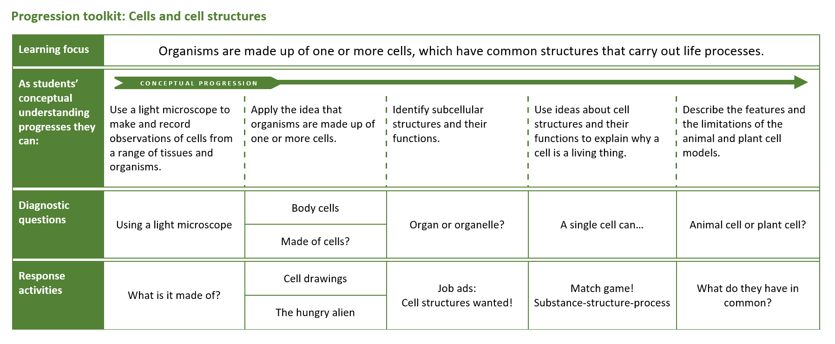
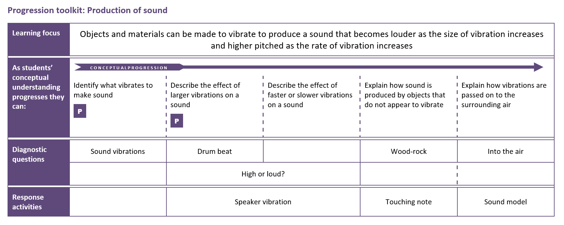
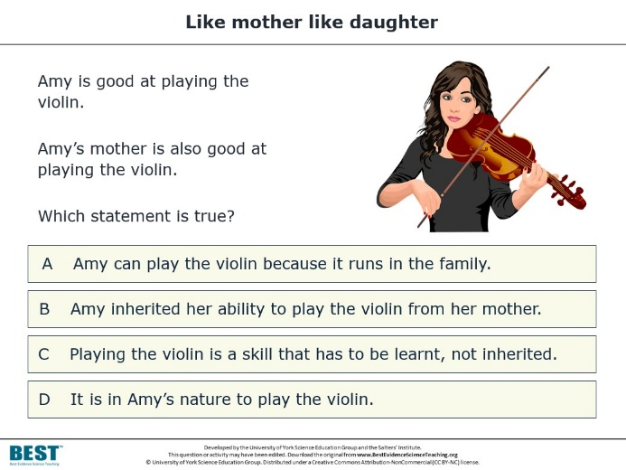
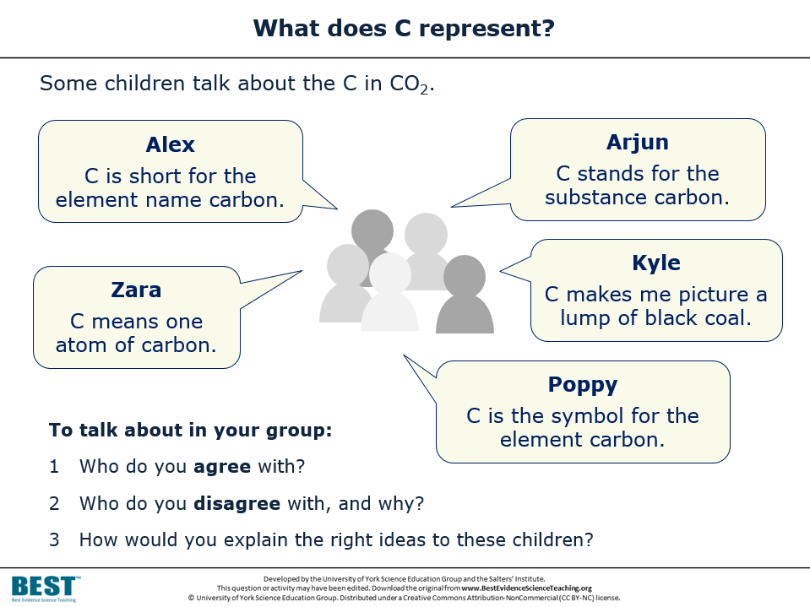
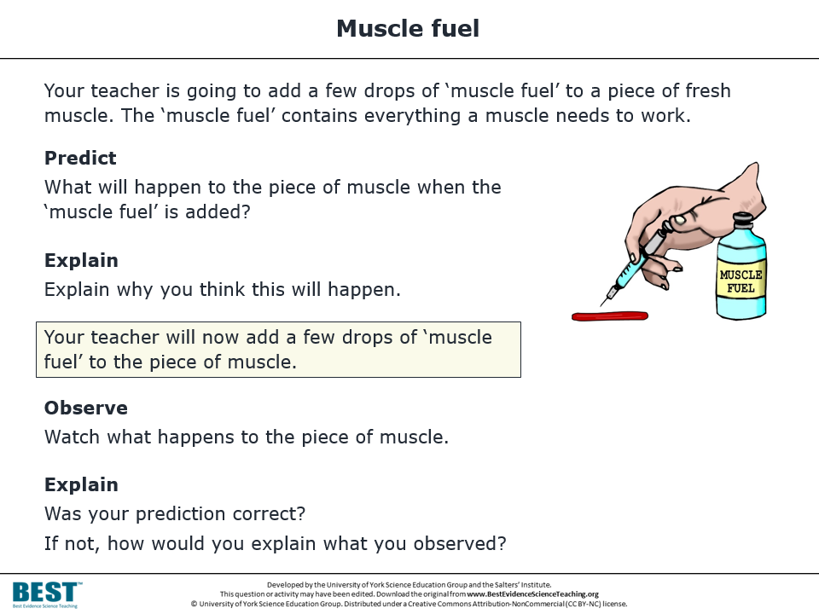




Progression toolkits
Based on research evidence
The best teaching draws on the best evidence.
Notes:
Best Evidence Science Teaching (BEST) is a new collection of resources developed from research evidence to help teachers develop evidence-based practices in their classrooms.
The resources are being developed by the University of York Science Education Group, a team of science education researchers and curriculum developers based at the University of York, UK. For over 35 years the group has been engaged in evidence-informed curriculum development, which means taking the best research evidence we can find and transforming it into resources for science teachers to use in the classroom. Much of our work has been done in collaboration with the Salters’ Institute, and we’re happy to be working with them once again on Best Evidence Science Teaching.
The great news is that thanks to the generous support of the Salters’ Institute, and a collaboration with STEM Learning, all of the Best Evidence Science Teaching resources are being made available online for FREE to support science teaching.

Slide 2

What’s
?

Slide 3

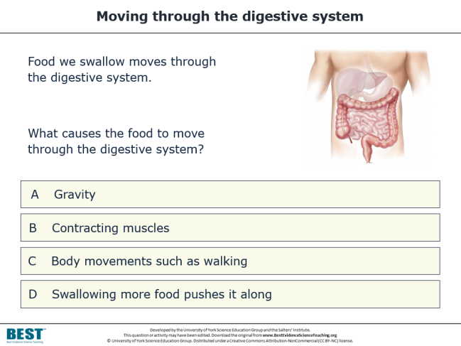
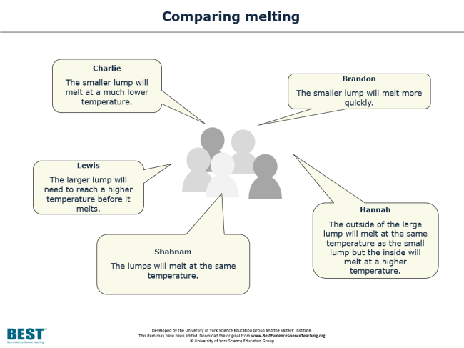

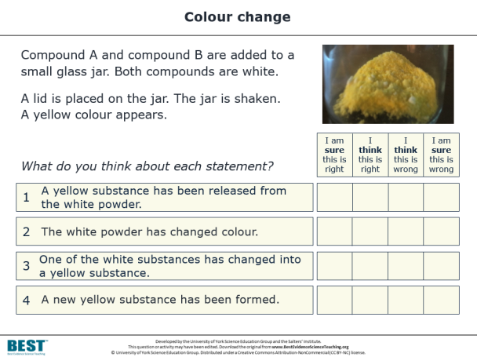
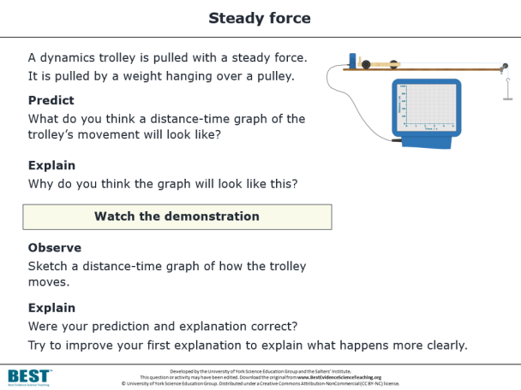





950+
Based on research evidence
ONLINE OPEN-ACCESS FREE
resources
PROGRESSION TOOLKITS
DIAGNOSTIC QUESTIONS
RESPONSE ACTIVITIES
…to help teachers develop evidence-based practices.
…to help develop students’ understanding of key concepts in science.
Notes:
In a nutshell, Best Evidence Science Teaching is a collection of over 950 resources for science teachers, all developed from research evidence and all online, open access and completely FREE to use.
There is a vast body of published research into school students’ understanding of science, their preconceptions and common misunderstandings. We’ve surveyed that research literature systematically for all of the key concepts you’ll be teaching in lower secondary science, and turned it into a series of diagnostic questions – short, formative assessment items that you can use quickly and easily in lessons to collect evidence of students’ understanding and of what preconceptions and misconceptions they hold.
Often the research will describe ways in which you could respond to the presence of misconceptions in your students – including interventions, activities and constructivist approaches that you could use to build on your students’ preconceptions and misconceptions, and to move their thinking on towards the kind of scientific understanding we would wish them to have. We’ve written those up into what we’re calling response activities, which are paired up with the diagnostic questions.
And we’ve gone a little further than that. There’s a lot of research into learning progressions and effective sequencing of ideas in science that help to build understanding. For each key concept we’ve developed progression toolkits, which you can use to help move your student’s thinking on.
The entire collection is online and completely FREE to use. We’ve developed these resources at the University of York with the support of the Salters’ Institute to support science teaching and learning. We want to help science teachers to begin developing evidence-based practices in their classrooms, ultimately to help students to develop their understanding of key concepts in science. We aim to do that by making research evidence-informed resources freely and easily accessible to teachers.

Slide 4
Why
?

Slide 5



High-level calls for evidence-based practice
We want a high quality teaching profession which embraces evidence-based practice to drive up standards in schools.
DfE white paper: Educational Excellence Everywhere (2016)
Educational policy and practice should be informed by the best available research evidence. There is increasing recognition of the need for the teaching profession to be research-informed.
The Royal Society & The British Academy, Harnessing Educational Research (2018)
Notes:
There have been high-level, policy-level calls for teachers to engage in evidence-based practice.
In 2016 the DfE published a white paper called Educational Excellence Everywhere, in which they said “We want a high quality teaching profession which embraces evidence-based practice to drive up standards in schools.” In 2018, the Royal Society and the British Academy jointly published a report called Harnessing Educational Research, in which they said that “educational policy and practice should be informed by the best available research evidence.”
I’m sure we’d all agree with that, and in fact this is nothing new. The notion that evidence-based teaching is a good thing is not a new idea. And yet these calls persist – because there are considerable challenges in making it happen. It’s very difficult for teachers to bridge the gap between research evidence and what they do in class.

Slide 6
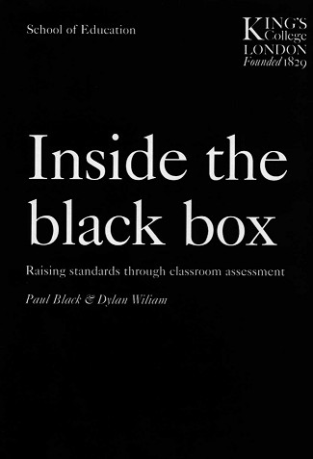

The challenges of transforming evidence into practice
Teachers will not take up attractive-sounding ideas, albeit based on extensive research, if these are presented as general principles... their classroom lives are too busy for this to be possible.
What they need is a variety of living examples of implementation.
Paul Black and Dylan Wiliam,
Inside the Black Box (1998)
Teachers are seeking to develop strategies that make best use of evidence.
Research organisations and intermediary bodies need to transform evidence for practice
[if it is to be effectively utilised by teachers].
NFER, Using Evidence in the Classroom: What Works and Why? (2014)
What they need is a variety of living examples of implementation.
Notes:
In Inside the Black Box, published in 1998, Black & Wiliam highlight one of the main barriers: classroom teachers are just too busy to systematically survey and distil research evidence into something that can be used in a class next week, next term or next year. There are other challenges as well. Much of the research is published in academic journals that schools don’t subscribe to, so the papers are hidden behind paywalls and teachers often can’t read more than the title and abstract.
Even if a teacher does have time to engage with science education research, one of the biggest hurdles they are likely to face is the question: where do I start?
Black & Wiliam go on to say that what teachers need is a variety of living examples of implementation. One way to provide that is with ready-made resources that teachers can use, which include information about the underpinning research evidence and data – where available – from classroom trials. From these, teachers can start to work out what might work – and then what does work – in their own classrooms.
In 2014 the NFER suggested that “intermediary bodies need to transform evidence for practice” - and that’s exactly what we’re doing with Best Evidence Science Teaching. The project is a mammoth undertaking, which is aiming to make high-quality, research-evidence informed resources freely and widely available to teachers.

Slide 7
example

Slide 8

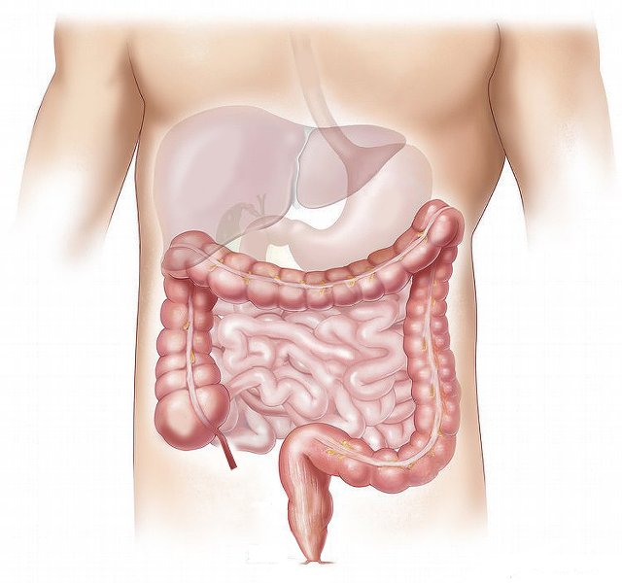
Moving through the digestive system
Food we swallow moves through the digestive system.
What causes food to move through the digestive system?
A
Gravity
B
Contracting muscles
C
Body movements such as walking
D
Swallowing more food pushes it along
Notes:
This is one of our diagnostic questions, taken from the over 950 resources that we’ve published so far. It’s a diagnostic question, aimed at lower secondary school students (age 11-14). It assesses understanding of the key concept that muscles are an essential part of organ systems.
The best answer is B – contracting muscles (a.k.a. peristalsis) is what is principally responsible for moving food through the digestive system. The other options, or ‘distracters’ as well call them, are misunderstandings that have been reported in the research literature as being common misunderstandings in children of lower secondary age.

Slide 9
Research evidence
When children up to age 15 were asked to draw what is inside the human body, most drew organs but very few drew muscles, and when muscles were drawn they were commonly only depicted in the limbs.
Reiss, M. J., et al. (2002). An international study of young peoples' drawings of what is inside themselves. Journal of Biological Education, 36(2), 58-64.
Bartoszeck, A. B., Machado, D. Z. and Amann-Gainotti, M. (2011). Graphic representation of organs and organ systems: psychological view and developmental patterns. EURASIA Journal of Mathematics, Science & Technology Education, 7(1), 41-51.
Rosalind Driver’s review of the research literature suggested that there was no evidence that school-age children recognise the involvement of muscles in the digestive, circulatory and respiratory systems.
Driver, R., et al. (1994). Making Sense of Secondary Science: Research into Children's Ideas, London, UK: Routledge.
Several studies have found that children from ages 4 to 10 do not appreciate that food is pushed through the digestive tract by waves of muscle contraction (peristalsis), believing instead that gravity and body movements such as walking and bending are responsible.
Teixeira, F. M. (2000). What happens to the food we eat? Children's conceptions of the structure and function of the digestive system. International Journal of Science Education, 22(5), 507-520.
AHİ, B. (2017). Thinking about digestive system in early childhood: a comparative study about biological knowledge. Cogent Education, 4(1).
Notes:
The question was built from research evidence on common preconceptions and misunderstandings that school-age children have, and you can see some of that summarised here. The research suggests that children tend to be more focussed on organs rather than muscles when thinking about what’s inside them, they don’t tend to think about the presence and roles of muscles in organs systems, and they think that food just moves through the digestive tract because of gravity or because other body movements such as walking help the food to be shuffled along.
To find, and access, this kind of research is often not easy for busy teachers. We’re working to locate this evidence for you, and using it to build good diagnostic questions.

Slide 10
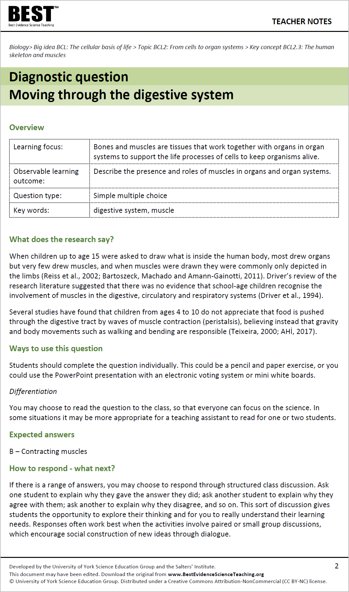
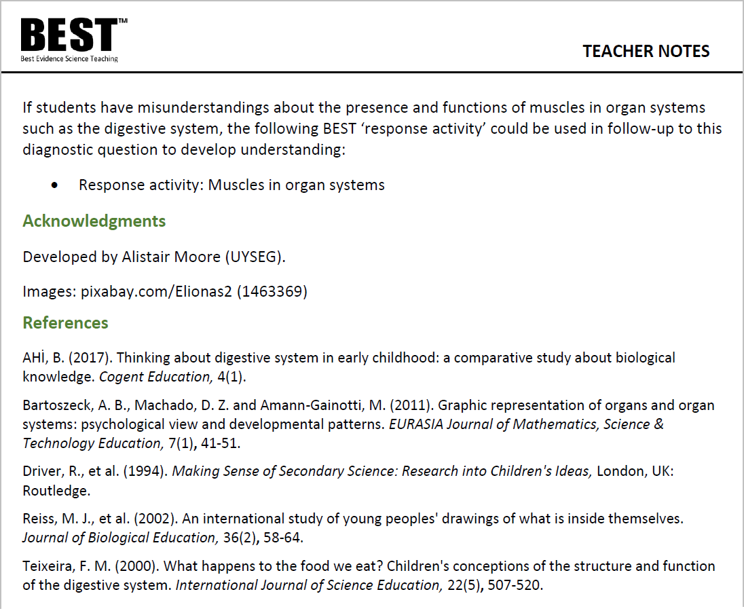

Evidence-informed practice
Teacher notes summarise the research evidence underpinning each resource.
Notes:
Every one our 950+ resources is provided with teacher notes that include a section called “What does the research say?”. That section provides a short summary of the underpinning research and useful teaching approaches. It’s usually just a couple of paragraphs, so it’s quick and easy to ready – but might just give a teacher an insight into some research that they wouldn’t otherwise have been able to access. We also provide the complete citations, for anybody who wishes to read further.
From trials in schools, we have some evidence these research notes can function as miniature episodes of self-directed professional development, which can lead to small but impactful changes in classroom practices.

Slide 11
Moving through the digestive system
Food we swallow moves through the digestive system.
What causes food to move through the digestive system?
A
Gravity
Editable
resources
B
Contracting muscles
C
Body movements such as walking
D
Swallowing more food pushes it along
Notes:
This is not an exam question – we’re not necessarily simply looking for students to pick the one expected answer. The pattern of responses in a class provides a picture of the landscape of understanding and misconceptions in the room.
Students may rightly think that gravity and other body movements will have some effect on the movement of food through parts of the digestive system. The diagnostic question can be used to build up a picture of what students in a class are thinking, and it’s useful to know if some students want to pick more than one answer. The question can then be used as the basis for a discussion with students; for example: why did they pick the answers they did? What do they think are the relative contributions of these factors in moving food through the digestive system? What would their answer be if the question was asked about a person who was lying down, or was motionless because they are asleep, or was an astronaut in space?
The diagnostic questions in Best Evidence Science Teaching are coupled with ‘response activities’ that will help you to respond effectively. When the evidence provided by a diagnostic question is used to decide what happens next, it becomes truly formative. The “E” in Best Evidence Science Teaching works in two ways – we’re using research evidence to develop the resources, and they provide you with the evidence you need about your students’ knowledge and understanding to help them make progress.
We’re providing all of these resources in editable formats (Word and PowerPoint), so you can tweak the wording to suit your students. And because it’s editable, you can copy and paste the contents into your own presentations.

Slide 12
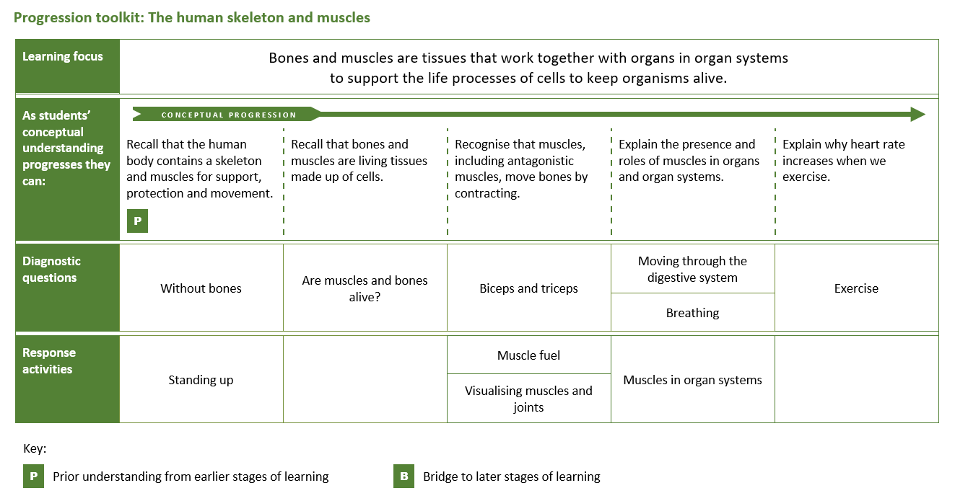

Evidence-informed progression
A progression toolkit helps you to test and develop understanding of a key concept in science.
A research-informed progression pathway describes what students should be able to do as their understanding of the concept develops.
Notes:
We could have provided our diagnostic questions and response activities as an item bank, but we’ve gone a little further than that. There’s a lot of research evidence on learning progressions, on appropriate sequencing of difficult ideas, on effective formative assessment, and on constructivist approaches that can help students to overcome misunderstandings and build scientific understanding.
We’re using that research to build ‘progression toolkits’ for key concepts in science, which include research-informed learning steps that provide a framework for developing understanding of the key concept. For each step in the learning progression, we provide one or more diagnostic questions - these provide evidence of common preconceptions and misunderstandings that may form barriers to developing scientific understanding.
The diagnostic questions are paired with response activities that can help students to overcome misunderstandings and move along the learning progression by building their scientific understanding. Response activities facilitate metacognition – they challenge students to think critically about what they and their piers understand. ‘Meaning making’ is encouraged through group dialogue and purposeful practical work.
We’ve found that trainee teachers, NQTs and teachers who are having to teach outside their specialism find the progression toolkits particularly helpful. Teachers in those positions don’t have the body of experience that helps them to know what the common misconceptions are and how to respond to them to build understanding; the research-informed progression toolkit helps them to do that.

Slide 13

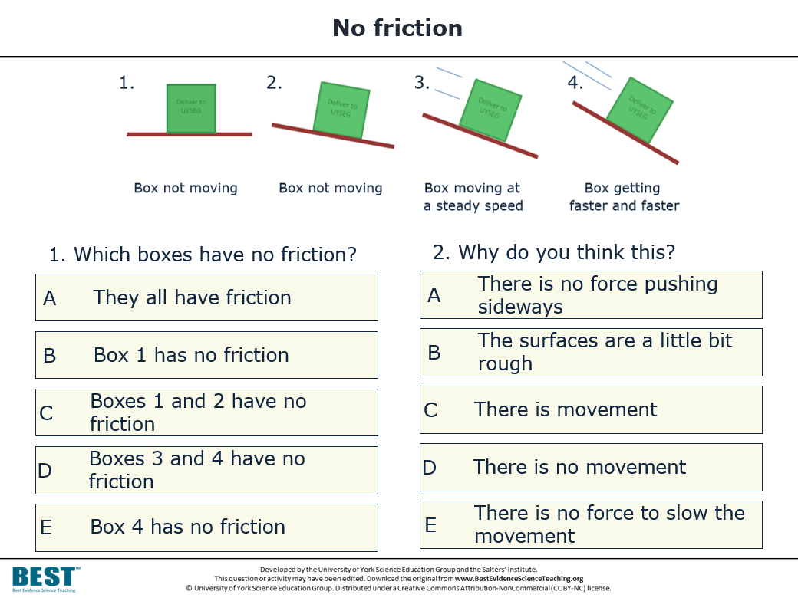
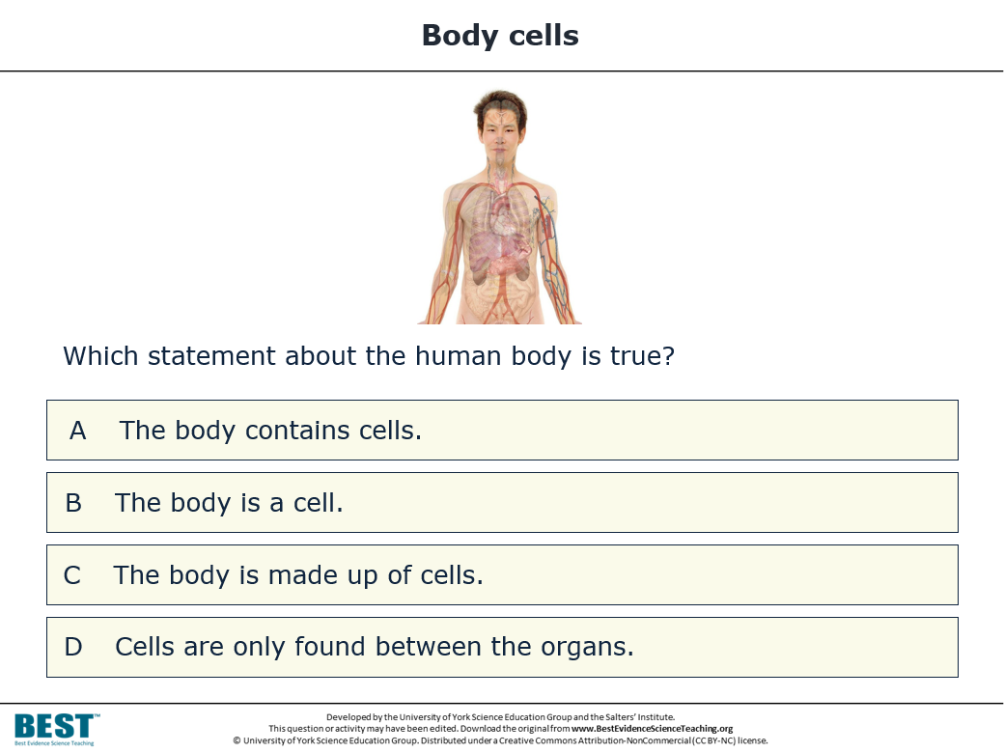
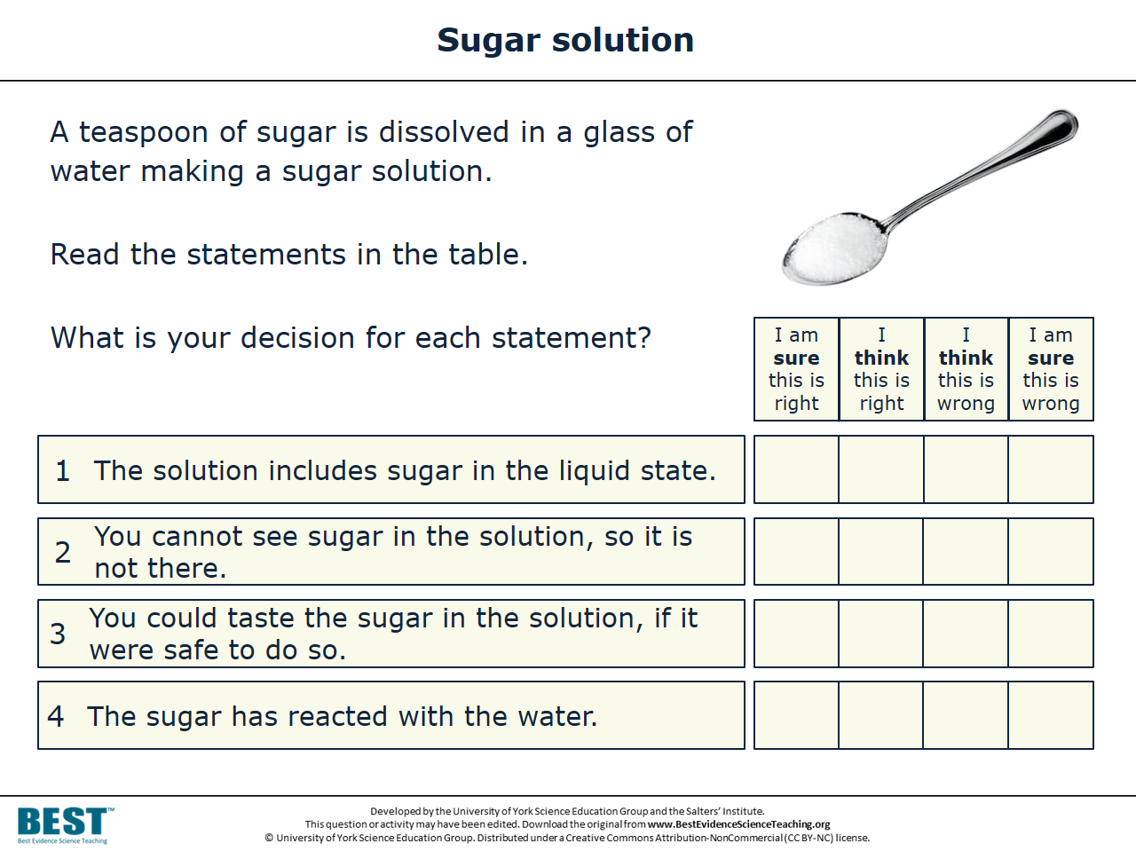
Diagnostic questions
Diagnostic questions help you to collect:
evidence of preconceptions and misunderstandings
evidence of where your students are in their conceptual progression.
They can be used formatively to decide what happens next.

Slide 14
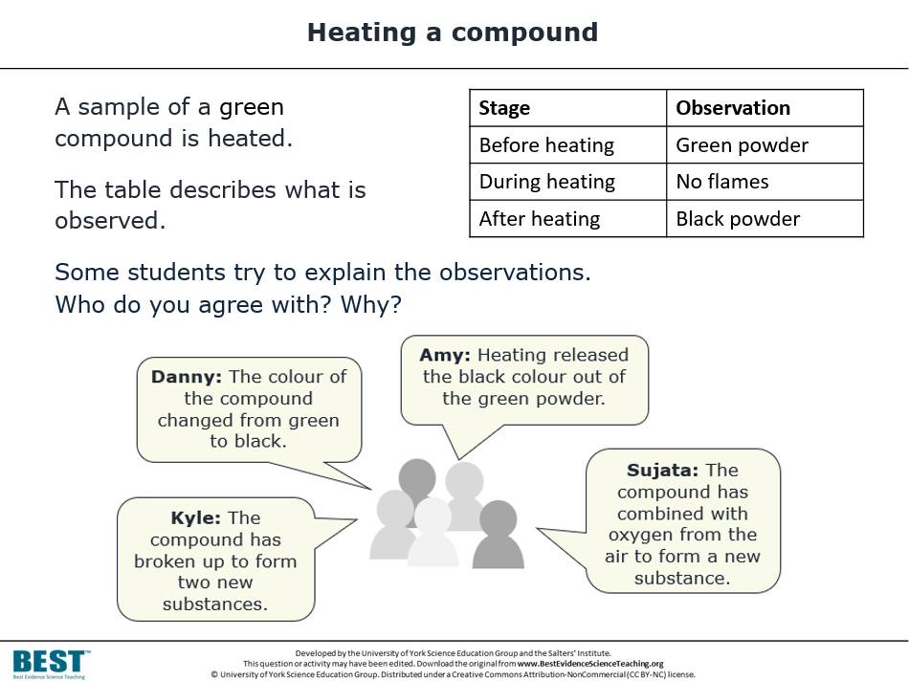
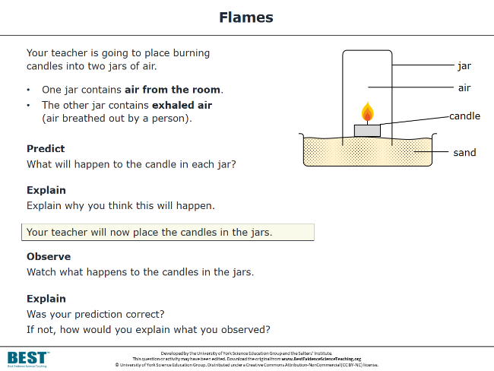
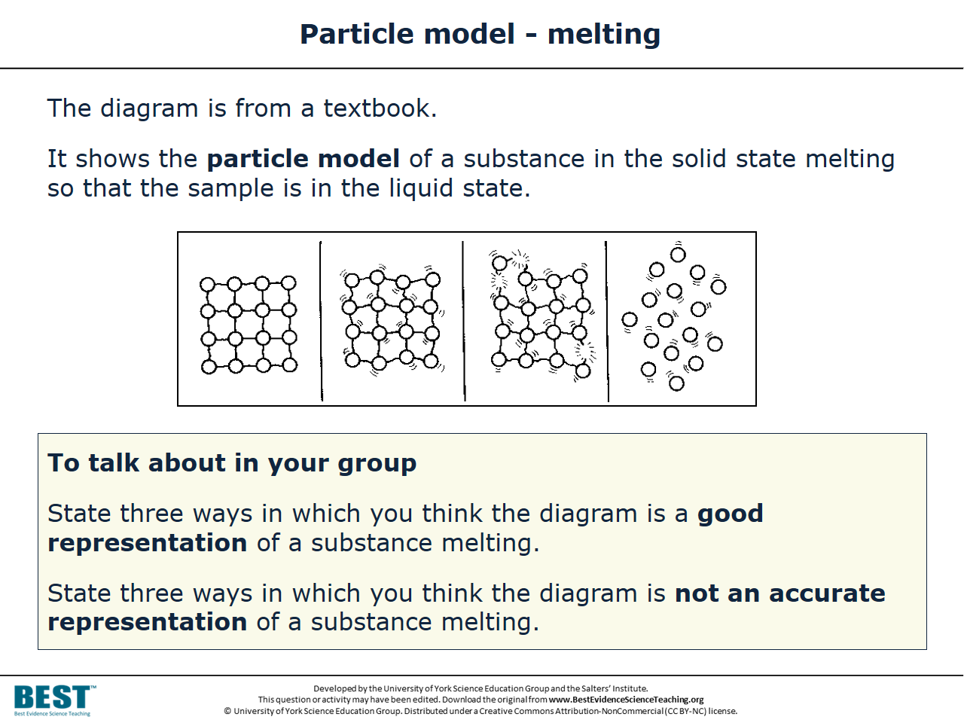
Response activities
Response activities:
facilitate metacognitive talk and dialogue
provide purposeful practical work
encourage meaning-making.
They help to challenge misunderstandings and overcome barriers to conceptual development.

Slide 15

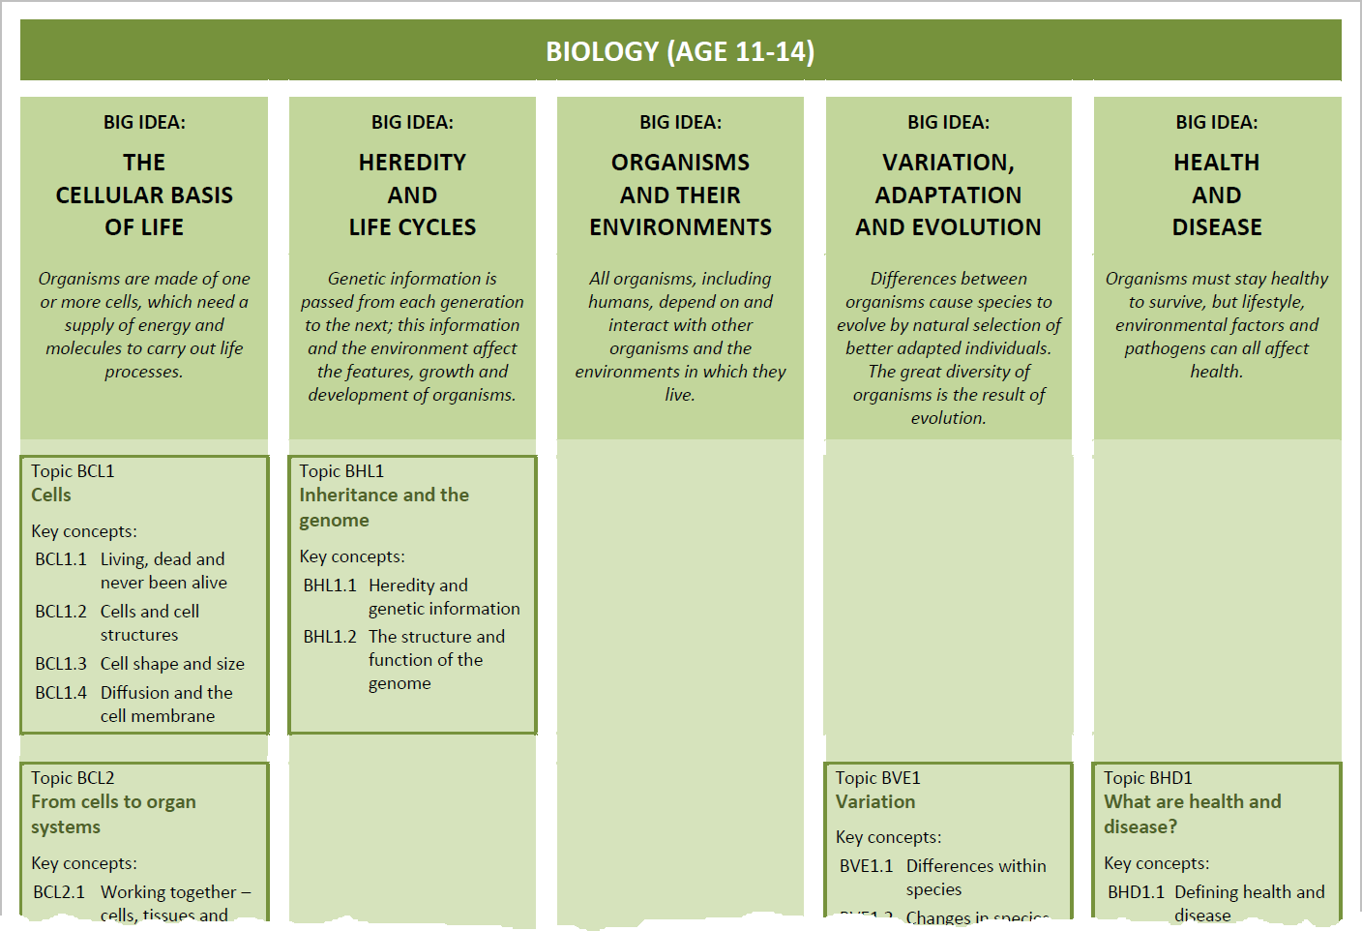

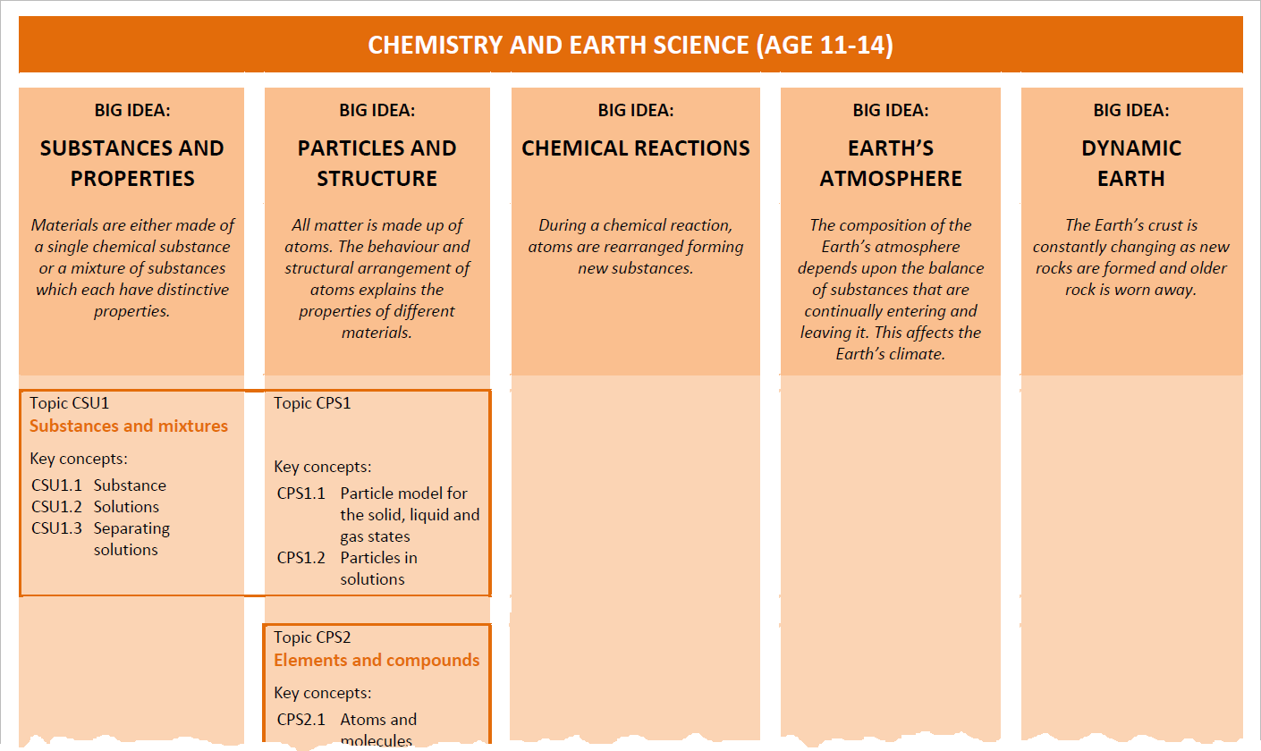

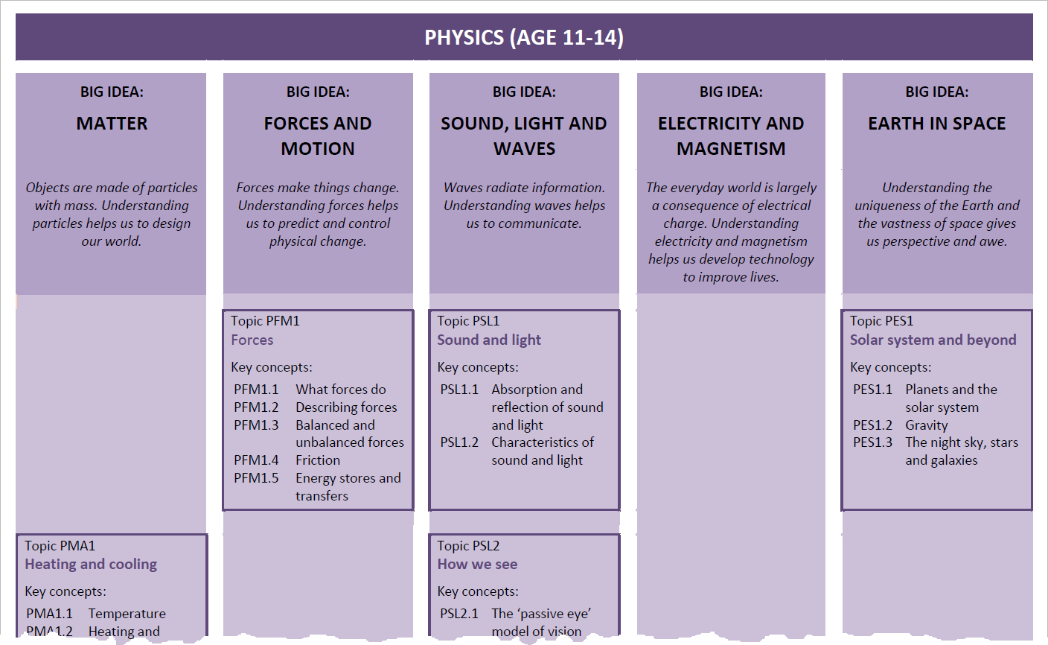
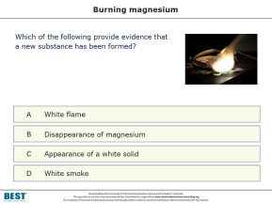
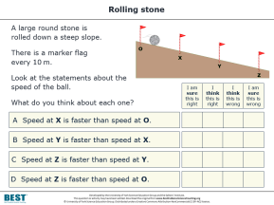
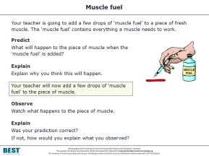
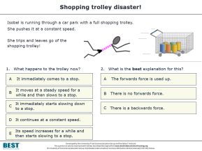
Evidence-informed curriculum planning
The BEST resources can be incorporated into existing schemes of learning…
…or use our research-informed maps to sequence key concepts to build understanding of the big ideas of science.
Notes:
We’ve surveyed the research literature and systematically developed resources for all of the key concepts that teachers will be teaching in secondary science. The key concepts are universal – so the resources are not tied to any particular exam board or specification that you may be teaching at GCSE level, or even to the current iteration of the English National Curriculum. It doesn’t matter where in the world you’re teaching science, or which specification you’re using, the Best Evidence Science Teaching resources cover key concepts that you will be teaching. So you should be able to incorporate them into your existing schemes of work.
We’ve also used research evidence on learning progressions and sequencing of ideas to produce ‘subject maps’. These illustrate how key concepts in science can be sequenced and linked together to build understanding of the big ideas of biology, chemistry, Earth science and physics. So if you find yourself wanting, or being required to, re-develop your secondary science curriculum in school, you may find these helpful. We’ve worked with a couple of schools in Yorkshire who were tasked with redeveloping their Key Stage 3 science curriculum - in one case they were given a single INSET day in which to do so! – and they wanted to base their decisions on some research evidence. They used the research-informed resources in Best Evidence Science Teaching as a starting point.

Slide 16
and
Improving Secondary Science
Notes:
So how might a science teacher use the Best Evidence Science Teaching resources to start developing evidence-based practices in their classroom?

Slide 17
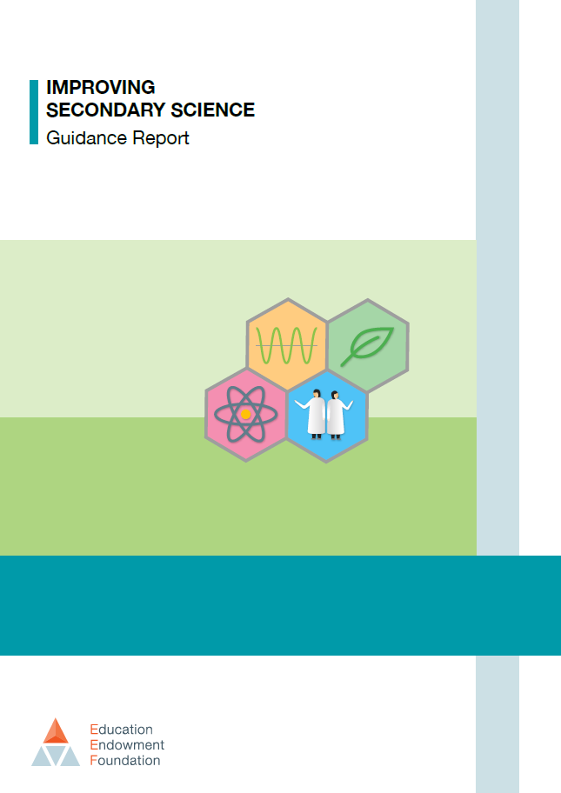
The Education Endowment Foundation (EEF) published a guidance report in 2018 titled ‘Improving Secondary Science’
The report cites Best Evidence Science Teaching as a good source of:
  diagnostic questions
  activities that promote metacognitive talk and dialogue
The report makes seven main recommendations…
Notes:
Coincidentally, as we were developing Best Evidence Science Teaching over the last 5 years, the Education Endowment Foundation (EEF) was developing its Improving Secondary Science guidance report, published in 2018. That report cites Best Evidence Science Teaching as a good source of diagnostic questions and a good source of activities that promote metacognitive talk and dialogue.

Slide 18

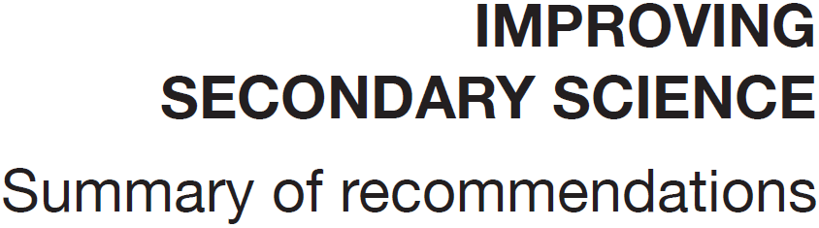
1
Preconceptions
Build on the ideas that pupils bring to lessons
2
Self-regulation
Help pupils direct their own learning
3
Modelling
Use models to support understanding
4
Memory
Support pupils to retain and retrieve knowledge
5
Practical work
Use practical work purposefully as part of a learning sequence
6
Language of science
Develop scientific vocabulary
7
Feedback
Use structured feedback to move on pupils’ thinking
Notes:
The EEF report makes seven main recommendations…
Or, to put it another way, the report identified seven main areas in which the development of evidence-based approaches could help to improve the teaching and learning of secondary science. So these seven areas provide a framework that could help to focus efforts in developing evidence-based approaches in school.

Slide 19
Moving through the digestive system
1
Preconceptions
Build on the ideas that pupils bring to lessons
Food we swallow moves through the digestive system.
What causes food to move through the digestive system?
7
Feedback
Use structured feedback to move on pupils’ thinking
A
Gravity
B
Contracting muscles
4
Memory
Support pupils to retain and retrieve knowledge
C
Body movements such as walking
D
Swallowing more food pushes it along
Notes:
Looking back at the diagnostic question I showed earlier, it’s obviously helping to provide evidence of preconceptions that students might have. The key phrase in EEF recommendation #1 is “Build on…”. When students answer this diagnostic question, it provides feedback from student to teacher about what they’re thinking (recommendation #7). The teacher could then provide feedback to the students about what they’ve misunderstood – perhaps the question could be used as the basis for some dialogic questioning, or students could talk in small groups about what they think are the right and wrong answers – and why. This can help to move their thinking on from their preconceptions towards the scientific understanding we would want them to have – and in doing so, help them to retain and retrieve the knowledge needed to understand key concepts (recommendation #4).

Slide 20
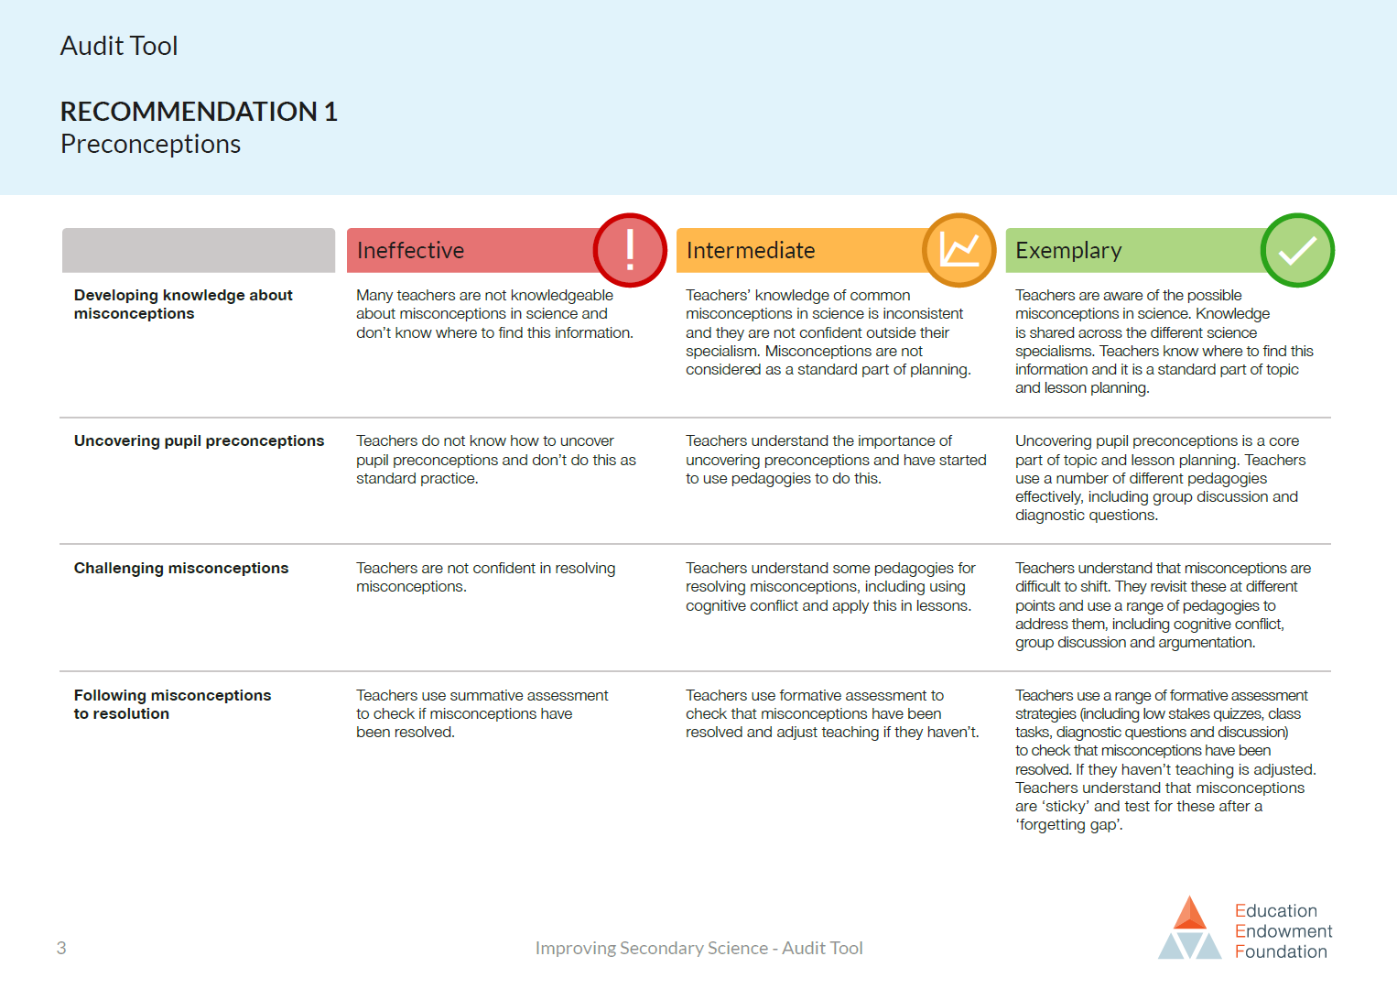
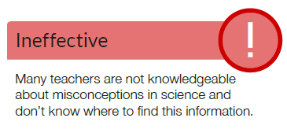
Notes:
The EEF published an ‘audit tool’ to accompany their report, in which they have set out short descriptors of what they think are ineffective, intermediate and exemplary practice in each of the seven areas. This is one page from the audit tool, and it relates to the first area – Preconceptions.
The first row is about teachers’ knowledge of common misconceptions.

Slide 21
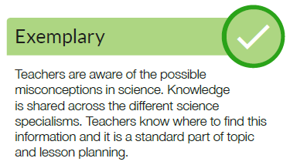
Notes:
It’s easy to see how the resources we’ve developed for Best Evidence Science Teaching could help a teacher to start moving from left to right along those descriptors.

Slide 22
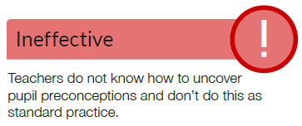
Notes:
The second and third rows are about teachers uncovering and resolving misconceptions in their students’ thinking.

Slide 23
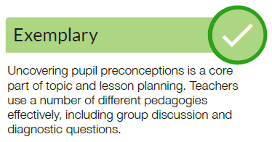
Notes:
Again, it’s easy to see how the resources we’ve developed for Best Evidence Science Teaching could help a teacher to start moving from left to right along those descriptors.

Slide 24
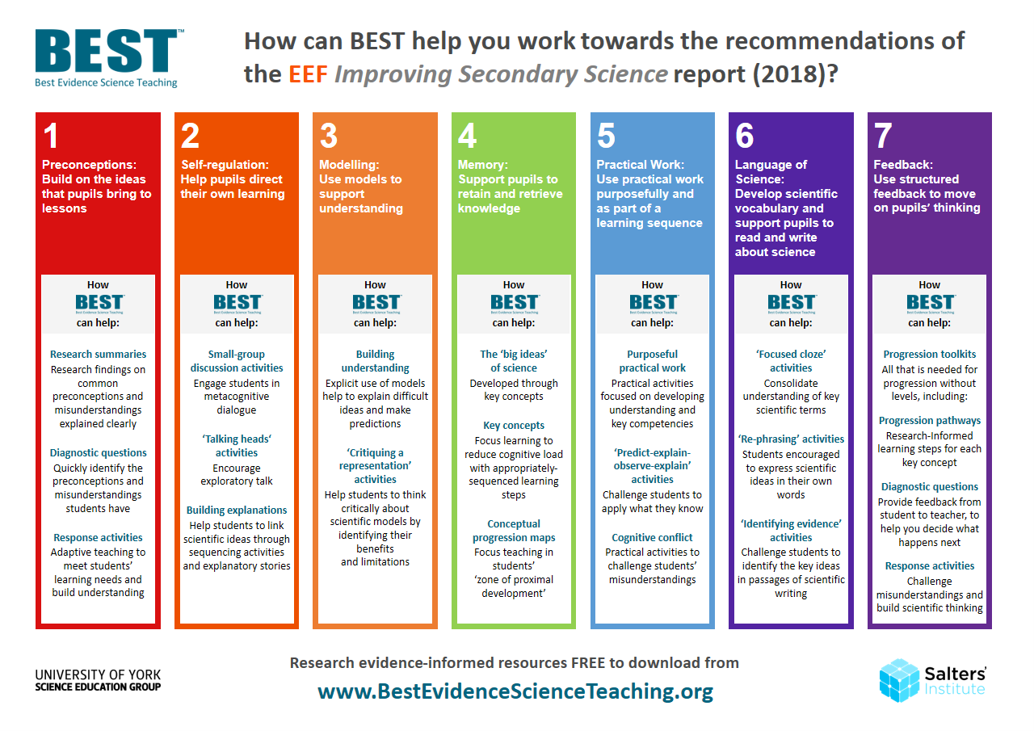
Notes:
We’ve produced a poster that suggests how the Best Evidence Science Teaching resources can help teachers to start developing research-informed approaches in the seven main areas identified in the EEF report.
We would never claim that Best Evidence Science Teaching is a quick fix to meeting the EEF’s recommendations, or to developing evidence-based practises in classrooms, but we do think the research-informed resources we’ve developed can be a useful tool for teachers in working towards this.
The poster can be downloaded for free from www.BestEvidenceScienceTeaching.org

Slide 25
diagnostic questions
Notes:
There are some common formats of diagnostic questions that we have used – not exclusively – but repeatedly throughout the Best Evidence Science Teaching resources, because they are powerfully diagnostic; that is, they provide very useful evidence about what students are thinking (what they understand, and what their misconceptions are), and why they are thinking it.
The following slides show examples of some of these useful formats of diagnostic questions.

Slide 26
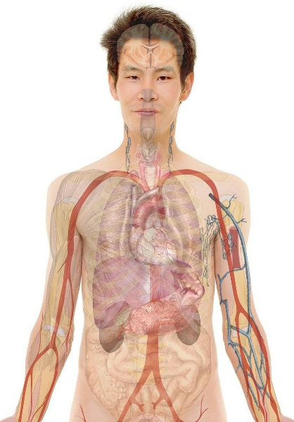
Body cells
Simple
multiple
choice
Which statement about the human body is true?
A
The body contains cells.
B
The body is a cell.
C
The body is made up of cells.
D
Cells are only found between the organs.
Notes:
Simple multiple choice
The answer options can be presented as words, numbers, pictures, graphs, equations... etc.
This type of diagnostic question provides a quick way to gather evidence of learning. It could be completed individually, in small groups to encourage discussion, or with a whole class using a voting system. Students could vote on the answer options using a show of hands, mini whiteboards, apps (e.g. Plickers), and so on.
The ‘distractors’ (the incorrect options) are developed from research on common misunderstandings, to reveal whether students hold these ideas. They are not obviously wrong to a student who holds these misconceptions; the question is more powerfully diagnostic (and testing) because the distractors are strong (i.e. tempting).

Slide 27
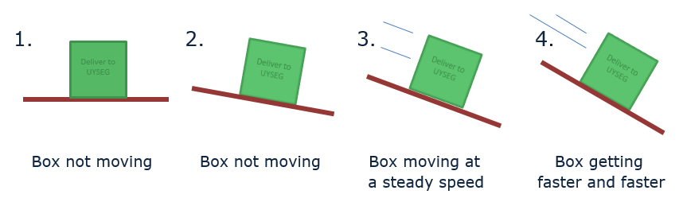
No friction
Two-tier
multiple
choice
1. Which boxes have no friction?
2. Why do you think this?
Intro
Intro
A
They all have friction
A
There is no force pushing sideways
B
Box 1 has no friction
B
The surfaces are a little bit rough
C
Boxes 1 and 2 have no friction
C
There is movement
D
Boxes 3 and 4 have no friction
D
There is no movement
E
Box 4 has no friction
E
There is no force to slow the movement
Notes:
Two-tier multiple choice
This format is commonly used in the science education research literature.
It provides more information about students’ thinking than a simple multiple choice question - it’s more powerfully diagnostic.
In the first tier, students must select what they think is the correct or best answer. In the second tier, students must select the correct or best explanation for the answer they chose in the first tier.

Slide 28
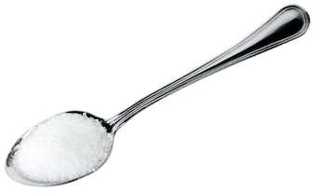
Sugar solution
Confidence
grid
A teaspoon of sugar is dissolved in a glass of water making a sugar solution.
Read the statements in the table.
What is your decision for each statement?
I am sure this is right
I think this is right
I think this is wrong
I am sure this is wrong
1
The solution includes sugar in the liquid state.
2
You cannot see sugar in the solution, so it is not there.
3
You could taste the sugar in the solution, if it were safe to do so.
4
The sugar has reacted with the water.
Notes:
Confidence grid
This formation provides more information about students’ thinking than a simple multiple choice question - it’s more powerfully diagnostic.
Students must evaluate each statement in turn, rather than homing in on the correct answer. For each statement they must indicate their confidence in ruling-in or ruling-out the answer.

Slide 29

Respiration
Focused
cloze
Respiration is one of the processes carried out by living things.
Complete the sentences in the box.
You should only use respiration or breathing to fill each gap.
Moving air into and out of your lungs is called ………………………… .
Getting energy from food is called ………………………… .
………………………… happens in all living things.
………………………… only happens in some living things.
………………………… does not happen in plants.
………………………… provides living things with oxygen for ………………………… .
Notes:
Focussed cloze
A particular type of ‘fill the gaps’ (cloze) activity, in which there are only two words from which the student can choose to fill the gaps.
The words provided to fill the gaps are a pair of words for which there is research evidence that they are commonly confused by students. Because there are lots of gaps but only two words, students really need to understand the difference between the two words to fill all the gaps correctly.

Slide 30
Respiration
6
Language of science
Develop scientific vocabulary
Focused
cloze
Respiration is one of the processes carried out by living things.
Complete the sentences in the box.
You should only use respiration or breathing to fill each gap.
1
Preconceptions
Build on the ideas that pupils bring to lessons
Moving air into and out of your lungs is called ………………………… .
Getting energy from food is called ………………………… .
………………………… happens in all living things.
………………………… only happens in some living things.
………………………… does not happen in plants.
………………………… provides living things with oxygen for ………………………… .
Notes:
Thinking about this with respect to the areas identified in the EEF Improving Secondary Science report, a focussed cloze activity provides evidence of students’ preconceptions and misunderstanding (area #1), and helps to build their understanding of the language of science (area #6) by encouraging them to think about using words in a scientific (rather than everyday) way.

Slide 31
response activities
Notes:
There is a greater variety of formats of response activities in the Best Evidence Science Teaching collection, as many are based on particular activities reported in the research literature. But there are some common general formats of response activities that we have used because they promote ‘meaning making’ and social construction of understanding through small group discussion and metacognitive talk, or through purposeful practical work.
The following slides show examples of some of these useful formats of response activities.

Slide 32
What does C represent?
Small
group
discussion
Some children talk about the C in CO₂.
Alex
C is short for the element name carbon.
Arjun
C stands for the substance carbon.
Kyle
C makes me picture a lump of black coal.
Zara
C means one atom of carbon.
Poppy
C is the symbol for the element carbon.
To talk about in your group:
1 Who do you agree with?
2 Who do you disagree with, and why?
3 How would you explain the right ideas to these children?
Notes:
Small group discussion
Small group discussion activities facilitate metacognitive talk and dialogue. Students have to think critically about what they know and understand, and discussion encourages ‘meaning making’ through social construction of understanding.
Listening in to the conversations of each group will give you insights into what your students are thinking. And careful selection of groups can be helpful: ensure a mix of abilities, and perhaps ask the most confident person to ask as a scribe: tell them they’re not allowed to suggest ideas, but have to write down the main points of the discussion and can ask questions for the rest of the people in the group to answer.

Slide 33
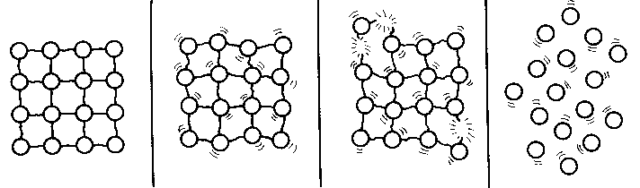
Particle model - melting
Critiquing a representation
The diagram is from a textbook.
It shows the particle model of a substance in the solid state melting so that the sample is in the liquid state.
To talk about in your group
State three ways in which you think the diagram is a good representation of a substance melting.
State three ways in which you think the diagram is not an accurate representation of a substance melting.
Notes:
This is another group discussion activity, this time focussed on critiquing a representation. This is a way of making scientific models explicit, and to get students to think critically about the uses and limitations of models.
The model is presented in this kind of activity without any indication of whether it’s a good or bad model; students have to talk about what the parts of the model represent, the uses and limitations of the model, and decide for themselves how useful it is.

Slide 34
Particle model - melting
3
Modelling
Use models to support understanding
Critiquing a representation
The diagram is from a textbook.
It shows the particle model of a substance in the solid state melting so that the sample is in the liquid state.
2
Self-regulation
Help pupils direct their own learning
To talk about in your group
State three ways in which you think the diagram is a good representation of a substance melting.
State three ways in which you think the diagram is not an accurate representation of a substance melting.
Notes:
Thinking about this with respect to the areas identified in the EEF Improving Secondary Science report, a small group discussion activity enables students to direct their own learning (area #2) as they build their own understanding through metacognitive talk and dialogue, and in this particular case it also enables them to think explicitly and critically about the use of models in science (area #3).

Slide 35
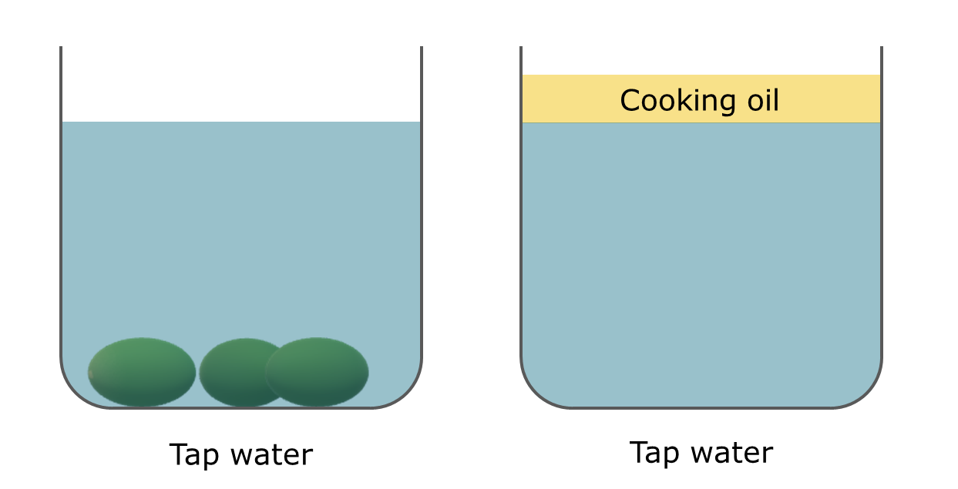
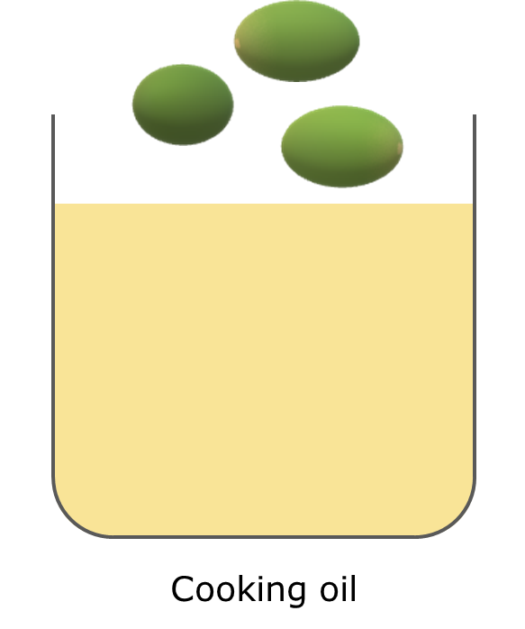
Grape expectations
PEOE
Grapes sink in tap water.
Cooking oil floats on tap water.
Predict
What will happen when grapes are put into cooking oil?
Explain
Explain why you think this will happen.
Watch the demonstration
Observe
Describe what you see.
?
Explain
Were your prediction and explanation correct?
Try to improve your first explanation to explain what happens more clearly.
Notes:
Purposeful practical work
An example of purposeful practical work, in the form of a predict-explain-observe-explain (PEOE) activity. This allows students to apply what they know to make a prediction, challenges their thinking about a phenomenon, and encourages them to build explanations for what they have predicted and what they observe.
The practical work can be very simple, but is powerful because it is used purposefully to develop students’ scientific understanding as part of a learning progression (in this case, a learning progression on density and buoyancy).

Slide 36
Grape expectations
5
Practical work
Use practical work purposefully as part of a learning sequence
PEOE
Grapes sink in tap water.
Cooking oil floats on tap water.
Predict
What will happen when grapes are put into cooking oil?
2
Self-regulation
Help pupils direct their own learning
Explain
Explain why you think this will happen.
Watch the demonstration
Observe
Describe what you see.
?
Explain
Were your prediction and explanation correct?
Try to improve your first explanation to explain what happens more clearly.
Notes:
Thinking about this with respect to the areas identified in the EEF Improving Secondary Science report, this kind of practical PEOE activity enables students to direct their own learning (area #2) as they build explanations for what they have predicted and what they observe, and is purposeful as it helps develop students’ scientific understanding as part of a learning progression (area #5).

Slide 37
The
team

Slide 38


BEST development partners
The Salters’ Institute was founded in 1918. It plays a major role in the support of science teaching and the encouragement of young people to pursue careers in science.
The University of York Science Education Group (UYSEG) was established in 1983 and has an international reputation for science education research and research-informed curriculum development.
We are providing FREE online access to the resources in collaboration with STEM Learning to support science teaching.
Notes:
Best Evidence Science Teaching is being developed at the University of York Science Education Group, with very generous sponsorship from the Salters’ Institute. That partnership has endured for over 35 years, and has included some ground-breaking curriculum development projects over the years. The Salters’ A level courses pioneered context-led teaching of science for students of that age, and Twenty First Century Science for GCSE led the way in developing students’ scientific literacy alongside their understanding of science ideas.
Best Evidence Science Teaching is the latest body of work to result from that valuable and productive partnership, and it has been a massive undertaking – surveying the research literature systematically for all of the topics in secondary science, distilling it and turning it into “stuff” that teachers can easily access and use.
We’re also very lucky to be collaborating with STEM Learning, who are making all of the Best Evidence Science Teaching resources available for free on their website.

Slide 39





BEST development team
Department of Education
Project
Director
Biology
Lead
Chemistry
Lead
Physics
Lead
Professor
Judith Bennett
Alistair
Moore
Helen
Harden
Peter
Fairhurst
Notes:
The University of York Science Education Group is part of the Department of Education at York. The Project Director is Professor Judith Bennett; the project was her brainchild, so without her vision and her persistence Best Evidence Science Teaching would never have existed. The core members of the Best Evidence Science Teaching development team are Alistair Moore (who leads the development of the biology resources), Helen harden (who leads chemistry and Earth science), and Peter Fairhurst (who leads physics). We must also acknowledge and thank two former members of the University of York Science Education Group: Mary Whitehouse, who put a lot of work into Best Evidence Science Teaching before she retired, and Professor Robin Millar, whose many years of research into teaching science and diagnostic questions in particular, through projects such as EPSE and York Science, provided some of the foundations upon which Best Evidence Science Teaching is built.

Slide 40



The BEST resources are all FREE online
The collection is initially focussed on 11-14
Topics available (January 2020):
BEST 14-16 coming in 2020!
  Cells
  From cells to organ systems
  Inheritance and the genome
  Life cycles
  Reproduction
  Food chains and food webs
  Ecosystems
  Variation
  What are health and disease?
  Human lifestyles and health
  Infectious disease
  Classification
  Substances and mixtures
  Solubility
  Acids and alkalis
  Periodic table
  Elements and compounds
  Chemical change
  Understanding chemical reactions
  Evaporation
  Energy and reactions
  Air pollution
  Earth’s resources
  Heating and cooling
  Floating and sinking
  Forces
  Moving by force
  More about force
  Sound and light
  How we see
  Making images
  Waves
  Simple electric circuits
  More electric circuits
  Magnets and electromagnets
  Solar system and beyond
  Earth, Moon and Sun
@BestEvSciTeach
www.BestEvidenceScienceTeaching.org
Notes:
All of the Best Evidence Science Teaching resources are free to download, and at the moment they’re focussed on science at age 11-14 (Key Stage 3 in England).
We are delighted to announce that, thanks to the generosity of the Salters’ Institute, we have now secured funding for another three years of development work to extend Best Evidence Science Teaching up to age 16. Research and development work on BEST 14-16 will commence in 2020, and resources will be published on a topic-by-topic basis from late 2020 through to the end of 2022.
Follow us on Twitter (@BestEvSciTeach) for updates on the publication of new topics, or email uyseg@york.ac.uk and ask to be signed up to our BEST email updates list.

